Slide 1
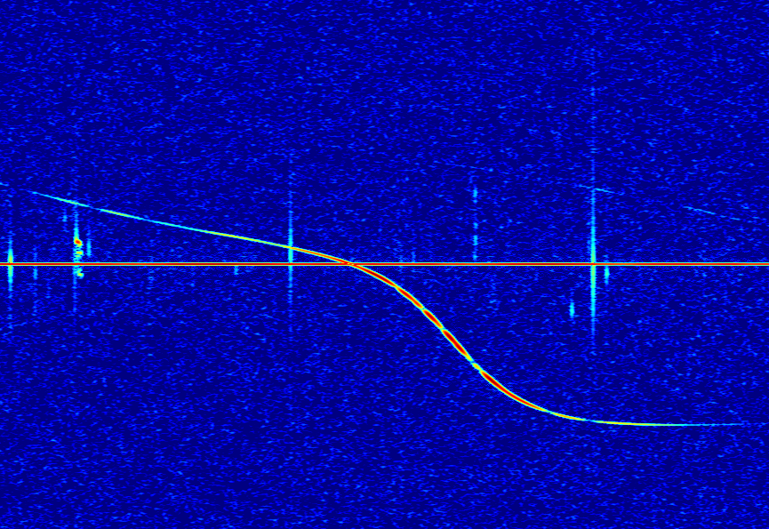
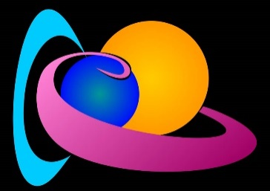
Reconstructing meteoroid trajectories using forward scatter radio observations from the BRAMS network
J. Balis^{1,2}, H. Lamy¹, M. Anciaux¹, E. Jehin²
01/10/2022
¹Royal Belgian Institute for Space Aeronomy
²STAR Institute, University of Liège
Contact: joachim.balis@aeronomie.be
Notes:
Notes for presentation

Slide 2
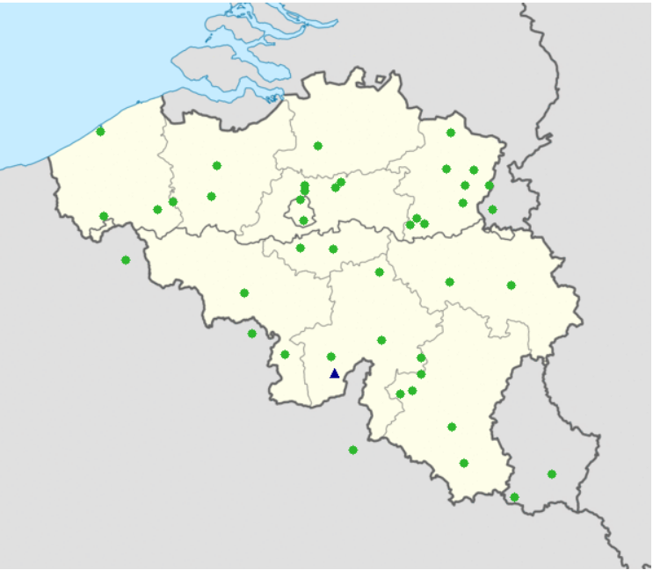
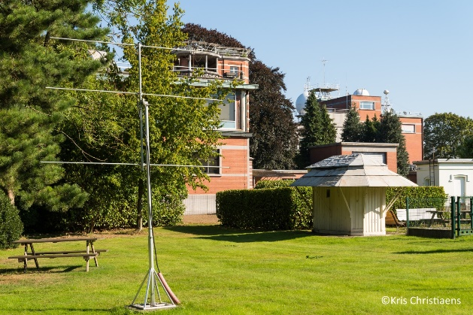
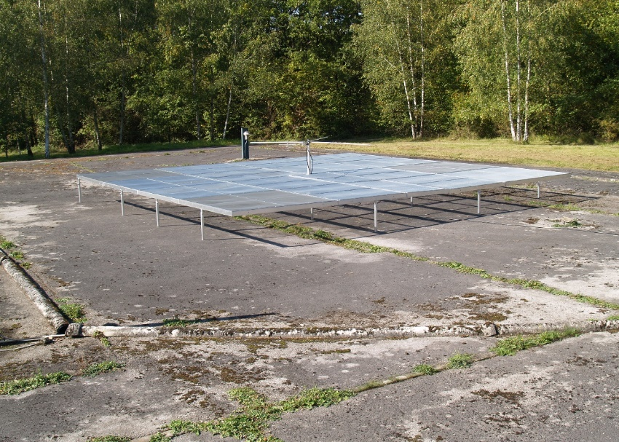
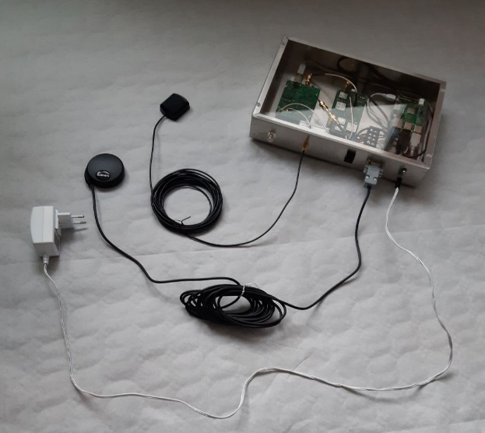
The BRAMS network
BRAMS = Belgian RAdio Meteor Stations
44 receiving stations
Green dots
3-elements Yagi antennas
Synchronized using GPS clocks
A dedicated transmitter
Located in Dourbes (blue triangle)
f = 49.97 MHz
CW with no modulation
Radiated power: 130 W
One radio interferometer
Red circle (Humain)
5 Yagi antennas
Information about the elevation and the azimuth angle
The 44 receivers do not give range or directional information (except for the interferometer).
That complexifies the reconstruction of meteoroid trajectories…
Notes:
So to start, BRAMS stands for Belgian Radio Meteor Stations. It is a network of radio stations, made of one transmitter and 42 receiving stations located all over Belgium and also a bit in the neighboring countries. The transmitter is located in Dourbes, in the South of Belgium. It emits a continuous wave at 49.97 MHz with a power of about 130 watts. It is a simple cross-dipole antenna, as you see here on the bottom left. The receivers are 3-elements Yagi antennas which are all synchronized using GPS clocks. There is also a different station in Humain, close to the transmitter, which has a radio interferometer. This system allows to obtain information about the direction of the received signal. From now on, it will also be our reference receiver.

Slide 3
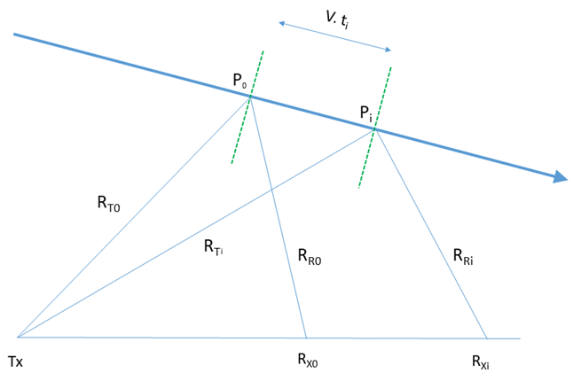
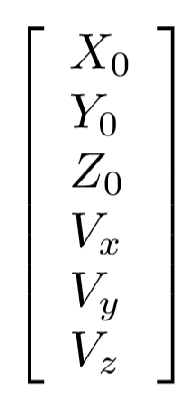
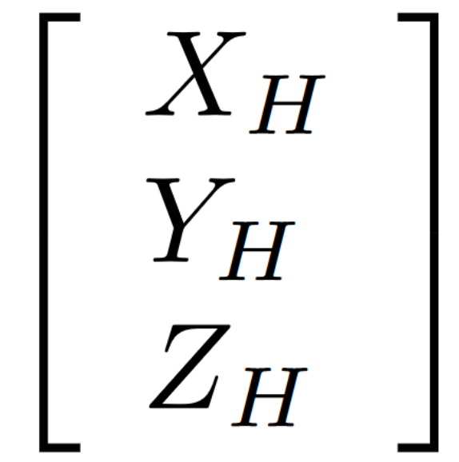
Trajectory reconstruction problem
Given the GPS synchronized signals obtained at the receivers, how can we reconstruct the corresponding trajectory?
Specular reflection : S_{i} = R_{Ti} + R_{Ri} must be minimum for each station i
6 unknowns: 3 coordinates of one specular point P₀ + 3 components of (constant) velocity v
Set of ≥ 6 non-linear equations which contain the time delays Δt_{i} between appearances of meteor echoes at station i and a reference station
Method 2 – Time delays + interferometer
Method 1 – Time delays only
Theoretical time delay
Set of n raw signals
Interferometric data
Experimental time delay
Time delays extraction
Experimental uncertainty
Meteor path
Target objective minimization
Elevation angle
Interferometer position
Elevation uncertainty
Azimuth angle
Solution vector
Transmitter
Receivers
Azimuth uncertainty

Slide 4
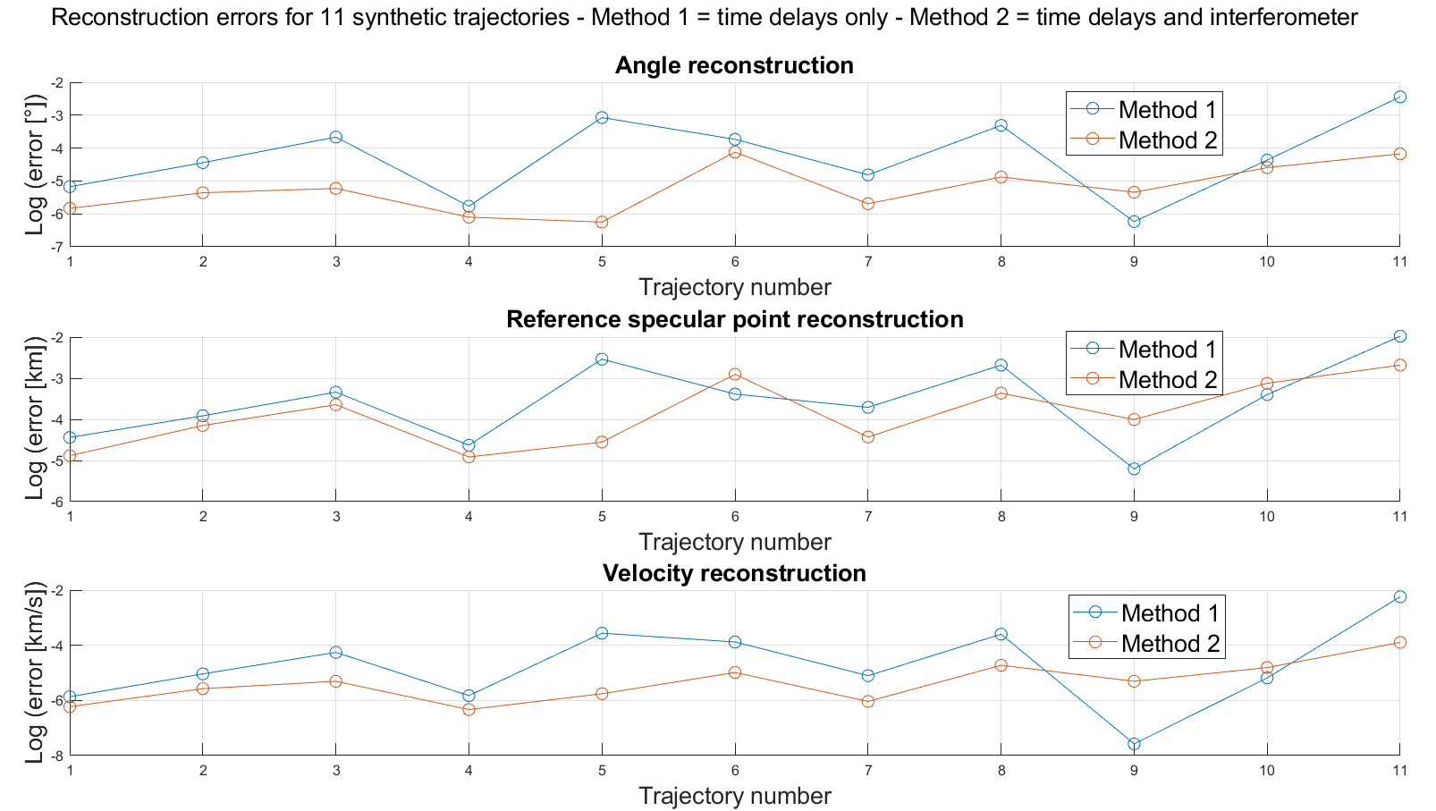
Solver validation – synthetic trajectories
1) We compute the theoretical time delays for synthetic trajectories
2) We feed them inside our solver and try to get back the corresponding trajectory
Using theoretical time delays at the BRAMS receivers:
Error on the trajectory angle:
∼ 0.001°
Error on the specular point location:
∼ A few m
Error on the velocity norm:
∼ 1 m/s
Notes:
So, to test the validity of our solver, we used trajectories reconstructed by the optical network CAMS-BeNeLux and computed the theoretical time differences that we should observe at our radio receivers. Then, we injected these time differences inside our solver in order to try to get back the correct trajectory.
We can see here a sample of 11 CAMS trajectories with the reference specular point location, that is to say the specular point of our station in Humain. In the table, we can also see the inclination of the trajectory with respect to the XY plane. You can at the bottom left, the error between the optical target trajectory and the trajectory that we manage to reconstruct. It is in log scale and we see that in terms of angle we are at about 10^-3 degrees of reconstruction error. In terms of position, we are at about a few meters, and in terms of velocity we are at about 1m/s.
That is very encouraging because this validates the solver and it means that, if we have access to the correct time differences, we can properly reconstruct the desired trajectory.

Slide 5
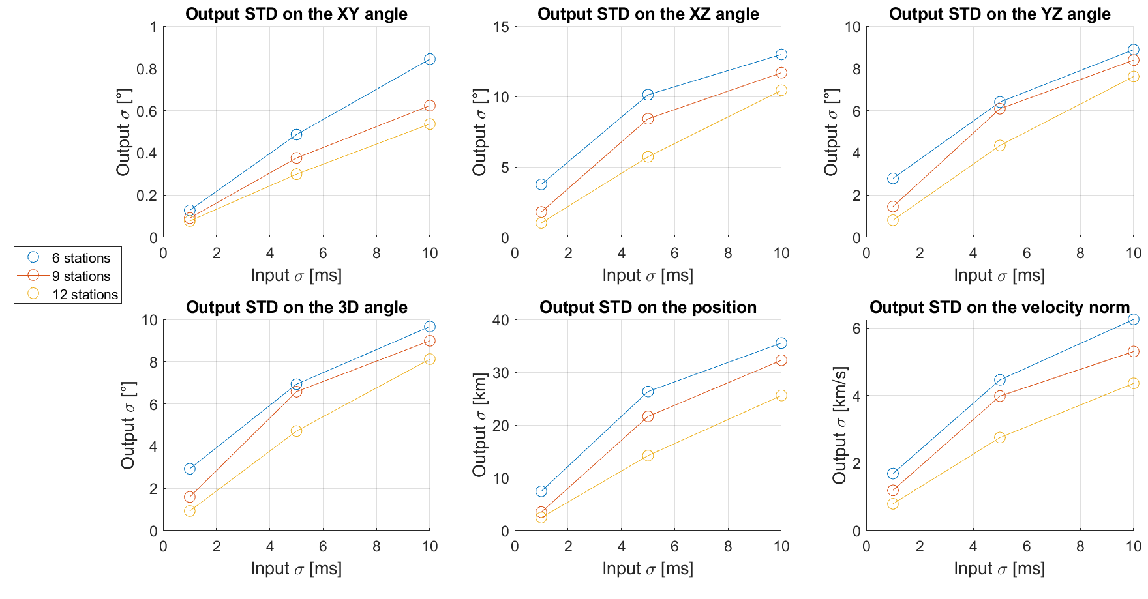
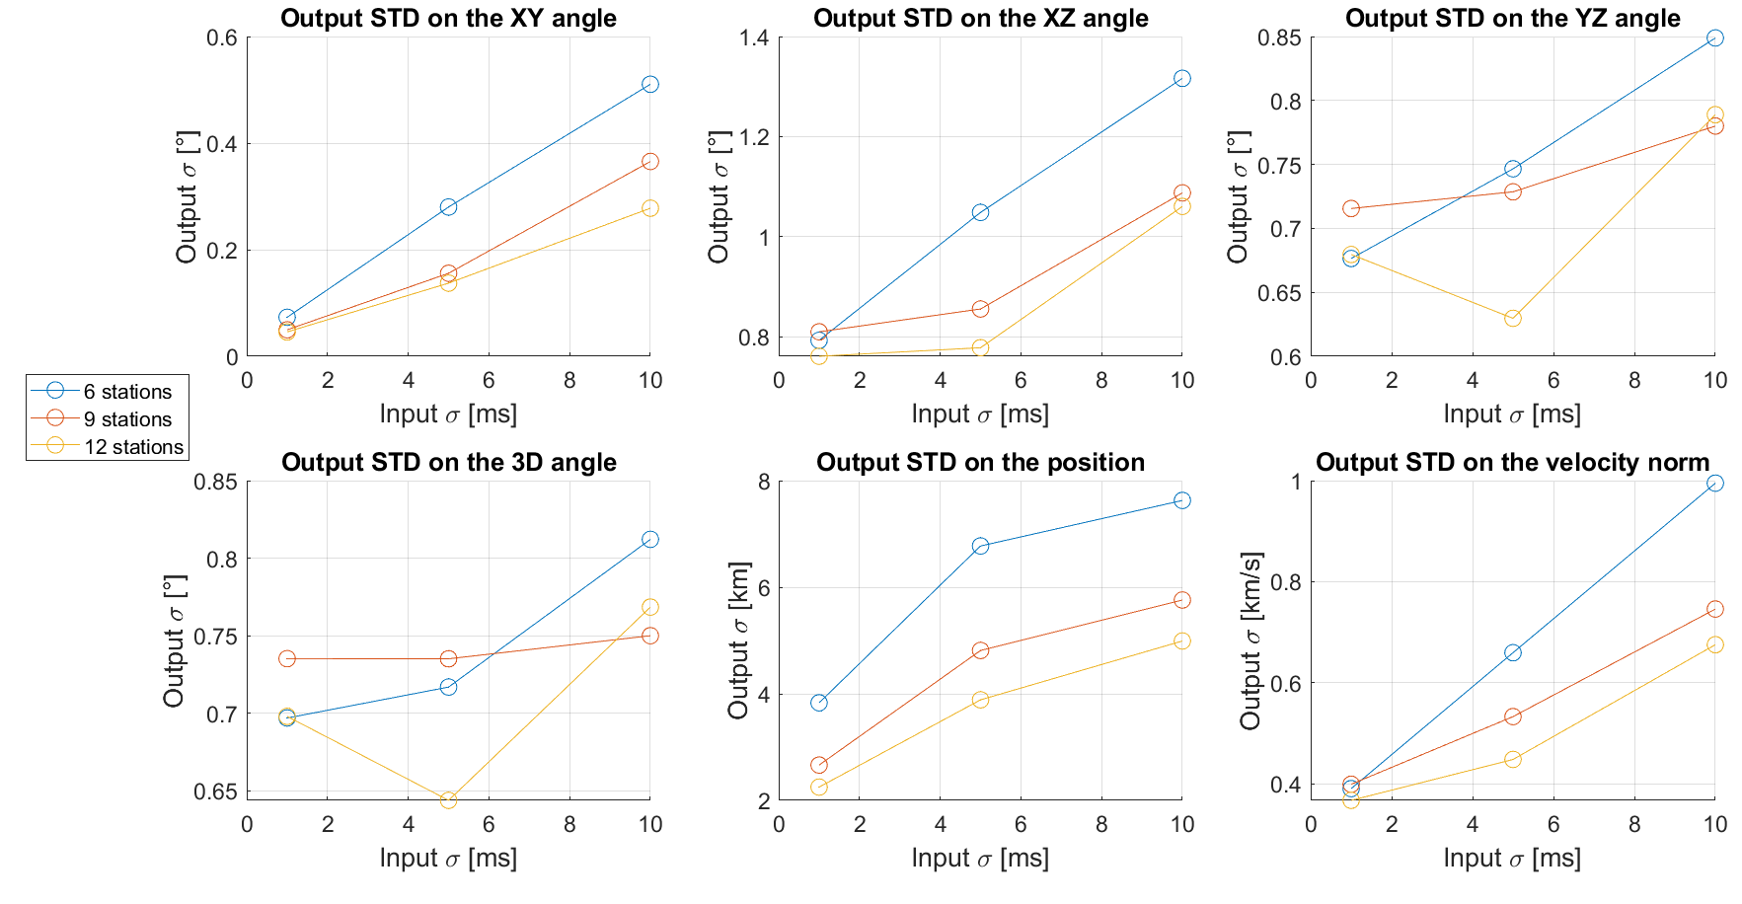
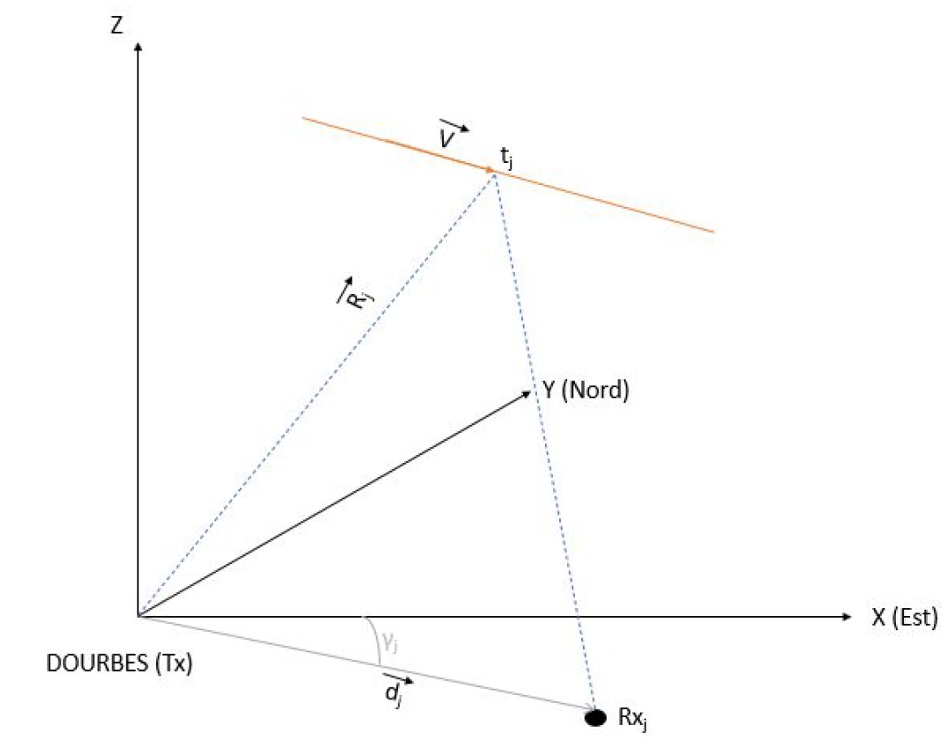
Uncertainty quantification – Monte-Carlo sampling
We quantify the uncertainty of the output trajectory with respect to the uncertainty of the input time delays
Method 2 -
Method 1 -
Reference frame centered on the BRAMS transmitter
X pointing East
Y pointing North
Z pointing upwards
- The trajectory reconstruction without the interferometer (method 1) is an ill-conditioned problem
- The interferometer alleviates this ill-conditioning
Uncertainty on $ε$and $θ$ = 1°

Slide 6
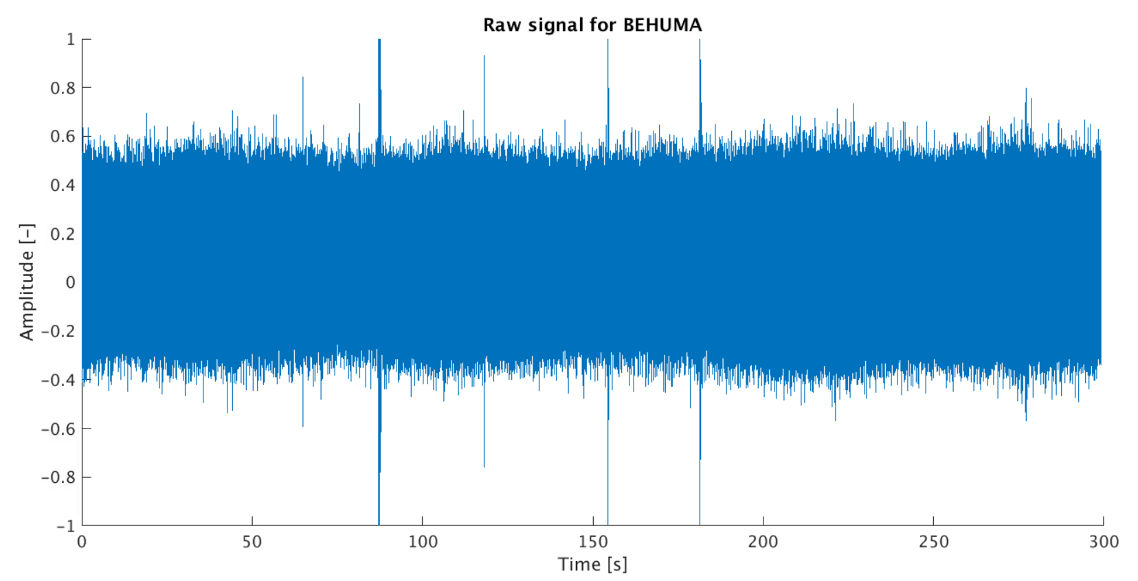
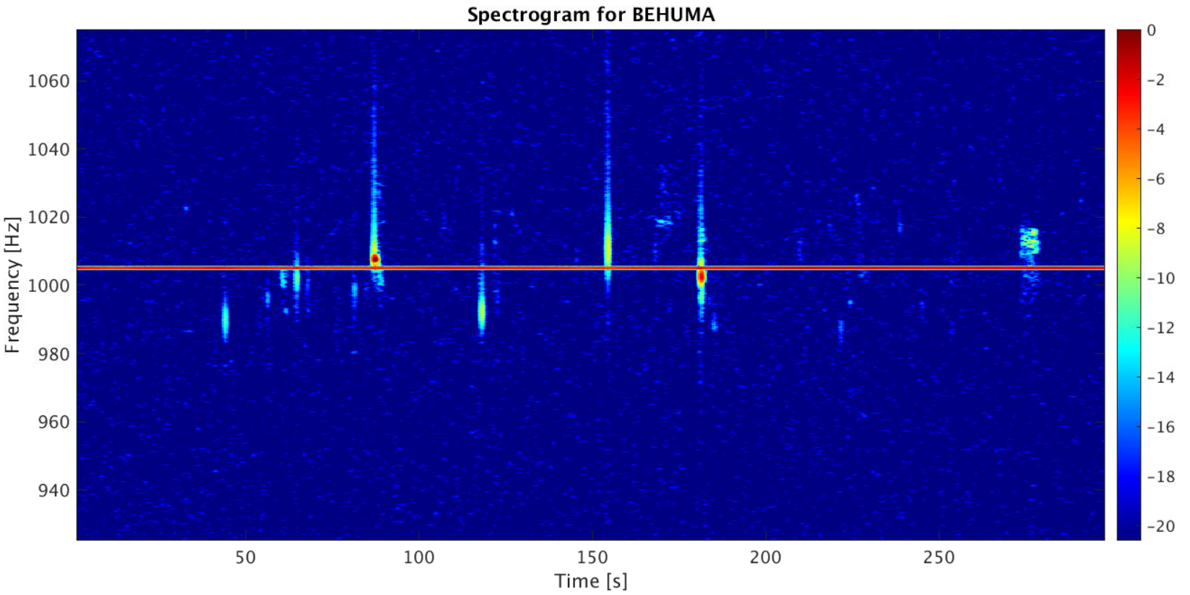
Signal acquisition
The signal is acquired at every receiver at a sampling frequency of 5512 or 6048 Hz
Amplitude vs. time
Frequency vs. time (power color-coded)
Direct signal

Slide 7
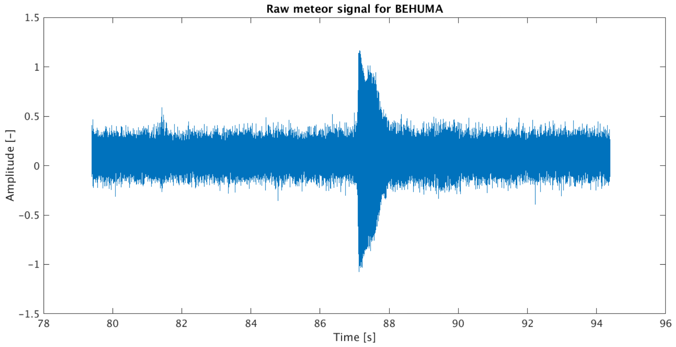
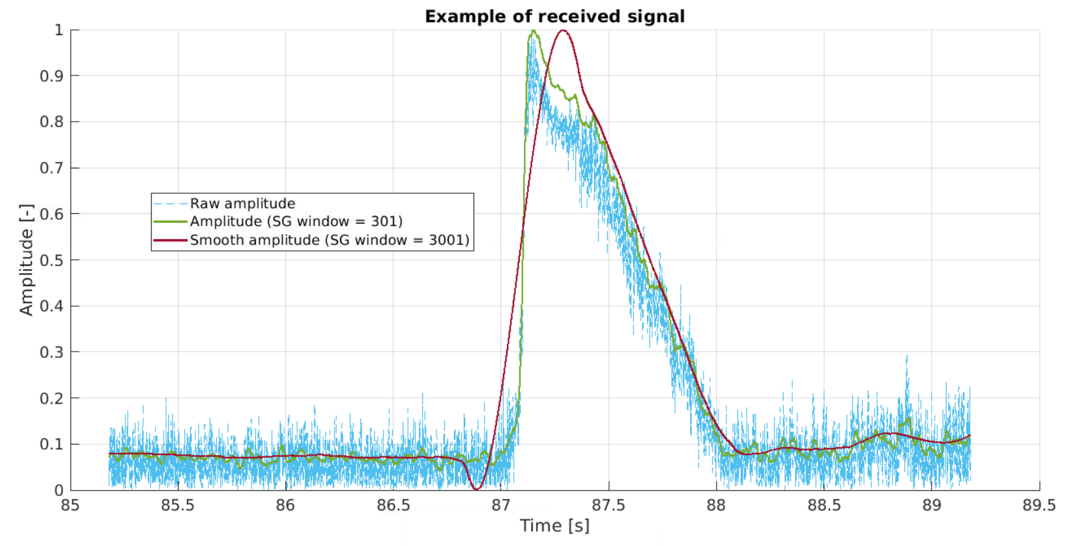
Signal processing
Subtraction of the direct signal and bandpass filter
Zoom on the raw echo
Filtered echo
Determining a precise timing definition is tricky and can lead to significant uncertainties..
Raw signal
Direct signal subtraction
Bandpass filtering
Savitzky-Golay smoothing
Timing identification
Time delays computation
Trajectory solver

Slide 8
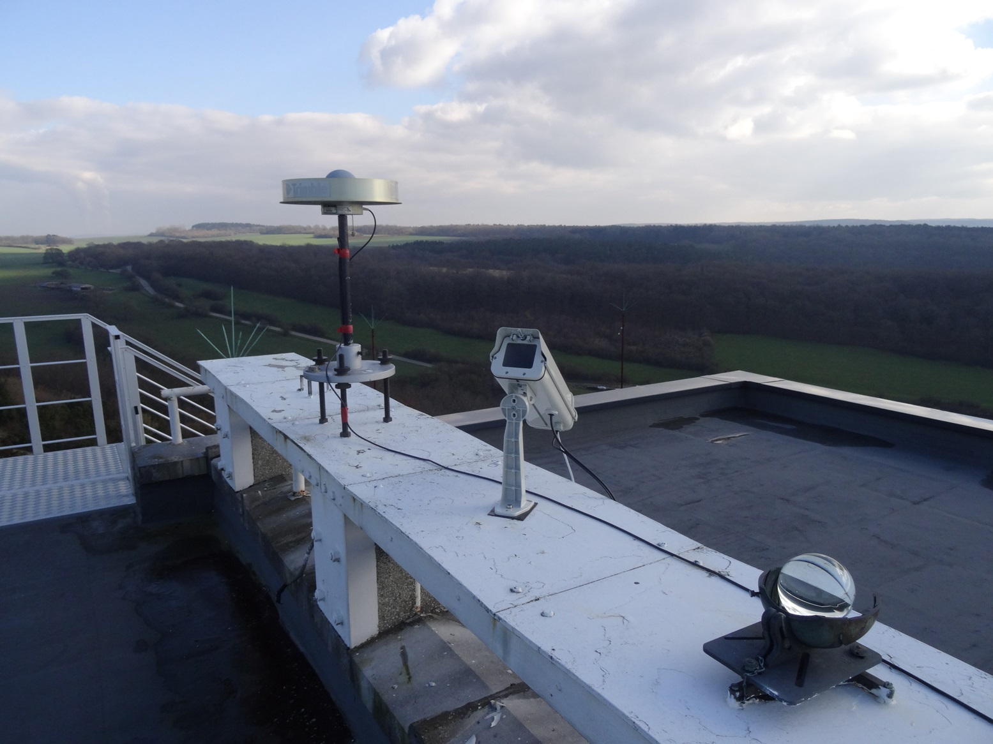
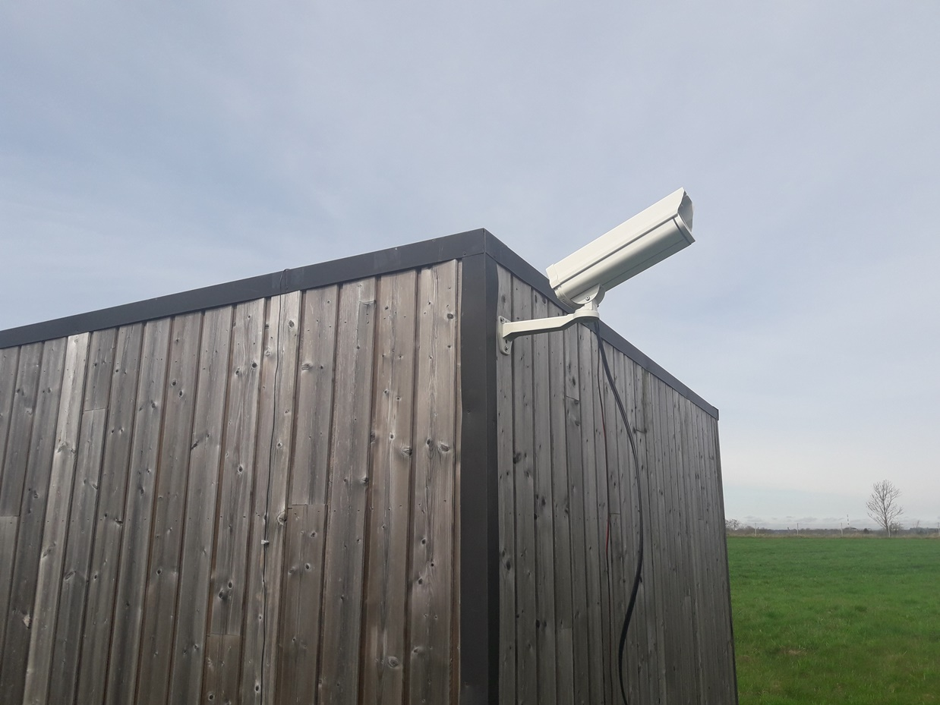
Comparison with optical data: CAMS - BeNeLux
Covered area: 90000 ${km}^{2}$
Number of cameras: ∼100
Objectives: localization of dust trails and identification of meteor showers
Field of view: 22.0° x 30.2°
Shutter speed: 1/60 s
Limiting magnitude: +5

Slide 9
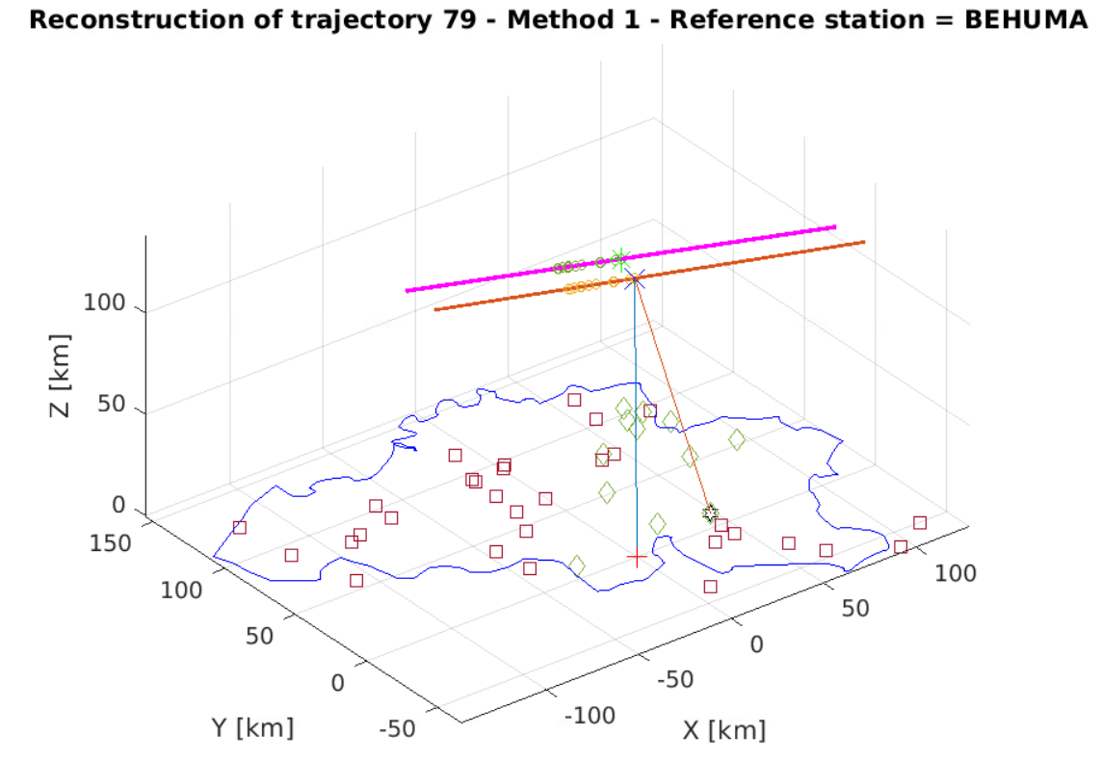
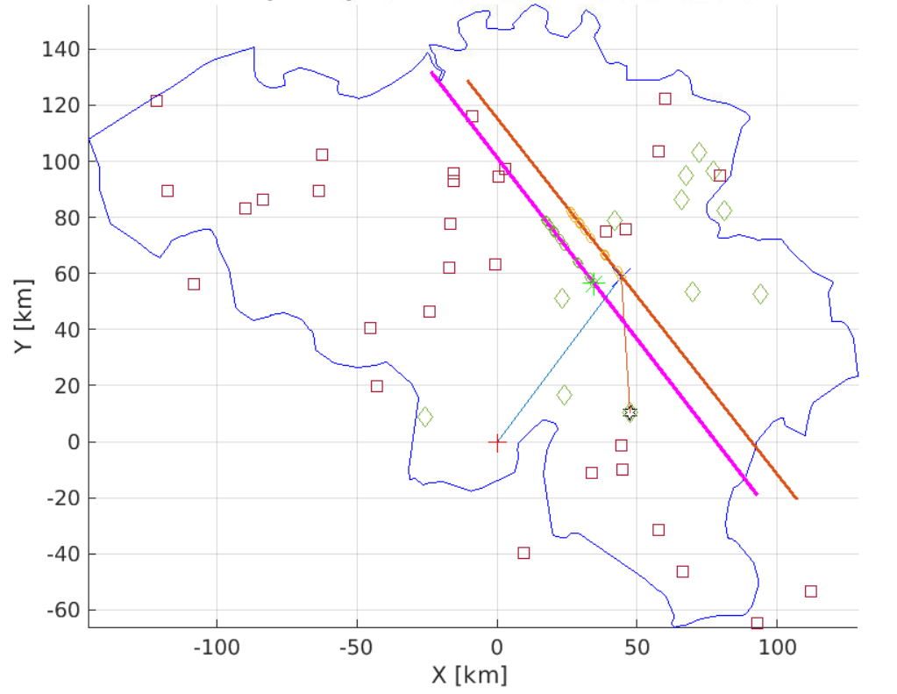
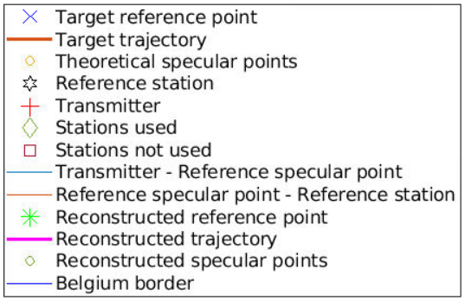
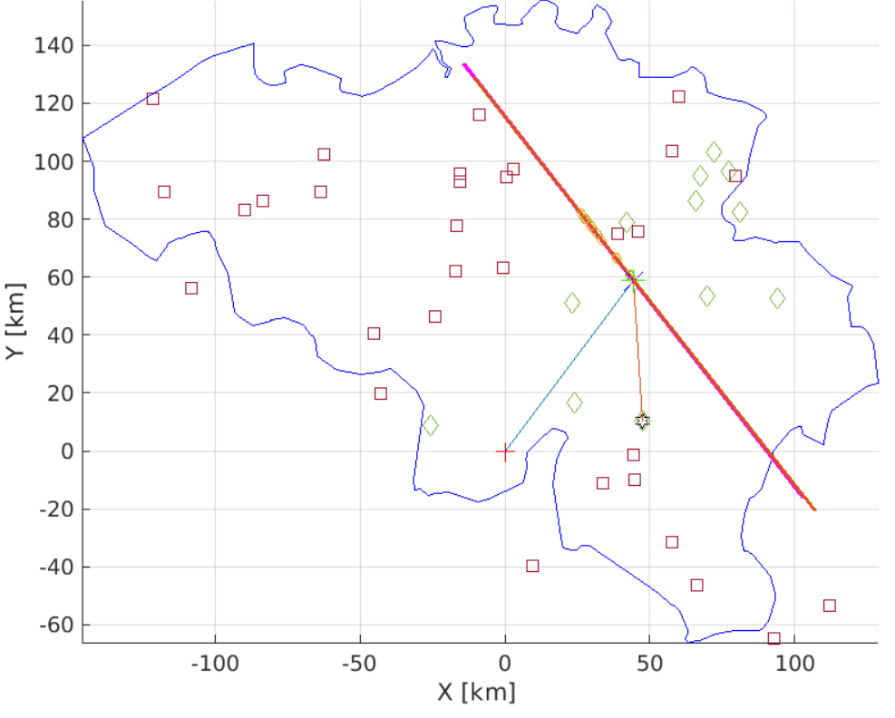
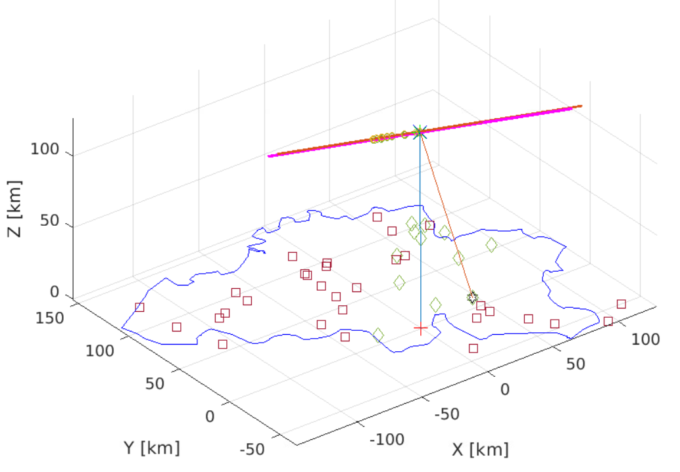
Method 1
Results – CAMS trajectory 79
Method 1 reconstruction error
Reference specular point: 17.36 km
Velocity norm: 1.58 km/s
Inclination: 0.61°
Method 2 reconstruction error
Reference specular point: 0.68 km
Velocity norm: 0.34 km/s
Inclination: 0.18°
Theoretical solution
X₀ = 44.33 km
Y₀ = 59.11 km
Z₀ = 94.90 km
V_{x} = -24.49 km/s
V_{y} = 31.09 km/s
V_{z} = -12.65 km/s
Method 2

Slide 10
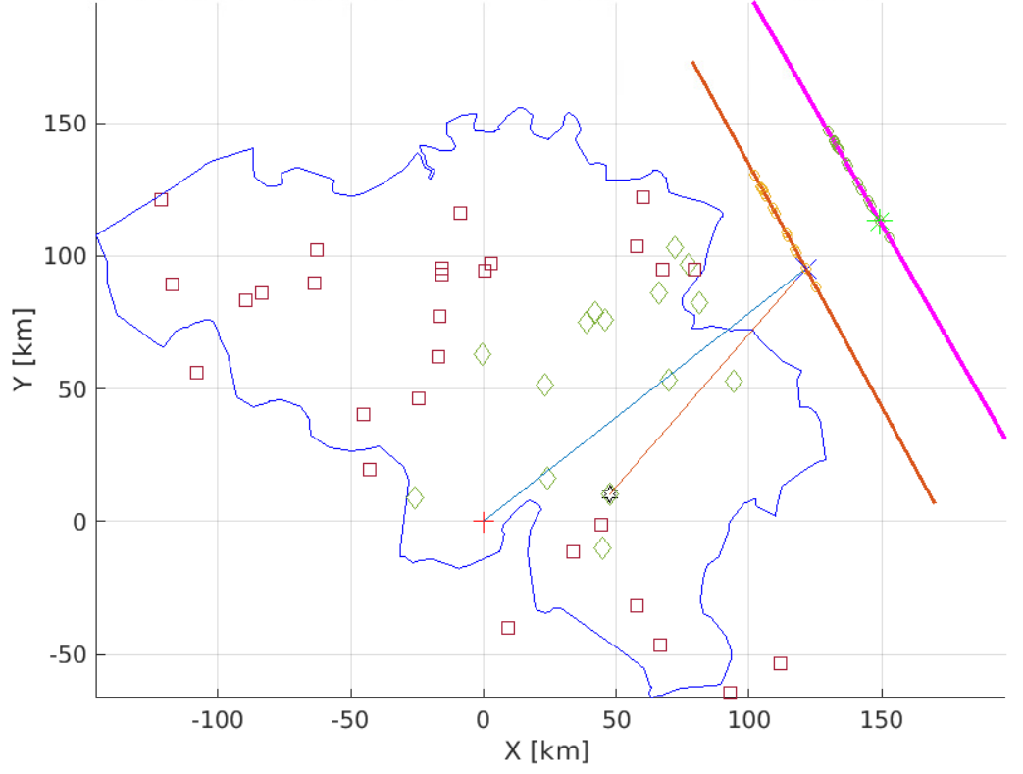
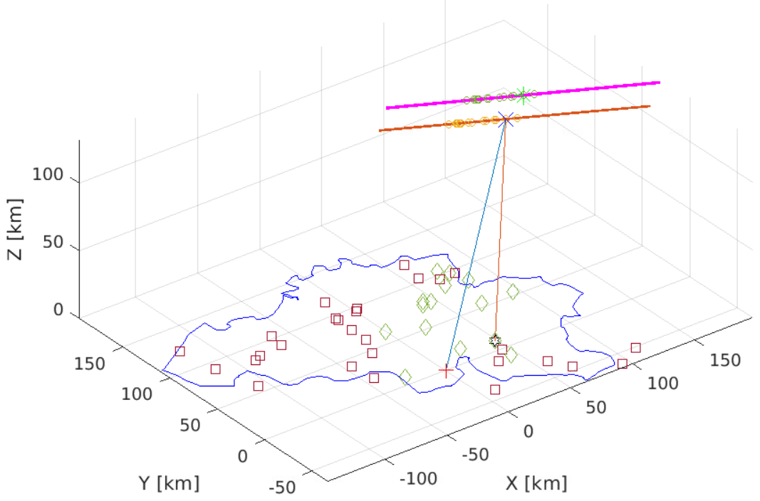
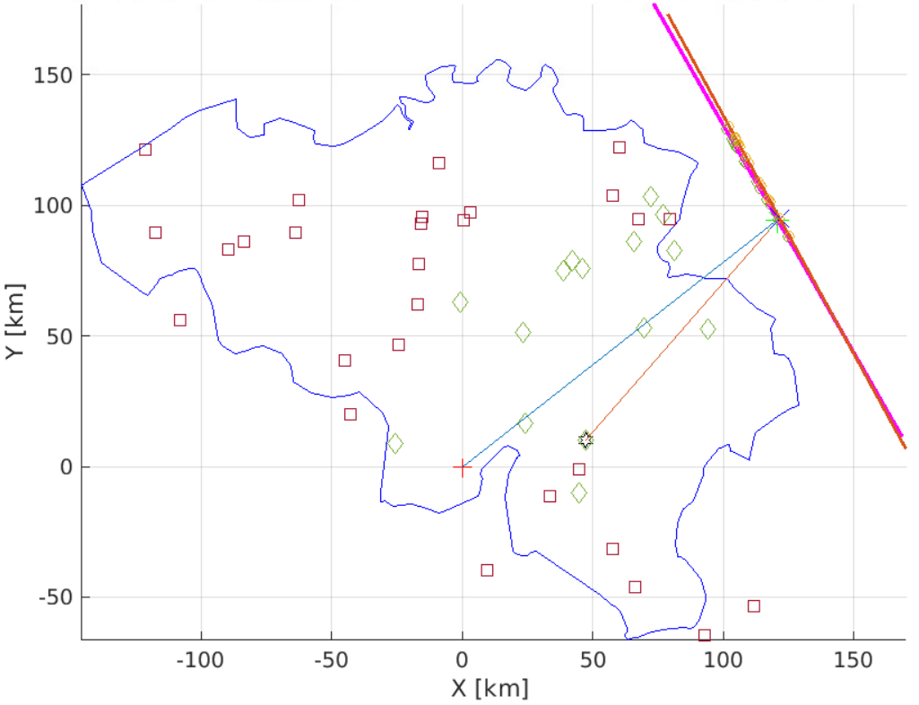
Method 1
Results – CAMS trajectory 105
Method 1 reconstruction error
Reference specular point: 33.12 km
Velocity norm: 0.85 km/s
Inclination: 1.21°
- Method 1 yields results within the error margins of the optical data for the radiant (< 2°) and the velocity (< 5%)
- Method 2 highly improves the position of the trajectories
Method 2 reconstruction error
Reference specular point: 1.34 km
Velocity norm: 0.08 km/s
Inclination: 1.12°
Theoretical solution
X₀ = 121.59 km
Y₀ = 95.16 km
Z₀ = 99.39 km
V_{x} = -18.88 km/s
V_{y} = 34.43 km/s
V_{z} = -12.87 km/s
Method 2

Slide 11
Conclusions & Perspectives
A non-linear trajectory reconstruction solver has been developed
The post-processing of the radio signals has been implemented
The method using the interferometer is much less sensitive to the uncertainties on the time delays
Several reconstructed trajectories with both methods yield an inclination (< 2°) and a velocity (< 5%) uncertainty comparable to CAMS optical data
Further effort is required to calibrate the BRAMS interferometer
The pre-t0 speed determination method (Mazur et al., 2020) is currently investigated
The introduction of deceleration models inside the solver will be tested

Slide 12
Thank you for listening!

Slide 14
Appendices

Slide 15
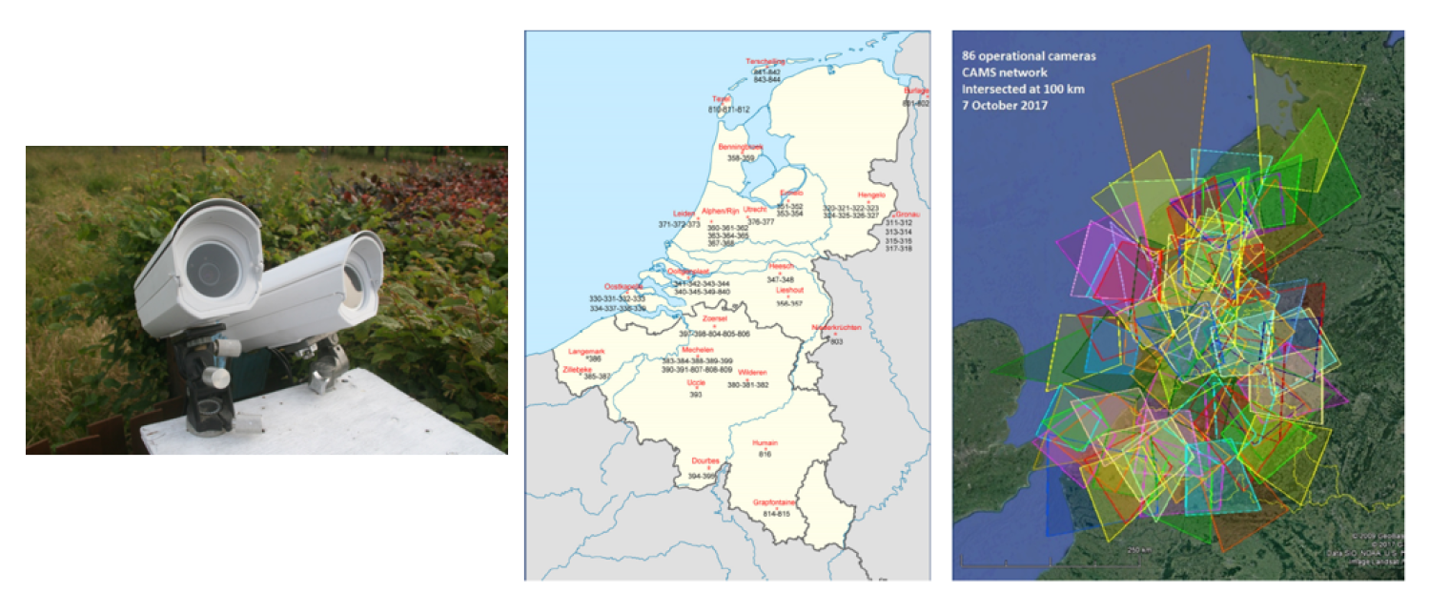
Comparison with optical data: CAMS - BeNeLux
Covered area: 90000 ${km}^{2}$
Number of cameras: ∼100
Objectives: localization of dust trails and identification of meteor showers
Field of view: 22.0° x 30.2°
Shutter speed: 1/60 s
Limiting magnitude: +5

Slide 16
Pre-t0 speed method

Slide 17
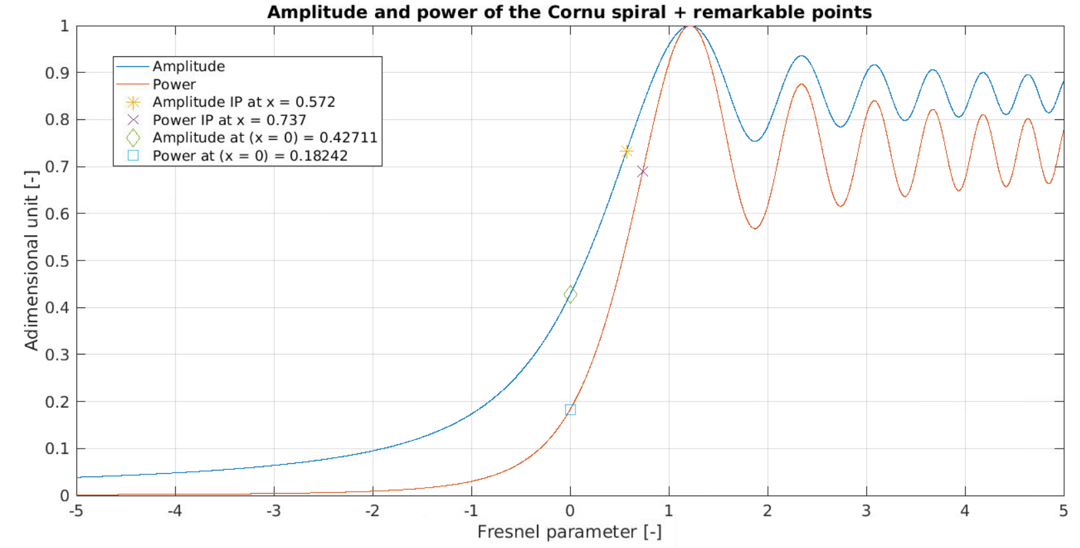
Cornu spiral

Slide 18
Post-processing steps
Choice of meteor (CAMS or other)
Novel contributions
Automatic identification of the BRAMS stations which have a corresponding WAV file
Existing implementations
Automatic determination:
Beacon frequency
Sampling frequency
Station type
PPS value
Removal of the beacon signal (with amplitude, frequency and phase interpolation)
Bandpass filtering around the max power
WAV file extraction
Timestamps extraction (+ correction for RSP2)
Envelope computation and Savitzky-Golay smoothing
Timing at half rise
Sample number at half rise
Receiver delay correction:
24.5 ms for AR
33.3 ms for RSP2
1.9 ms for ICOM
Everything is automated except the selection of the stations
Time differences (using a reference station)
Trajectory solver
Trajectory solution

Slide 19
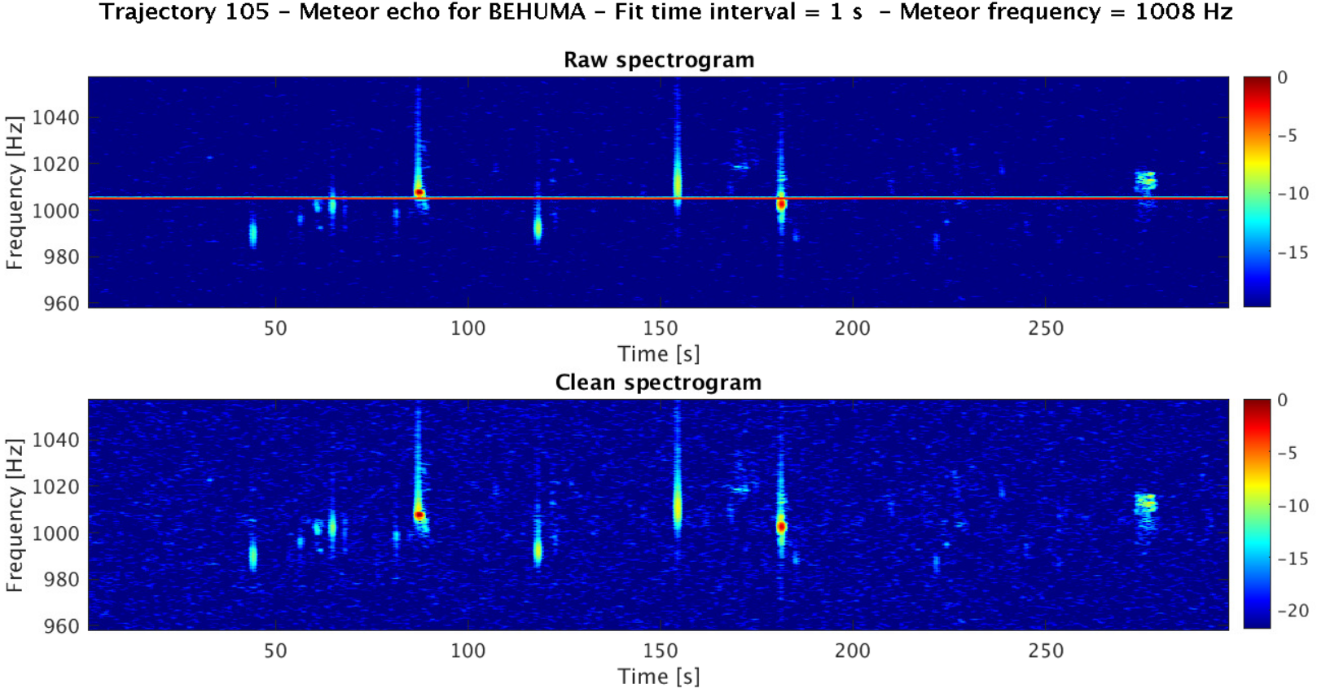
Beacon signal subtraction (I)
The beacon signal is reconstructed and subtracted
To do so, the amplitude , frequency and phase are fitted in the frequency domain
In the zones where we detect that the fit residual is high (i.e. 3 MAD above the median fit residual), we perform an interpolation of the 3 parameters (which is tricky for the phase).

Slide 20
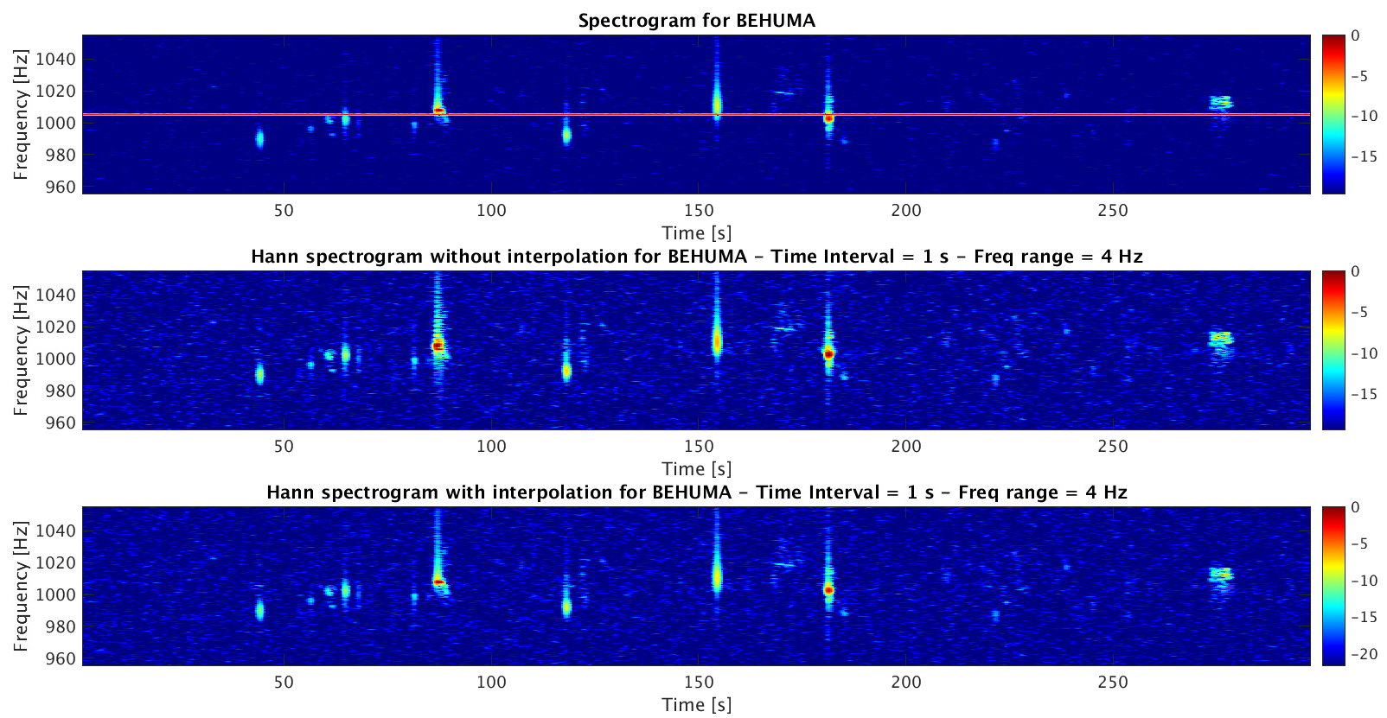
Beacon signal subtraction (II)

Slide 21
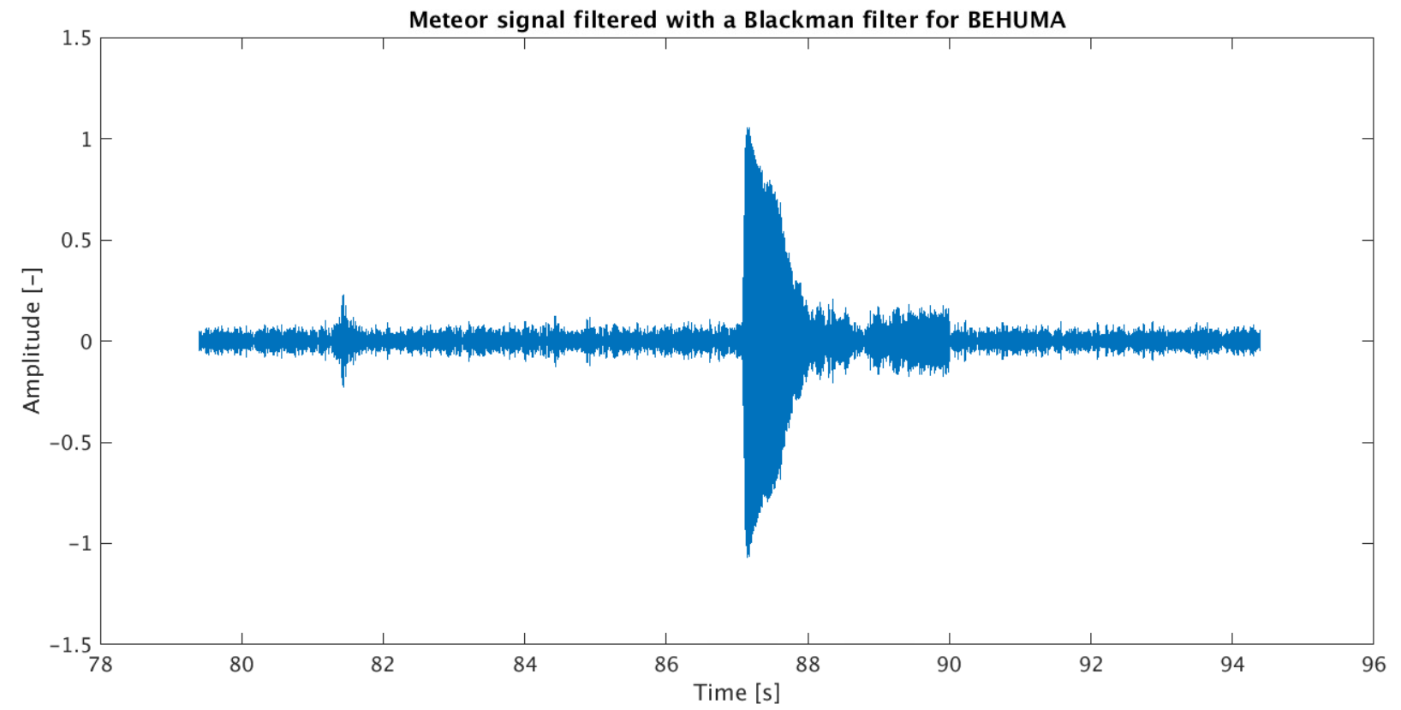
Signal filtering
A Blackman bandpass filter is applied around the meteor echo
Filter
The sinc-windowed Blackman filter allows to reduce the noise level and to avoid beats
It has very good frequency performance (steep transition band and excellent stopband attenuation)
BUT :
The noise in the bandpass range is not filtered
It has bad time performance (ripple and overshoot), whatever the filter order

Slide 22
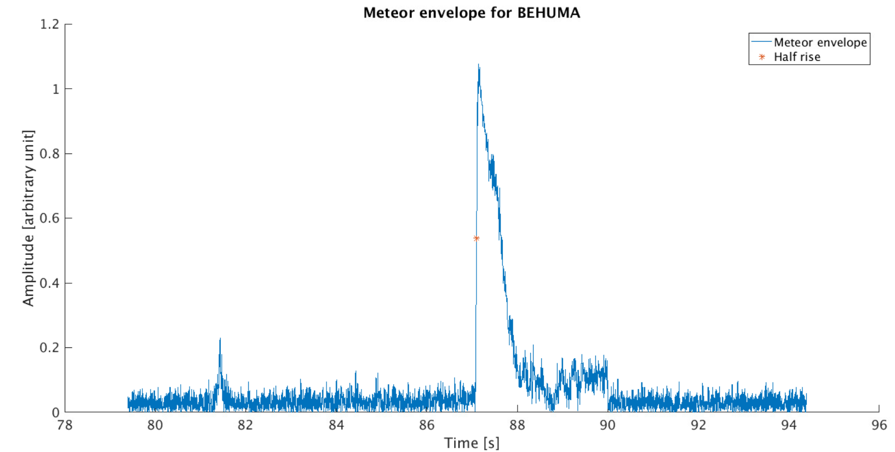
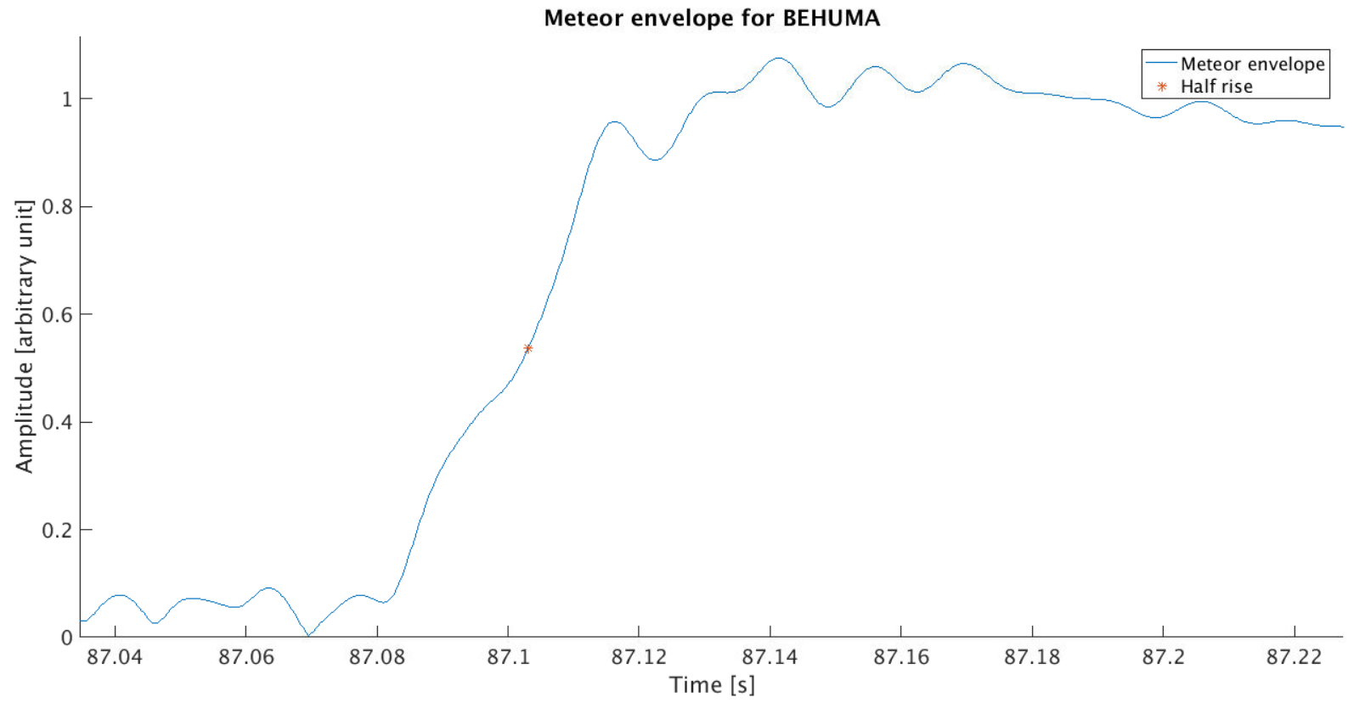
Specular point timing identification
The envelope of the meteor echo is computed, and the t0 timing is identified
Signal after the Hilbert transform
Zoom around the meteor echo
60 ms
Literature values for the rise are between 10 ms and 100 ms
22

Slide 23
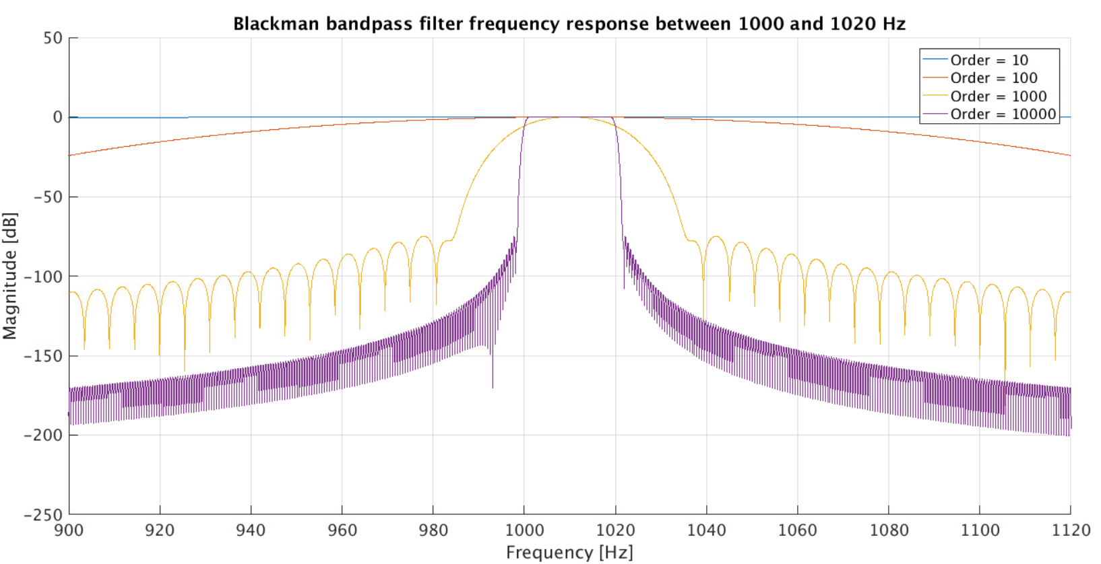
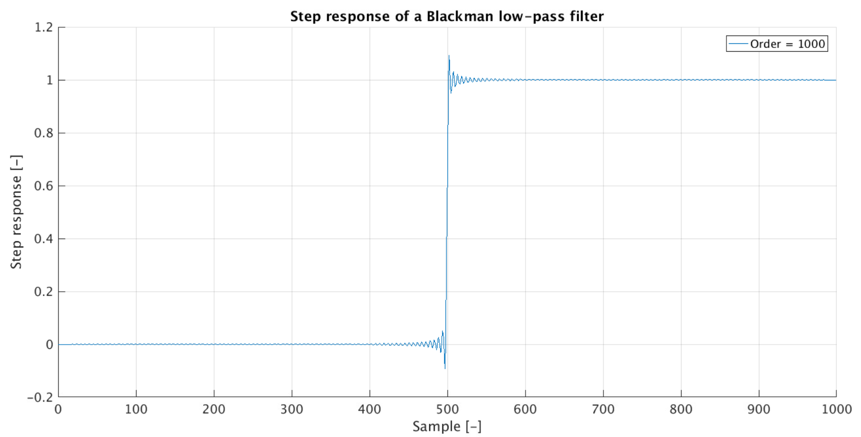
Windowed-sinc filter
A Blackman bandpass filter is applied around the meteor echo
Sinc-windowed passband filter
Comes from the convolution of a low-pass and a high-pass filter
Impulse response of the low-pass filter:
With the cut-off frequency and the filter length
Very good frequency performance (steep transition band, excellent stopband attenuation)
Bad time performance (ripple and overshoot), whatever the filter order

Slide 24
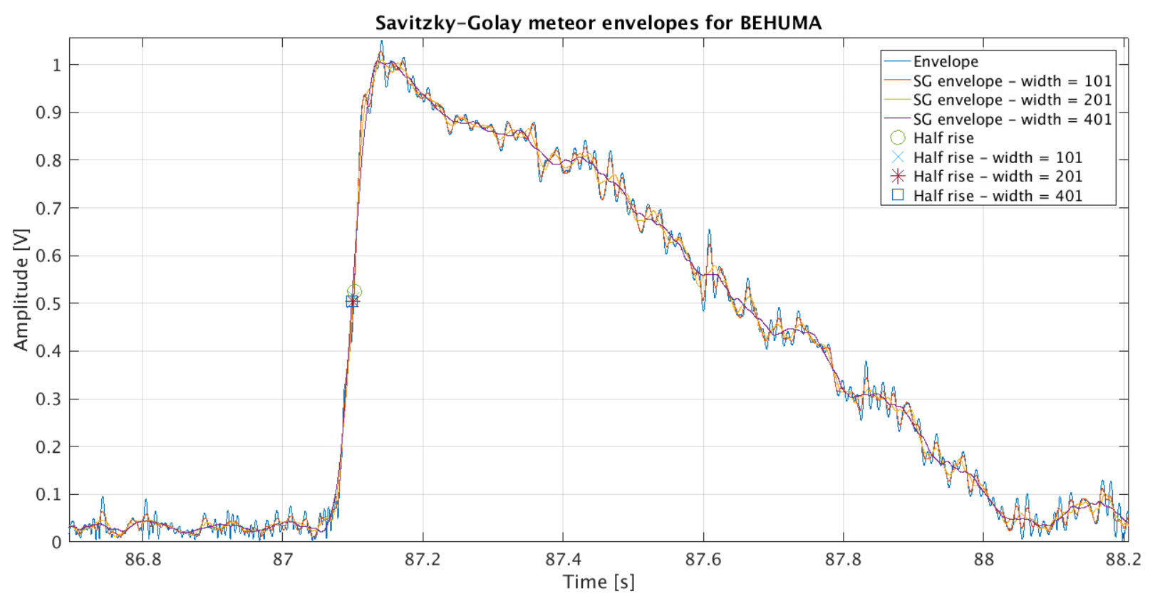
Savitzky-Golay filters

Slide 25
STD variation depending on the mean time delay

