Slide 1
BRAMS : advances on Trajectory retrieval
  Content
Initial state and limitations
Current advances
Future work
Notes:
1

Slide 2
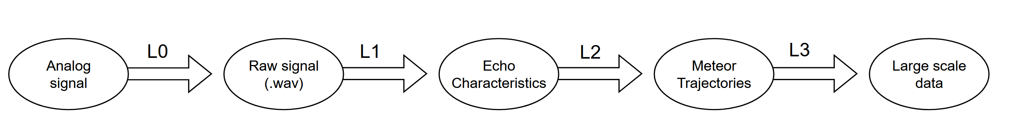
First a few definitions :
L1 – Extracting measured quantites
Filtering parasitic signals
(beacon, airplanes)
Detecting echoes
Determining T0,speed,…
L2 – « Trajectory Retrieval »
Inferring meteor trajectory from measurements
Inverse problem
=> Iterative scheme
Orbit determination
L3 – Large-scale processing
Autonomous retrieval
Meteor counts
Shower activities
…
L0 - Data collection
Shifting to audio domain
Sampling signal
Determining timestamps
Storing data
Notes:
2

Slide 3
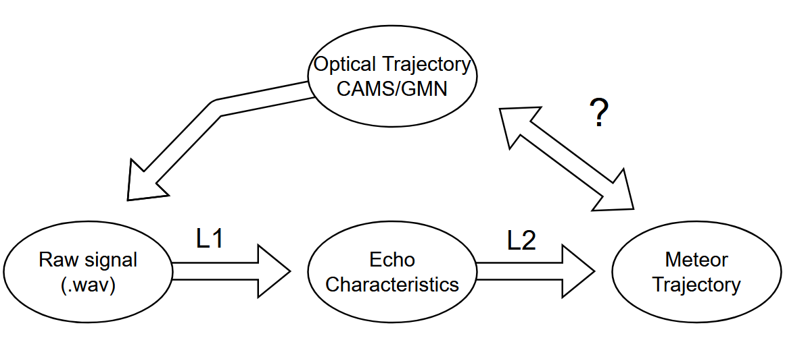
First task : further optical validation
Poor results…
Very few events yield enough echoes
Solver (L2) crashes
Nonphysical solutions
Notes:
3

Slide 4
Limitations :
Notes:
4

Slide 5
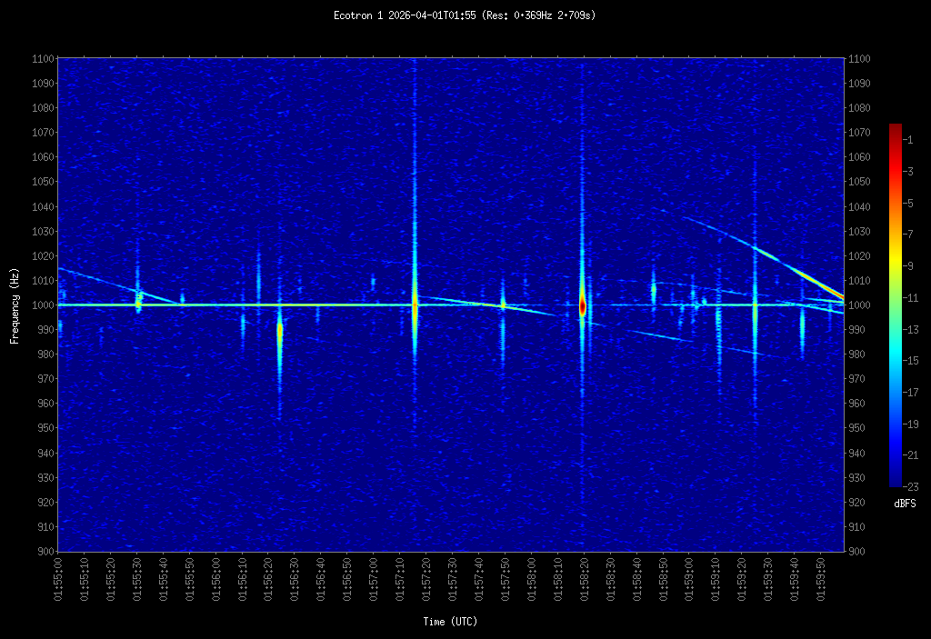
Limitations : L1
Manual counts at Ecotron for 1 hour
=> 192 echoes detected
=> 70 were successfully characterised
=> 48 groups with 6 echoes or more
=> 20 of which only have ToF
=> 10 Trajectories with more than 2 PreT0
=> Outlier filtering, spurious data
=> Only 6 viable trajectories !
Notes:
5

Slide 6
Limitations : L1
Manual counts at Ecotron for 1 hour
=> 192 echoes detected
=> 70 were successfully characterised
=> 48 groups with 6 echoes or more
=> 20 of which only have ToF
=> 10 Trajectories with more than 2 PreT0
=> Outlier filtering, spurious data
=> Only 6 viable trajectories !
Notes:
6

Slide 7
Limitations : L1
ToF-PreT0 incompatibility
 | Underdense | Trans/Overdense
ToF | Works well | Rejection due to shape criteria ; Poor handling of fragmentation
Pre-T0 phase | SNR too low | Works well
Very narrow sweetspot !
Notes:
7

Slide 8
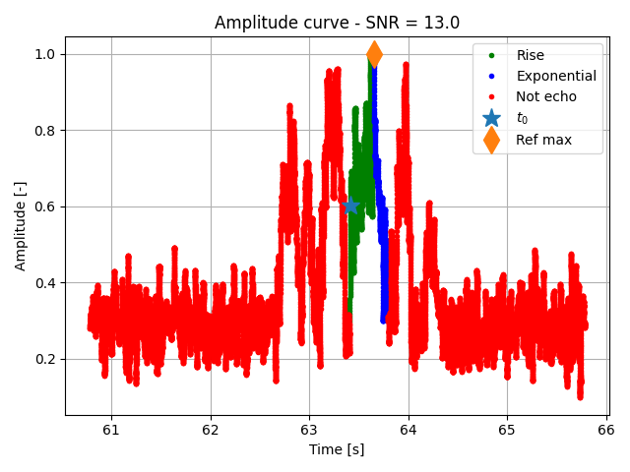
Limitations : L1
Poor fragmentation/overdense handling
Notes:
8

Slide 9
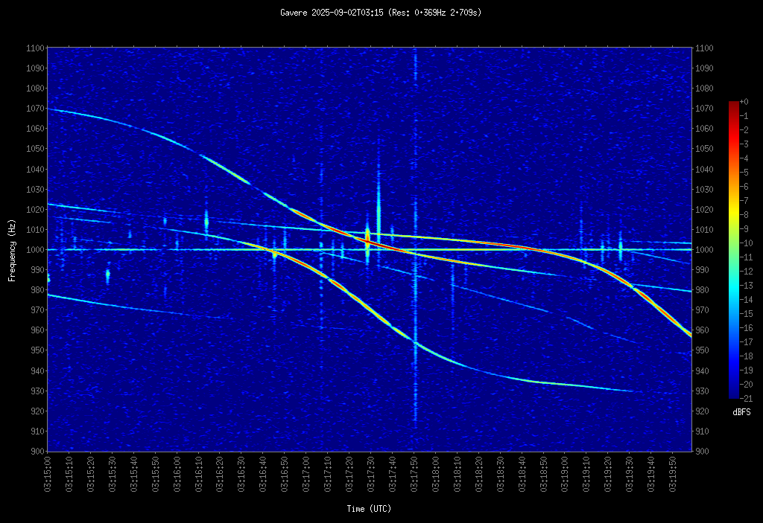
Limitations : L1
Airplane substraction
Notes:
9

Slide 10
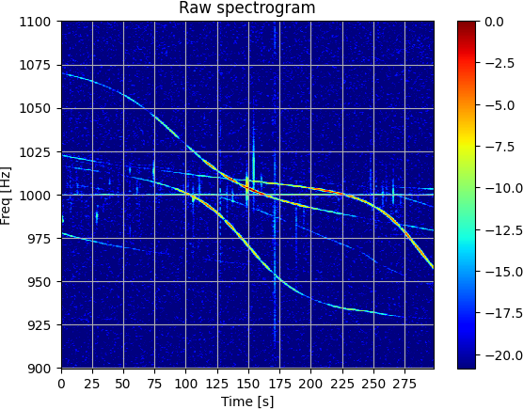
Limitations : L1
Airplane substraction
Notes:
10

Slide 11
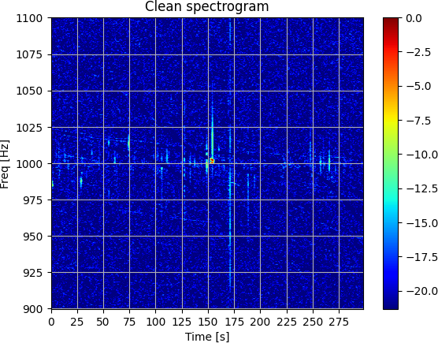
Limitations : L1
Airplane substraction
Notes:
11

Slide 12
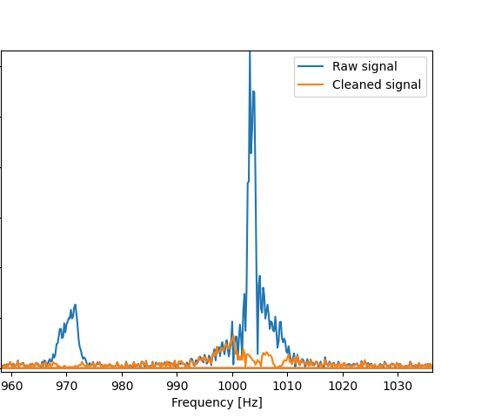
Limitations : L1
« Punches a hole» in the spectra of echoes
Loss of energy
Distorted shape
Notes:
12

Slide 13
Limitations : L1
Poorly estimated SNR & Uncertainties
Good measurements are ignored
=> Loss information
Noisy measurements are given too much importance
=> Deterioration of the fit
Notes:
13

Slide 14
Limitations :
L1.5 ?
How to determine whether two echoes belong to the same event ?
Fragmentation
Spurious data
Simultaneous events
Notes:
14

Slide 15
Limitations :
Slow (± min/call)
Unstable
Rigid structure : Hard to implement new features
(deceleration, new meas. types…)
Notes:
15

Slide 16
Current progress :
Notes:
16

Slide 17
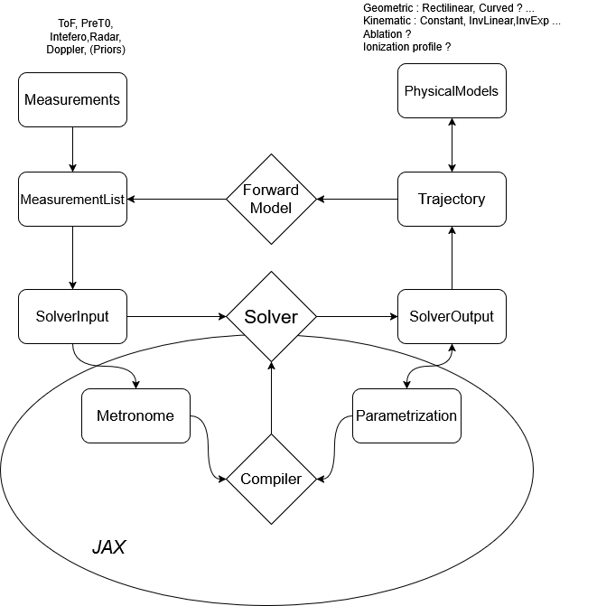
Solver (L2) :
Complete rewrite(s) of the L2 algorithm :
Fully custom iterative scheme
More stable
Massive Speed-up : ±45s -> ±150ms
Multi-emitter support
Fully modular
Notes:
17

Slide 18
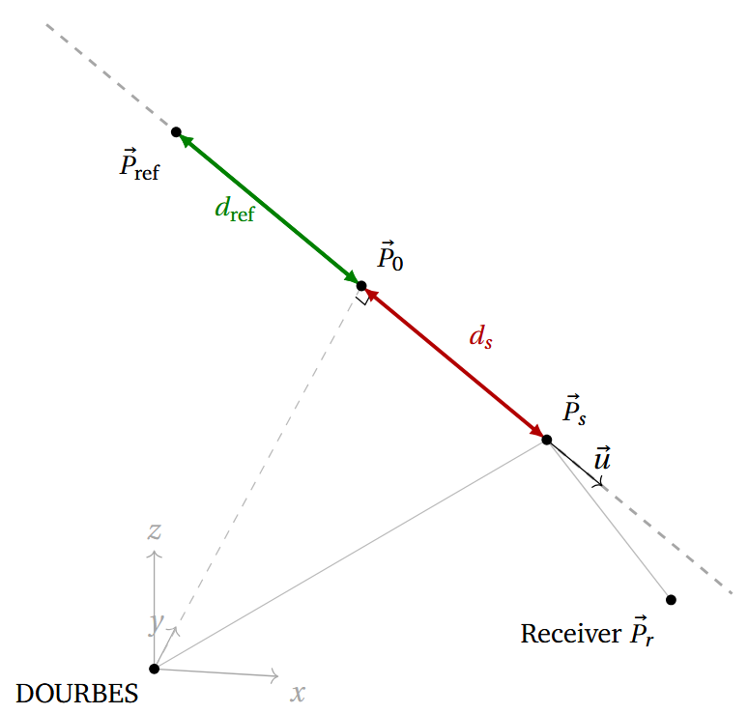



Solver (L2) :
Example of modularity : Implementation of ToF
?
L1
Trajectory
Geometry
Model
Kinematic Model
Notes:
18

Slide 19
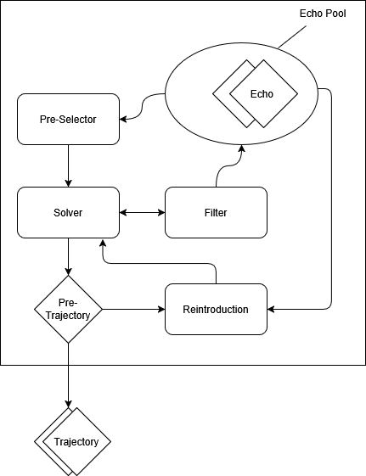
Selector (L1.5) :
Notes:
19

Slide 20
Echo characterization (L1) :
New airplane filtering technique (Early WIP)
New echo analysis techniques (Under investigation)
Goals :
  Speed-up (>>50min of data/min)
  Detect and analyze every echo
Notes:
20

Slide 21
Airplane substraction (L1) :
Notes:
21

Slide 22
Limitations : L1
Airplane substraction
Notes:
22

Slide 23
Limitations : L1
Airplane substraction
Notes:
23

Slide 24
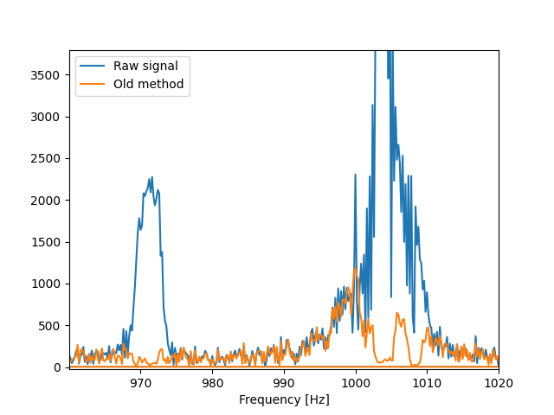
Airplane substraction (L1) :
Notes:
24

Slide 25
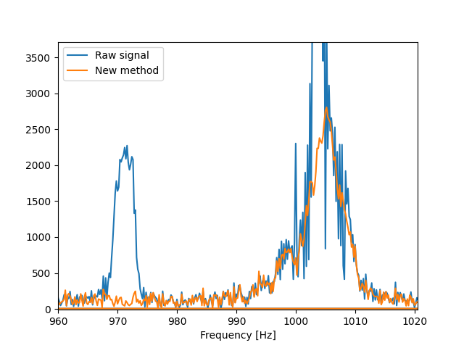
Airplane substraction (L1) :
Notes:
25

Slide 26
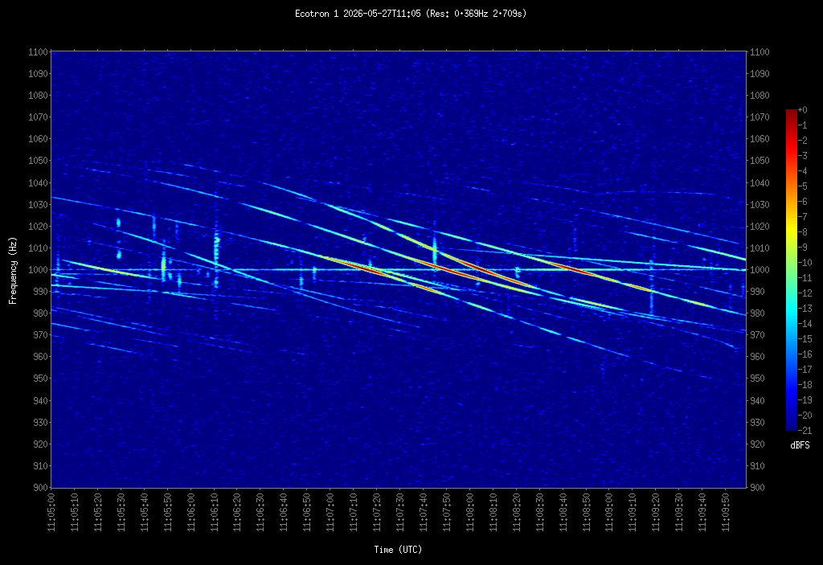
Airplane substraction (L1) :
Notes:
26

Slide 27
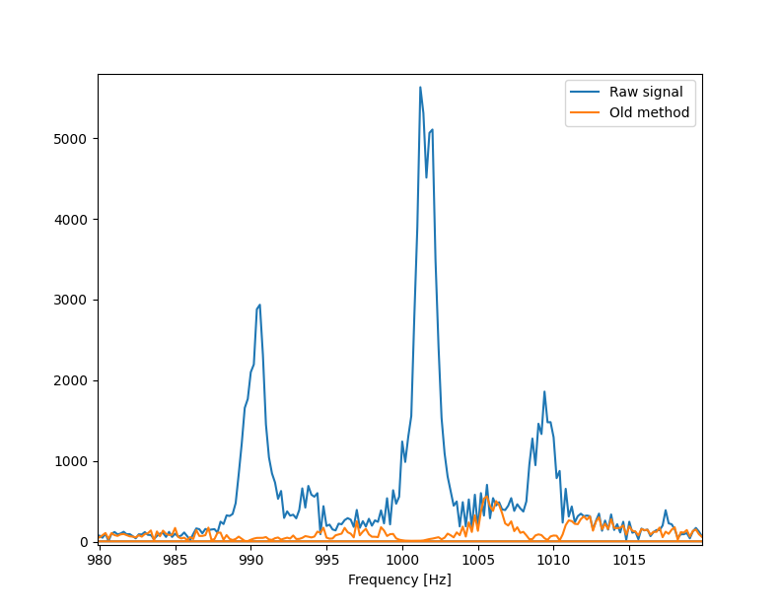
Airplane substraction (L1) :
Notes:
27

Slide 28
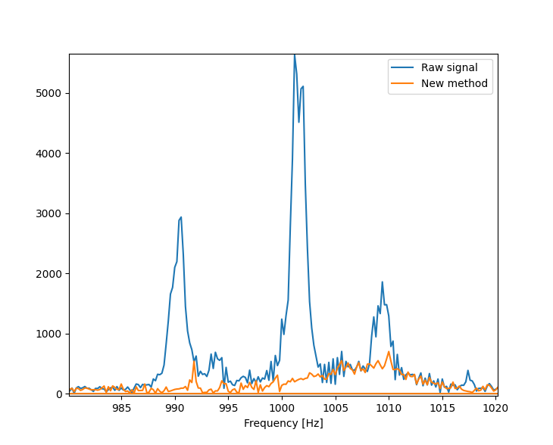
Airplane substraction (L1) :
Notes:
28

Slide 29
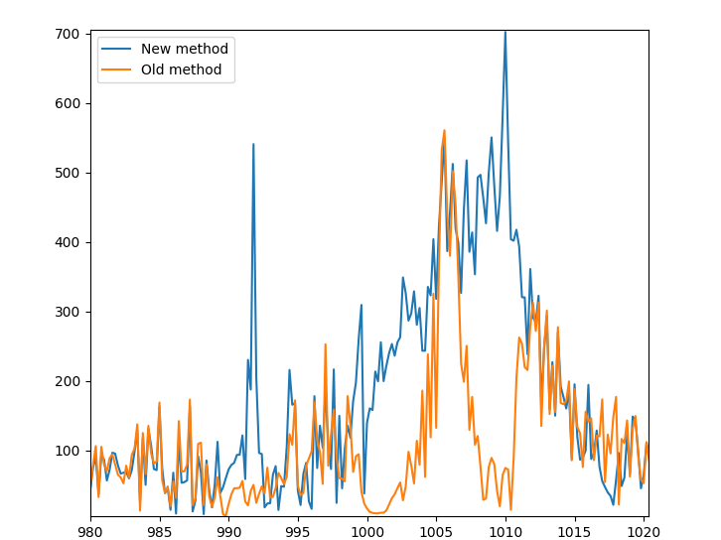
Airplane substraction (L1) :
Notes:
29

Slide 30
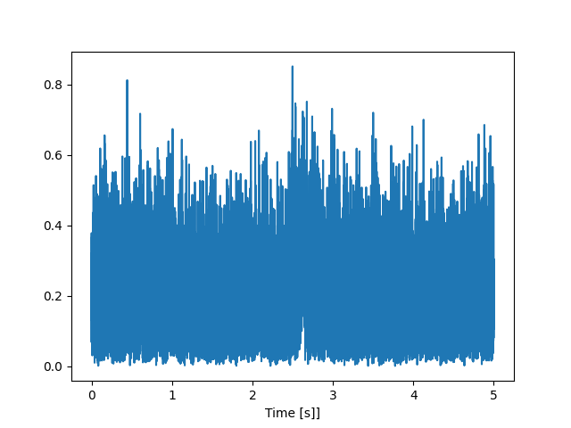
Airplane substraction (L1) :
Notes:
30

Slide 31
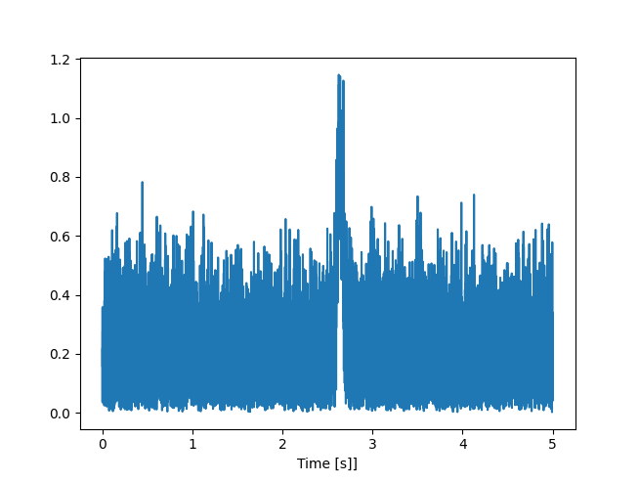
Airplane substraction (L1) :
Notes:
31

Slide 32
What next ?
Orbit determination
Plot utilities
Autonomous retrieval

