Slide 1
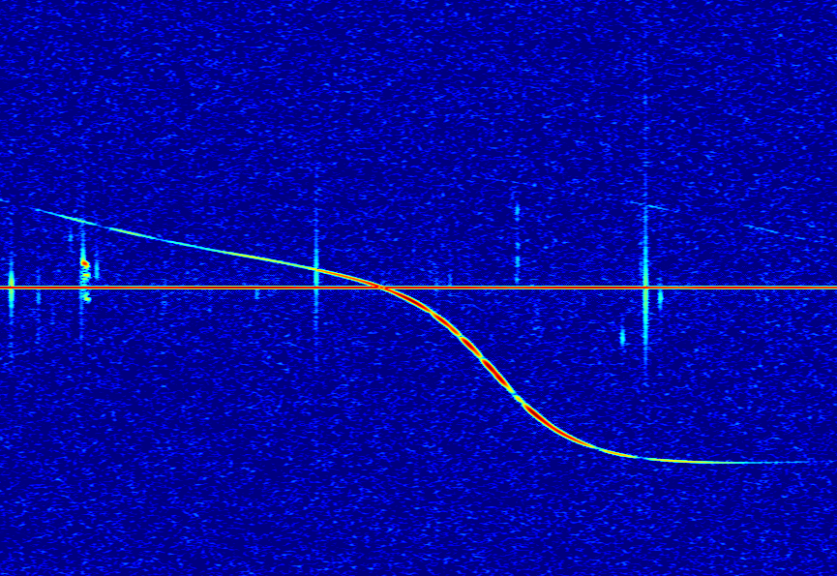


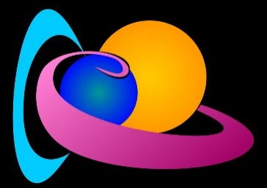
Improved meteoroid trajectory and speed reconstruction with BRAMS: pre-t0 phase technique and uncertainty quantification
Joachim Balis, Hervé Lamy, Michel Anciaux, Emmanuel Jehin, Johan De Keyser, Daniel Kastinen, Peter Brown
EPSC-DPS Joint meeting 2025 – Helsinki – 9 September 2025
Notes:
Notes for presentation

Slide 2
Outline
The BRAMS network
Trajectory reconstruction using time-of-flights only
Trajectory reconstruction using pre-t0 phase measurements in addition
Uncertainty quantification
Conclusions & perspectives

Slide 3
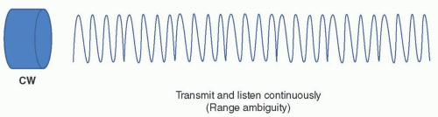
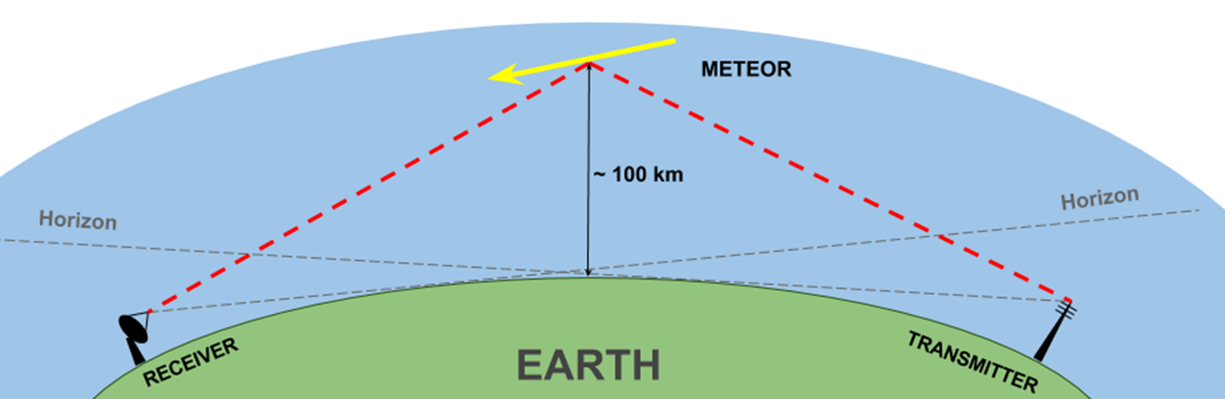
Can we use a CW forward scatter system to determine meteoroid trajectory and speed?
No range information because CW
Everything is more complex to interpret
No CW forward scatter system without range information can determine meteoroid trajectories and speeds

Slide 4
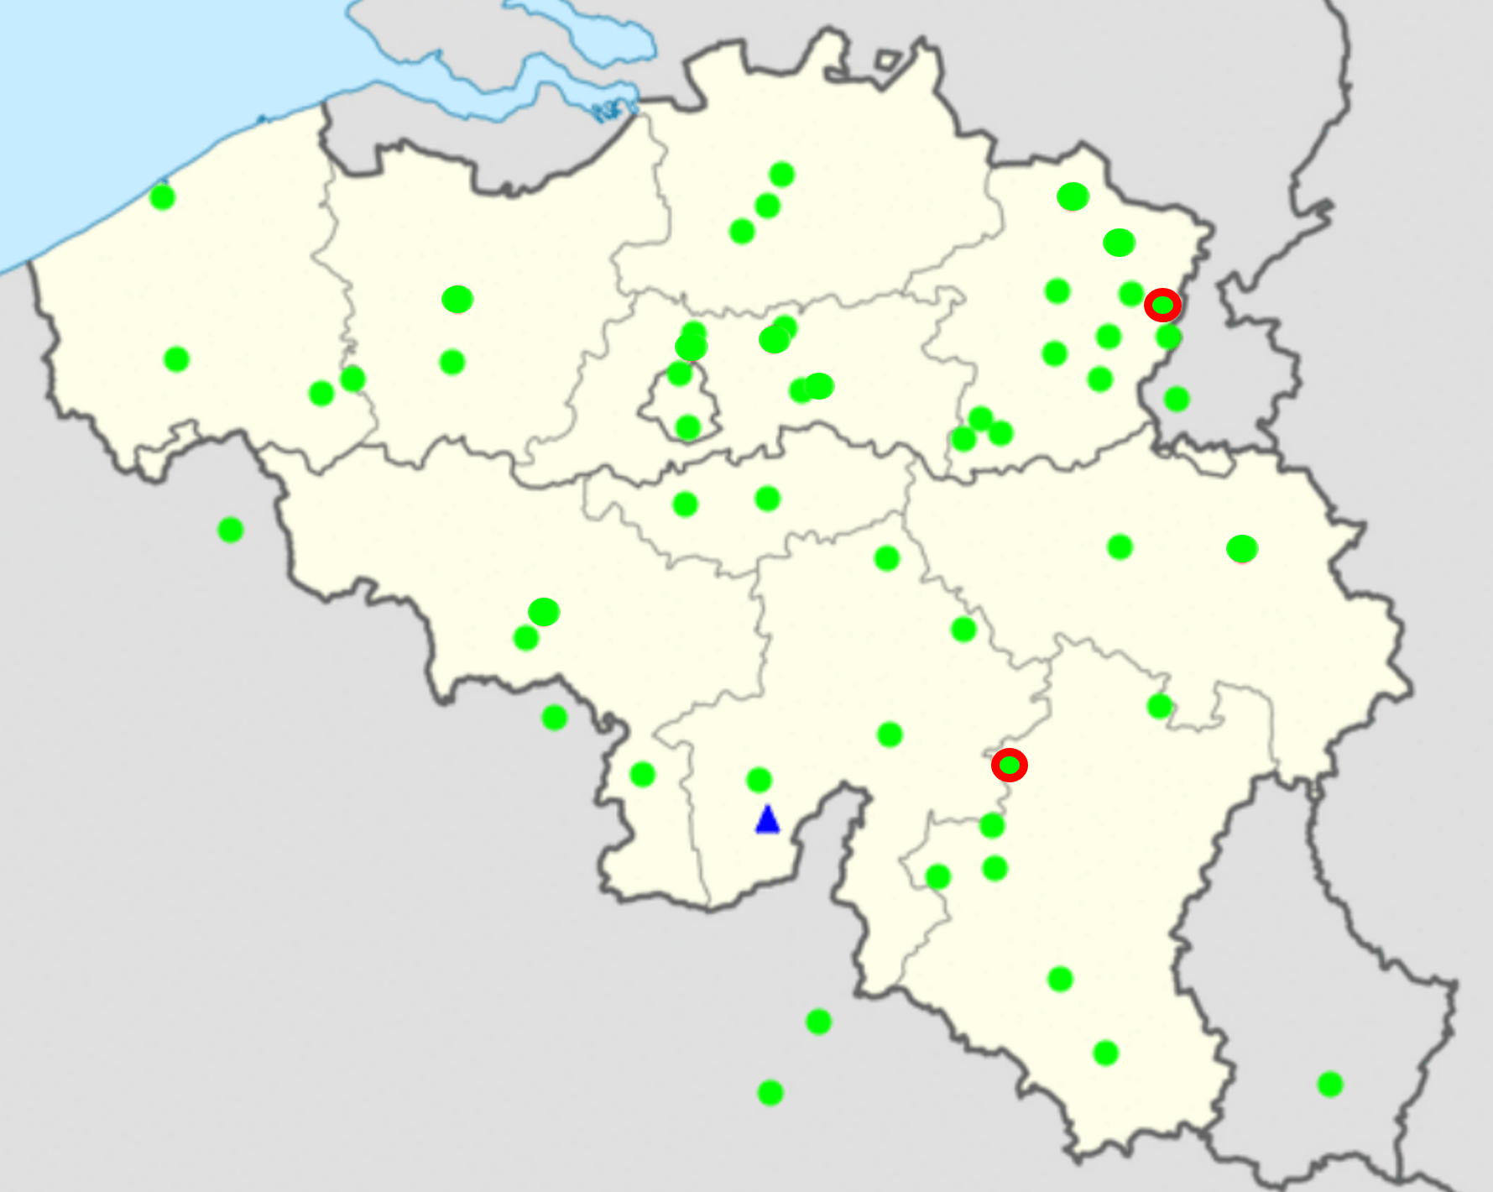
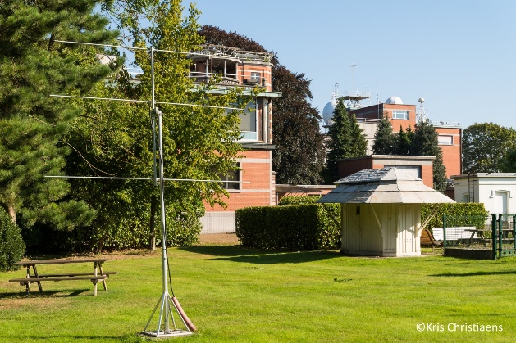
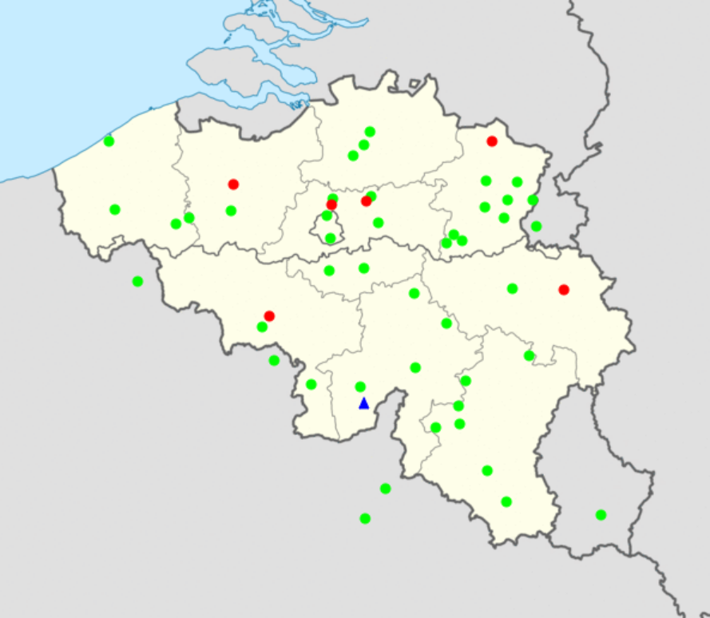
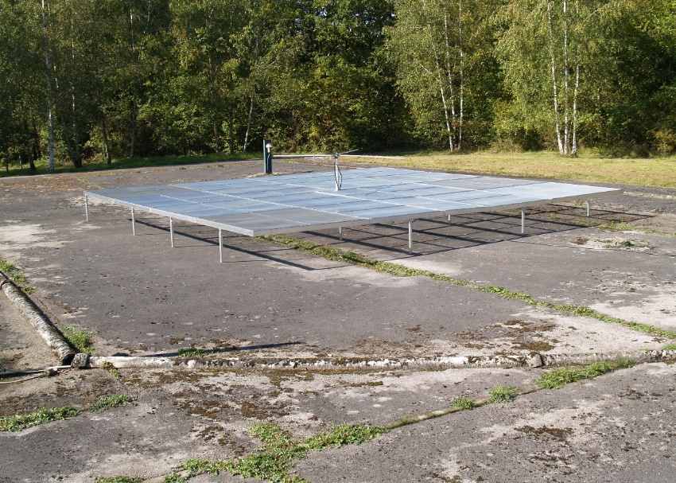
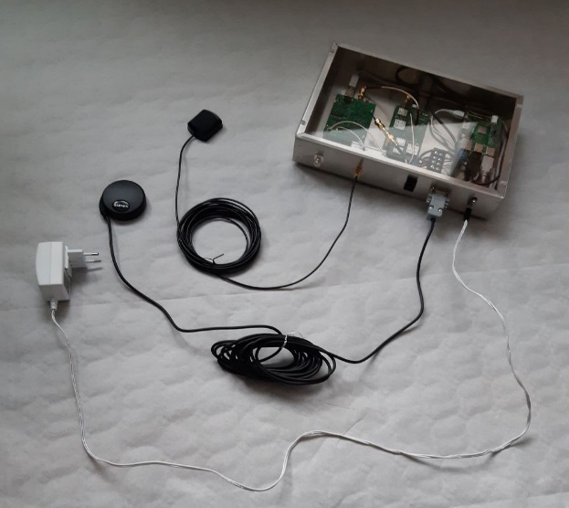
The BRAMS network
BRAMS = Belgian RAdio Meteor Stations
51 receiving stations
Green dots
3-element Yagi antennas
Synchronized using GPS clocks
A dedicated transmitter
Located in Dourbes (blue triangle)
f = 49.97 MHz
CW with no modulation
Radiated power: ~350 W
The 51 receivers have no range or AOA information (except for the interferometers)
That strongly complexifies the reconstruction of meteoroid trajectories and speeds..
Two radio interferometers
Red circles (Humain and Ecotron)
5 Yagi antennas
Information about the AOA

Slide 5
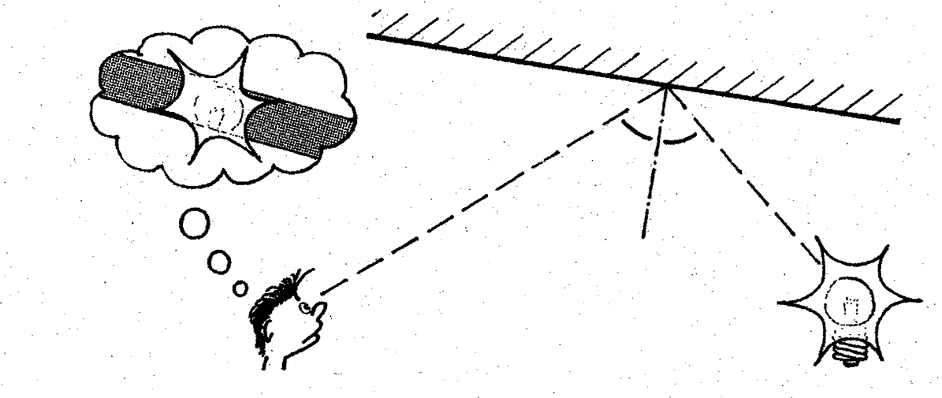
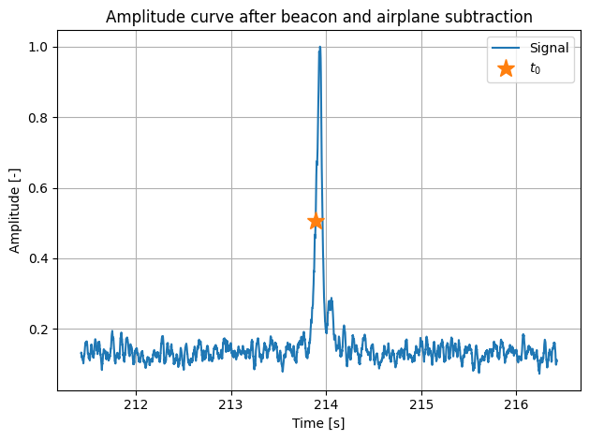
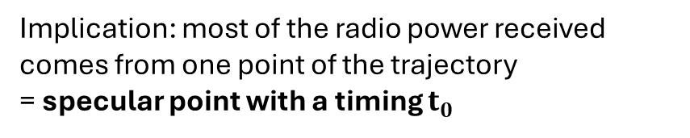
Trajectory reconstruction
Specular reflection
Amplitude curve
Implication: most of the radio power received comes from one point of the trajectory
= specular point with a timing $t_{0}$

Slide 6
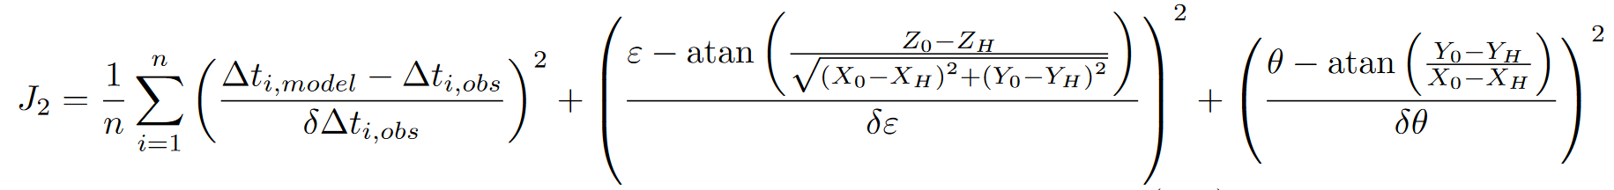
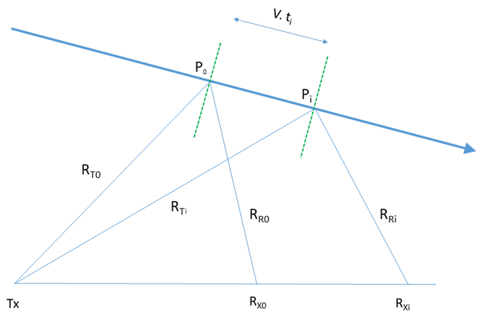
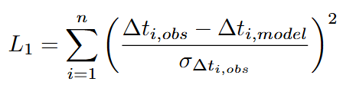
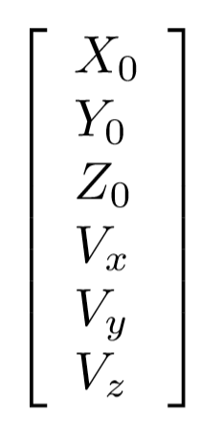
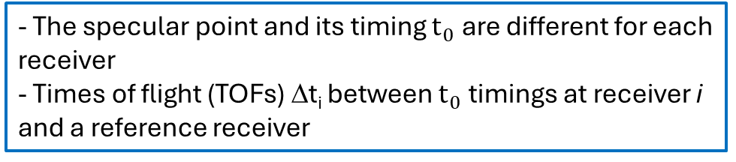
Trajectory reconstruction algorithm
- The specular point and its timing $t_{0}$are different for each receiver
- Times of flight (TOFs) Δt_{i} between $t_{0}$timings at receiver i and a reference receiver
Set of ≥ 6 non-linear equations for 6 unknowns: a specular point P₀ + a constant velocity v
Set of n raw signals
/
Observed / Modelled TOF
TOFs extraction
Experimental uncertainty
Meteor path
Cost function minimization
Solution vector
Transmitter
Receivers

Slide 7
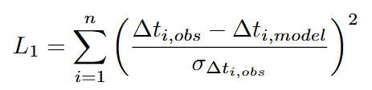
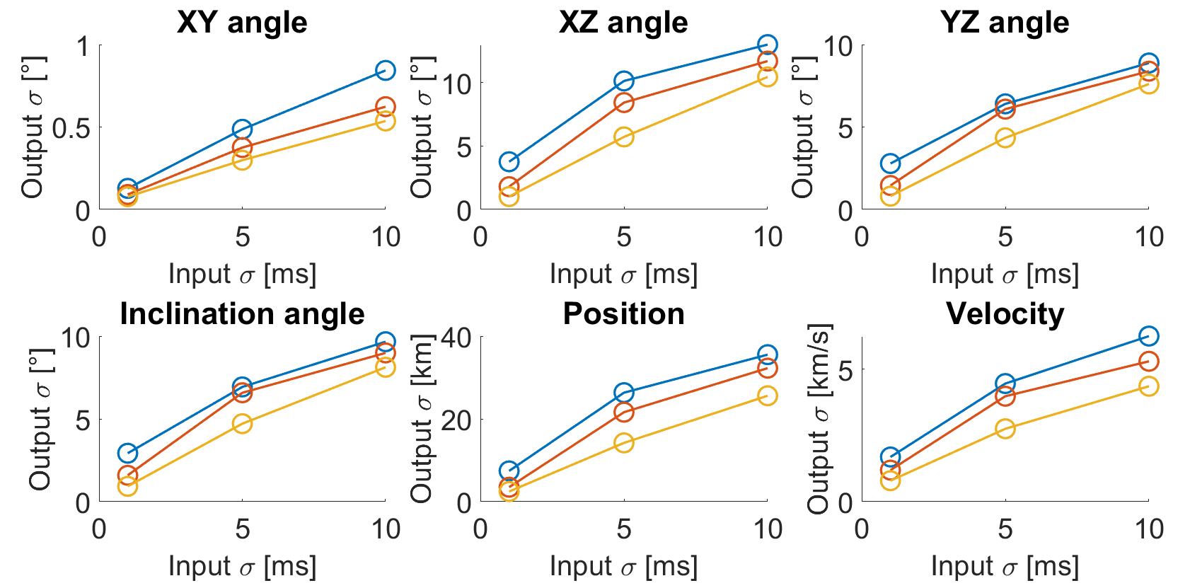
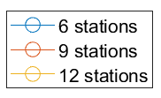
Sensitivity analysis
We quantify the sensitivity of the output trajectory to TOF measurements errors
The CW forward scatter trajectory reconstruction problem has been solved for the first time
The problem is ill-conditioned
The interferometer alleviates this ill-conditioning (when available)
Further analysis and results in Balis et al., 2023

Slide 8
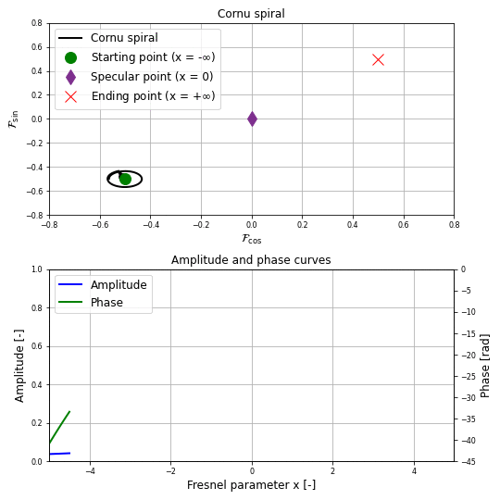
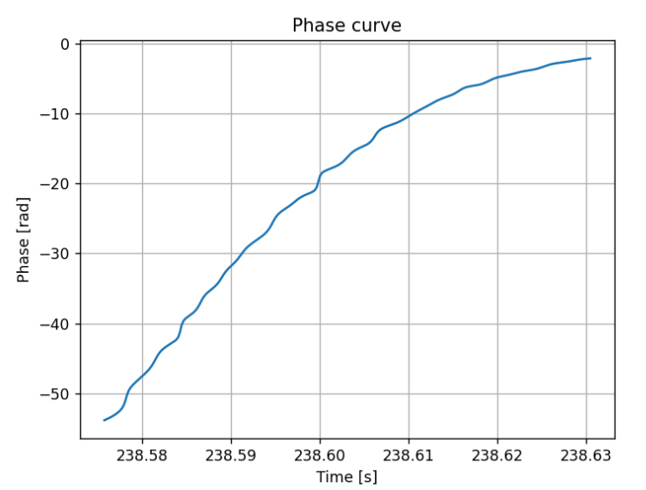
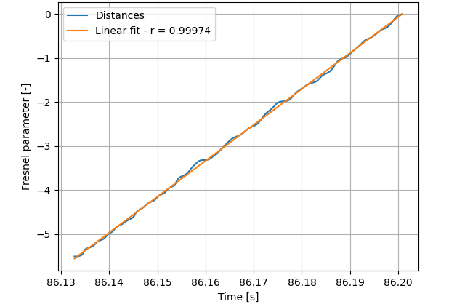


Pre-$t_{0}$ phase method
Signal phase
Cornu spiral
Fresnel parameter x
Derivative
Meteor speed
Geometry
Pre-$t_{0}$ pseudo speed
Example (BEHUMA_SYS001)

Slide 9
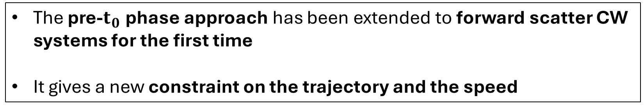
Pre-$t_{0}$ phase method
The pre-$t_{0}$ phase approach has been extended to forward scatter CW systems for the first time
It gives a new constraint on the trajectory and the speed

Slide 10
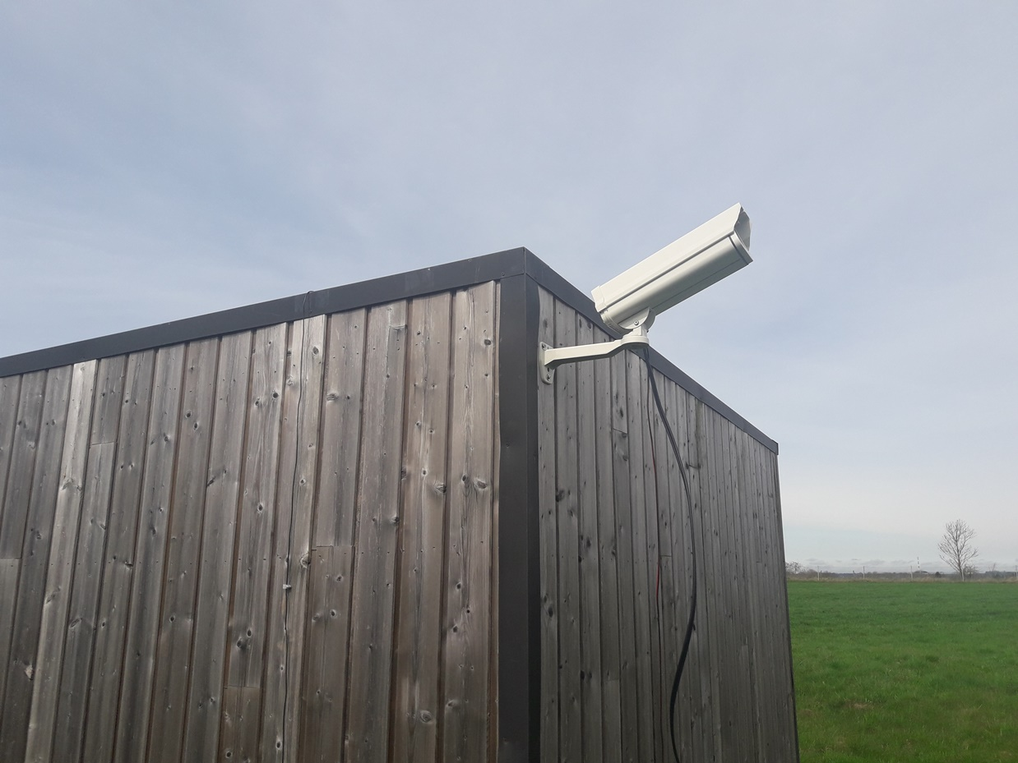
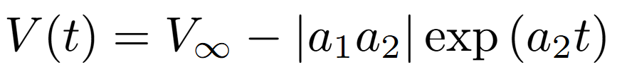
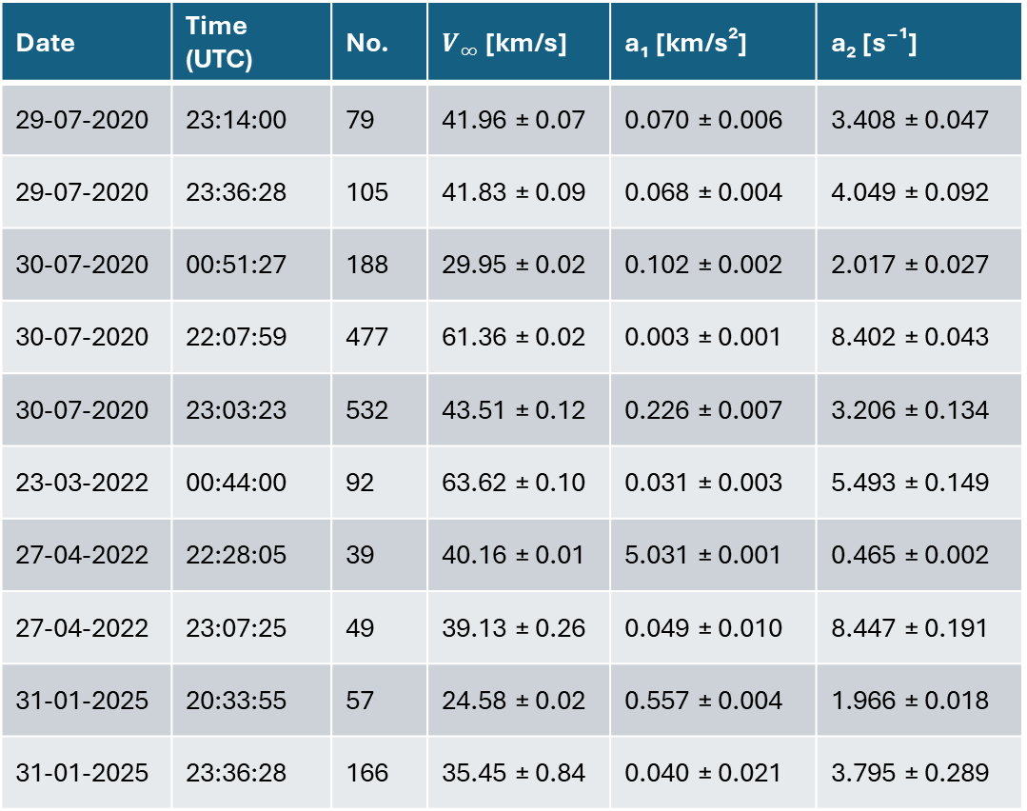
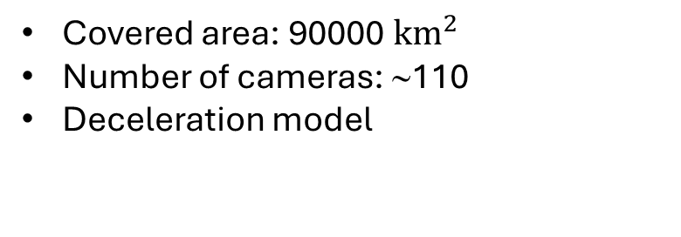
Validation with CAMS-BeNeLux optical data
Date | Time (UTC) | No. | $V_{∞}$ [km/s] | a₁ [km/s²] | a₂ [s⁻¹]
29-07-2020 | 23:14:00 | 79 | 41.96 ± 0.07 | 0.070 ± 0.006 | 3.408 ± 0.047
29-07-2020 | 23:36:28 | 105 | 41.83 ± 0.09 | 0.068 ± 0.004 | 4.049 ± 0.092
30-07-2020 | 00:51:27 | 188 | 29.95 ± 0.02 | 0.102 ± 0.002 | 2.017 ± 0.027
30-07-2020 | 22:07:59 | 477 | 61.36 ± 0.02 | 0.003 ± 0.001 | 8.402 ± 0.043
30-07-2020 | 23:03:23 | 532 | 43.51 ± 0.12 | 0.226 ± 0.007 | 3.206 ± 0.134
23-03-2022 | 00:44:00 | 92 | 63.62 ± 0.10 | 0.031 ± 0.003 | 5.493 ± 0.149
27-04-2022 | 22:28:05 | 39 | 40.16 ± 0.01 | 5.031 ± 0.001 | 0.465 ± 0.002
27-04-2022 | 23:07:25 | 49 | 39.13 ± 0.26 | 0.049 ± 0.010 | 8.447 ± 0.191
31-01-2025 | 20:33:55 | 57 | 24.58 ± 0.02 | 0.557 ± 0.004 | 1.966 ± 0.018
31-01-2025 | 23:36:28 | 166 | 35.45 ± 0.84 | 0.040 ± 0.021 | 3.795 ± 0.289
Covered area: 90000 ${km}^{2}$
Number of cameras: ∼110
Deceleration model

Slide 11
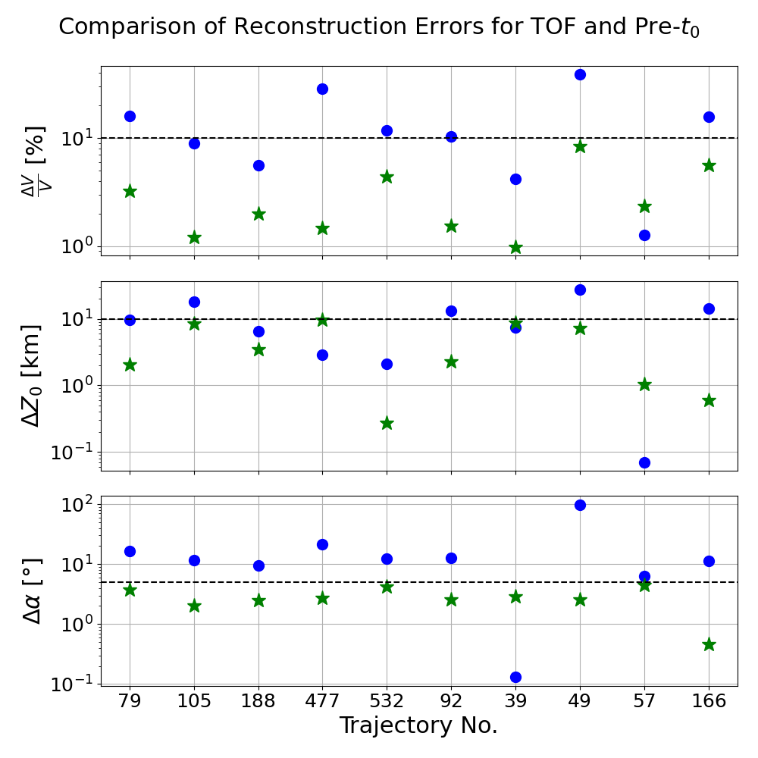

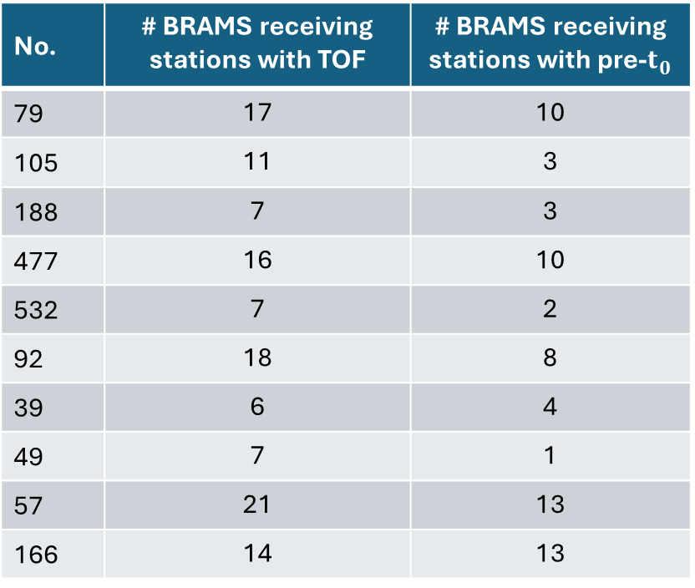
Reconstruction errors – Comparison with CAMS
Errors without interferometry in logarithmic scale
No. | # BRAMS receiving stations with TOF | # BRAMS receiving stations with pre-$t_{0}$
79 | 17 | 10
105 | 11 | 3
188 | 7 | 3
477 | 16 | 10
532 | 7 | 2
92 | 18 | 8
39 | 6 | 4
49 | 7 | 1
57 | 21 | 13
166 | 14 | 13
10% error line
10 km error line
5° error line

Slide 12
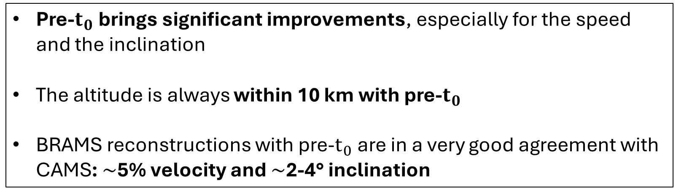
Reconstruction errors – Comparison with CAMS
Pre-$t_{0}$ brings significant improvements, especially for the speed and the inclination
The altitude is always within 10 km with pre-$t_{0}$
BRAMS reconstructions with pre-$t_{0}$are in a very good agreement with CAMS: $\sim$5% velocity and $\sim$2-4° inclination

Slide 13
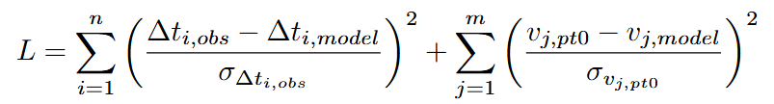
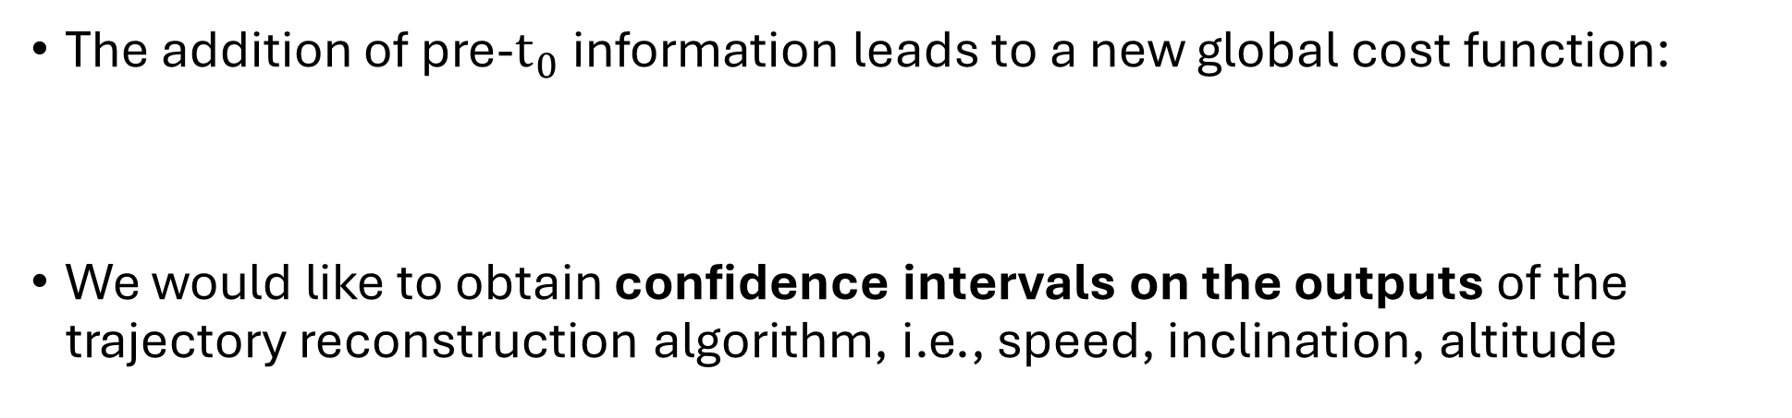
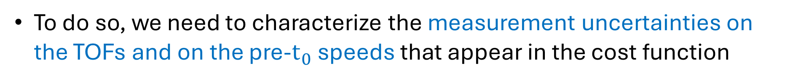
Uncertainty quantification
The addition of pre-$t_{0}$information leads to a new global cost function:
We would like to obtain confidence intervals on the outputs of the trajectory reconstruction algorithm, i.e., speed, inclination, altitude
To do so, we need to characterize the measurement uncertainties on the TOFs and on the pre-$t_{0}$ speeds that appear in the cost function

Slide 14
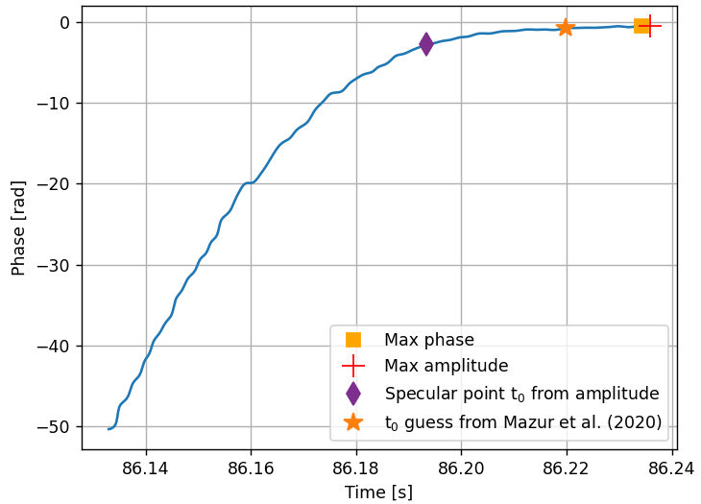
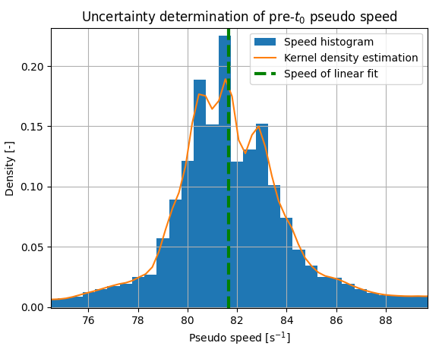
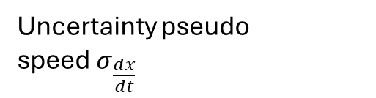
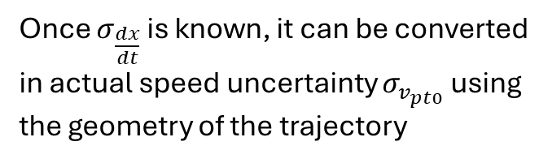


Pre-$t_{0}$ uncertainty
Phase φ(t)
Fresnel parameter x(t)
Cornu spiral
Slope of linear fit
Meteor pseudo speed $\frac{dx}{dt}$
Sliding windows of varying sizes
Full width at half maximum (FWHM)
Pseudo speed histogram
Once $σ_{\frac{dx}{dt}}$ is known, it can be converted in actual speed uncertainty $σ_{v_{pt0}}$ using the geometry of the trajectory
Uncertainty pseudo speed$σ_{\frac{dx}{dt}}$
FWHM

Slide 15
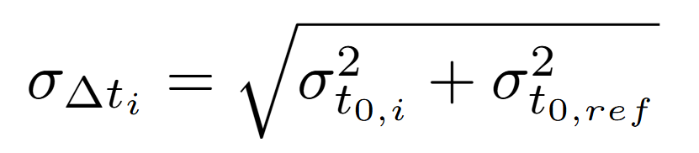


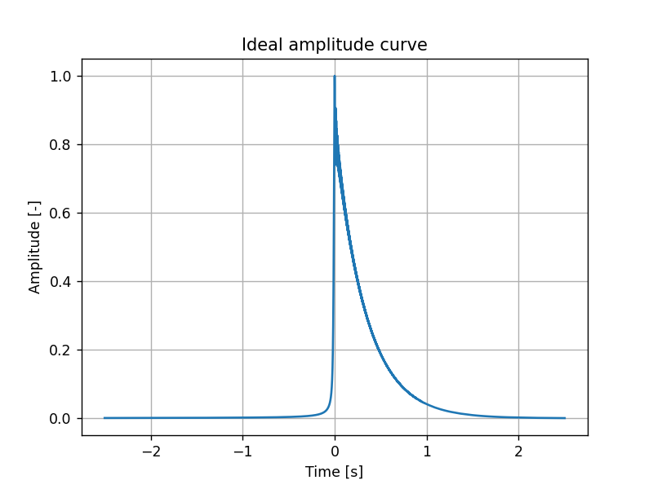
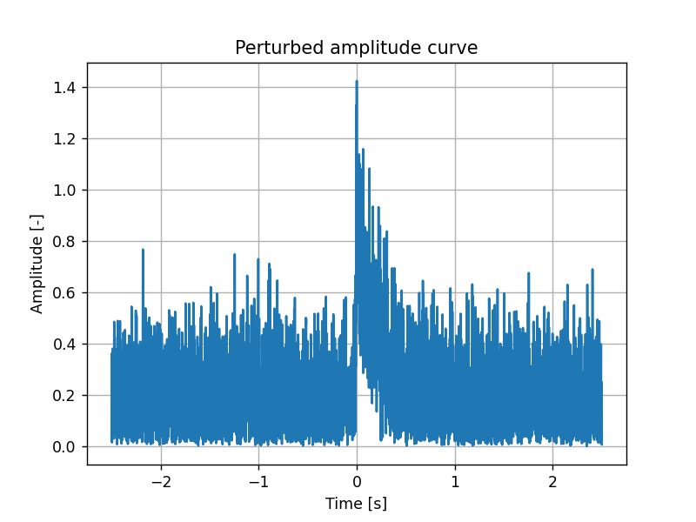

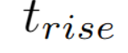
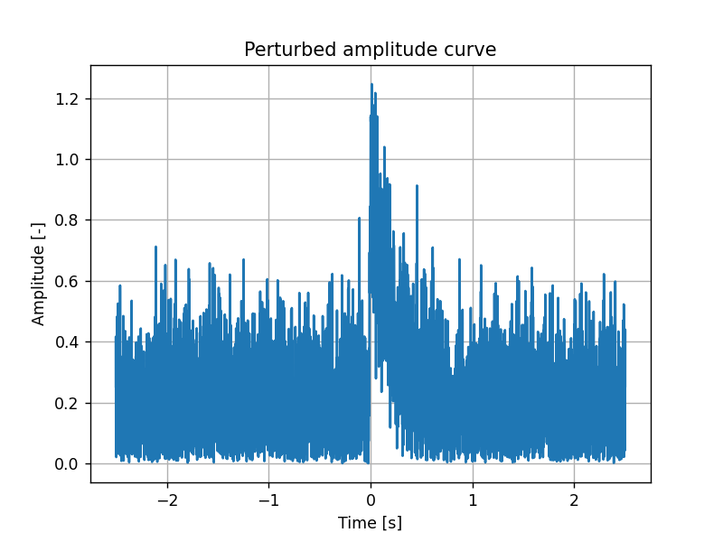
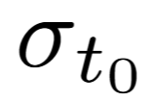
TOF uncertainty
We want to determine
The uncertainties on the TOFs depend on the uncertainty on the determination of the $t_{0}$ timings
We use Monte Carlo simulations to get
10,000 clones with the same
Gaussian random noise with a given SNR
Processing
Rise time
Statistics
Processing

Slide 16
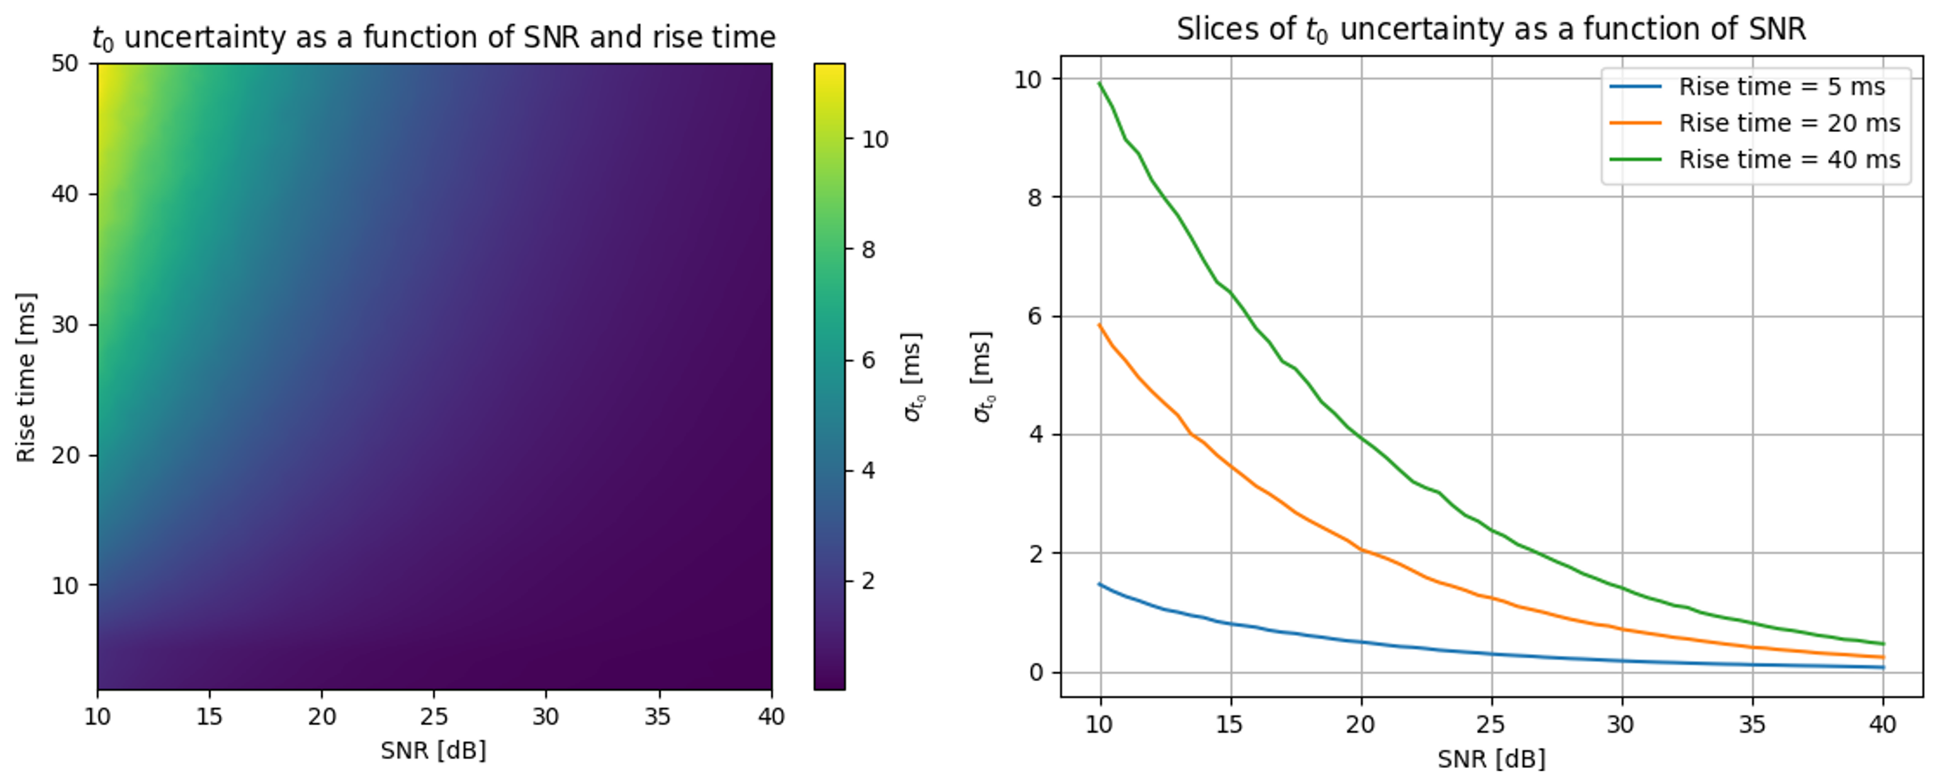

Results of $t_{0}$ uncertainty
These curves have been computed once and for all
They can be accessed for each meteor event from a look-up table

Slide 17
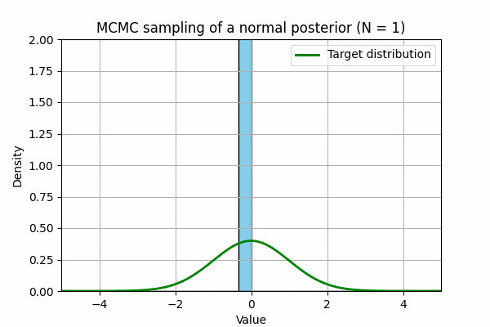
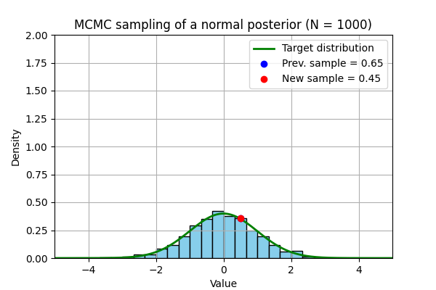
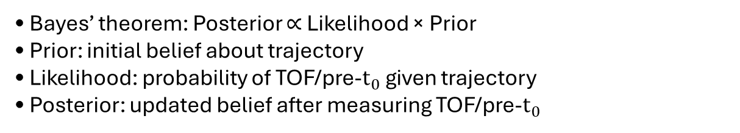
Uncertainty propagation
How to quantify the reliability of the trajectories? We need a method which:
• Gives accurate confidence intervals
• Highlights the correlation between solution parameters
Bayesian framework
• Bayes’ theorem: Posterior ∝ Likelihood × Prior
• Prior: initial belief about trajectory
• Likelihood: probability of TOF/pre-$t_{0}$ given trajectory
• Posterior: updated belief after measuring TOF/pre-$t_{0}$
  With a uniform prior as well as independent and normally distributed measurements: the log-posterior is proportional to the cost function
MCMC (Markov Chain Monte Carlo)
  • Samples from any posterior distributions
  • Builds a Markov chain to approximate the posterior

Slide 18
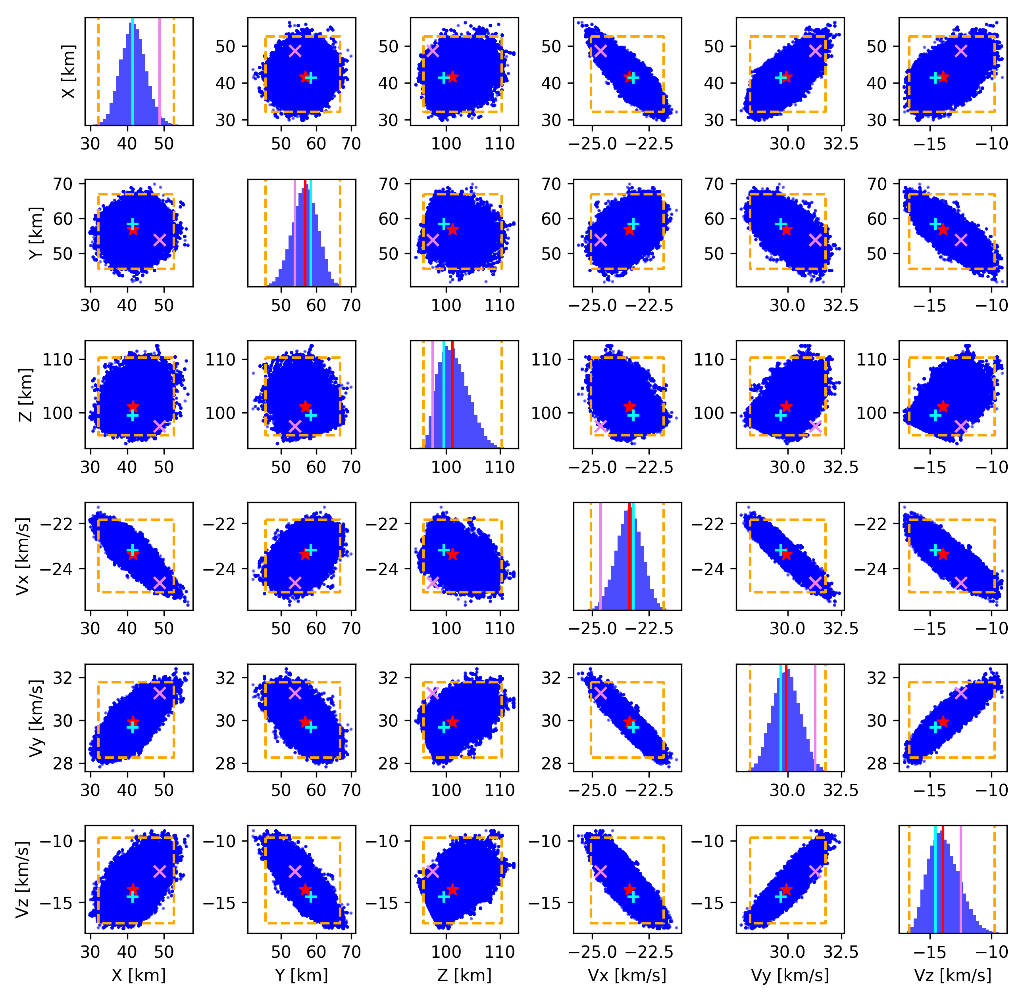
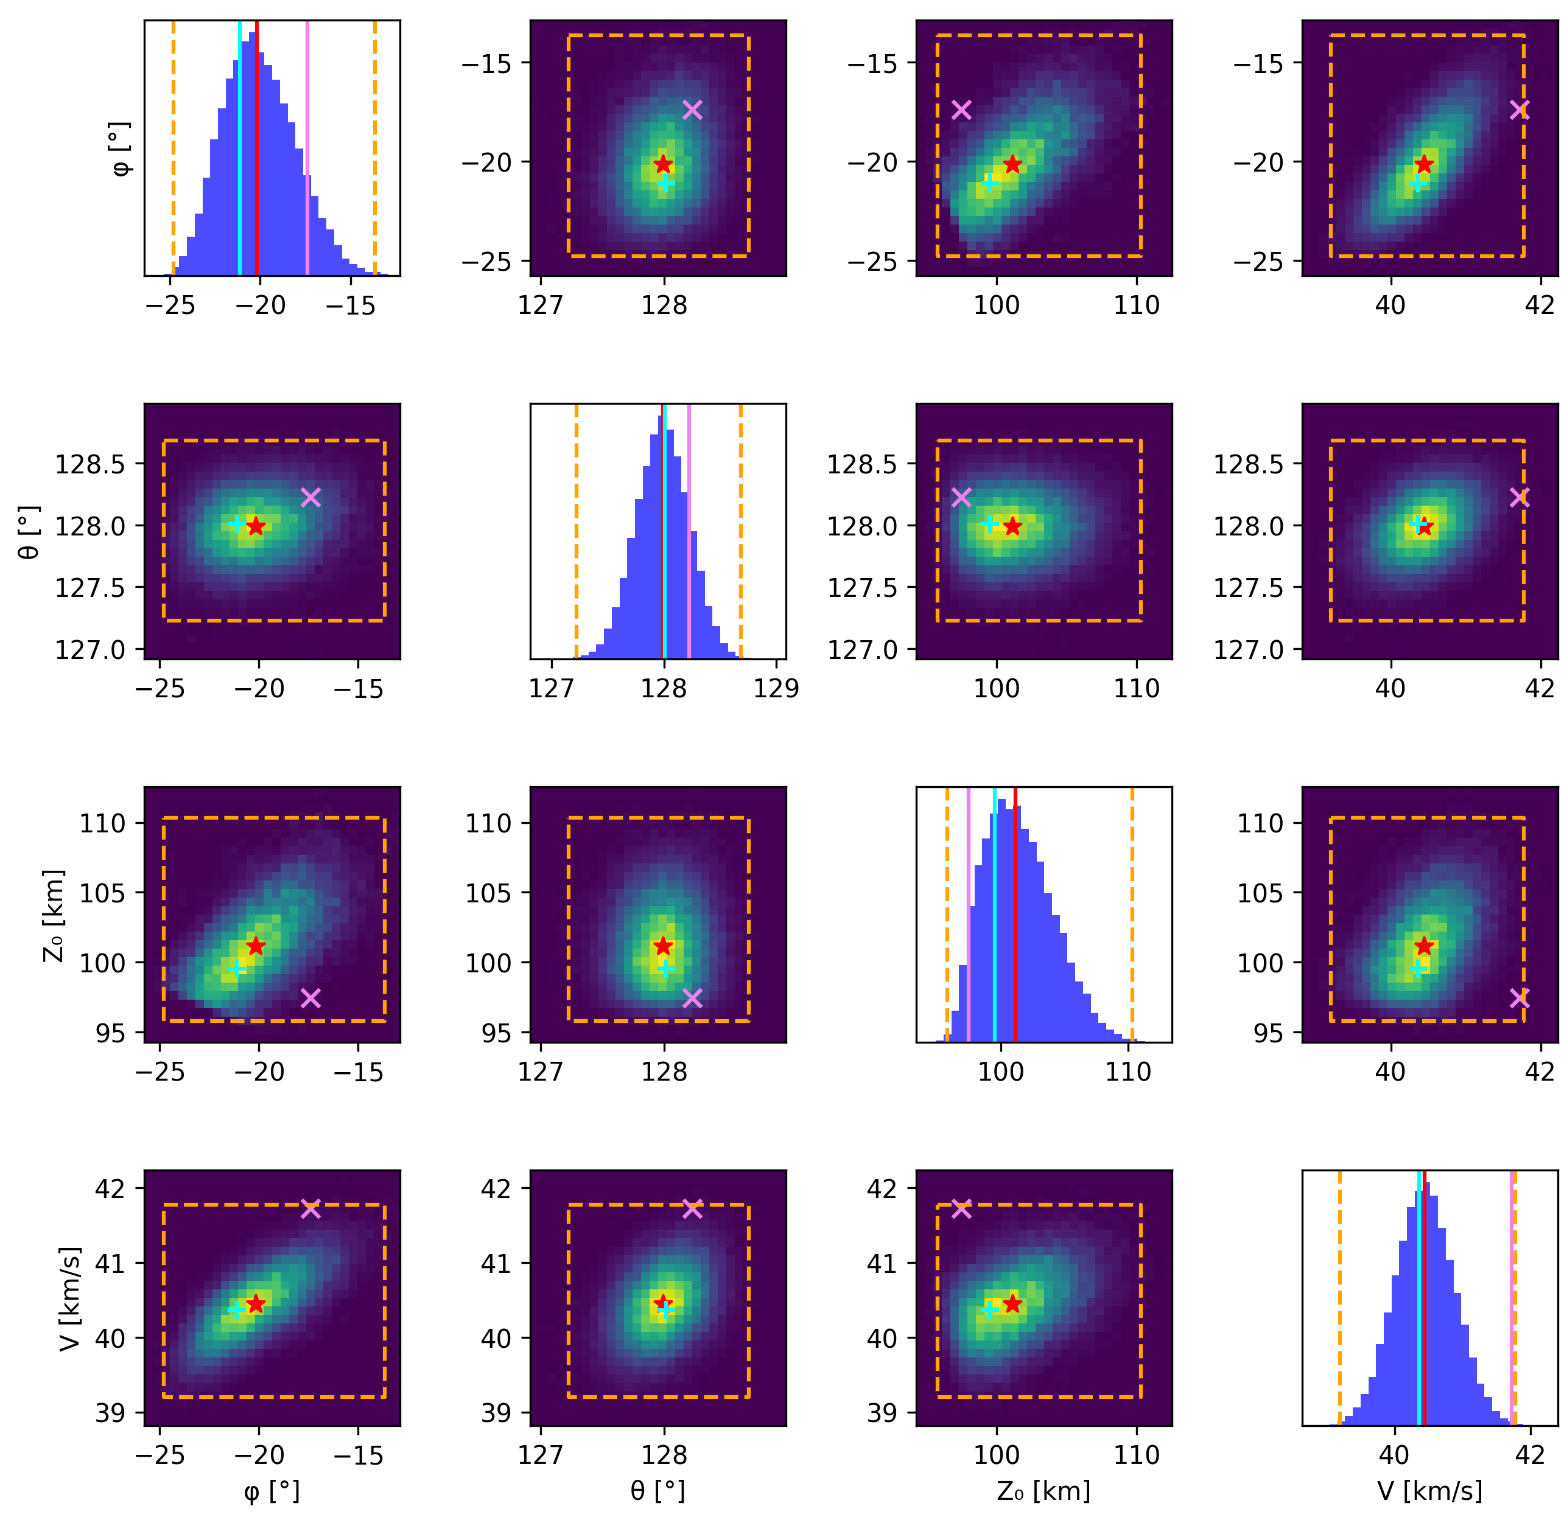

MCMC results – Trajectory 79
Scatter matrix for ${\text{X}}_{0}$, ${\text{Y}}_{0}$, ${\text{Z}}_{0}$, Vx, Vy, Vz
Density matrix for elevation φ, azimuth θ, altitude ${\text{Z}}_{0}$, speed V
MCMC samples
Solver solution
Posterior median
CAMS solution
3σ confidence intervals

Slide 19


Uncertainty characterization
From the posterior distributions, we extract uncertainties and confidence intervals
For most BRAMS events, the CAMS solution lies within the 95% confidence interval
Tight confidence intervals or the speed V and the azimuth θ, but looser for the altitude ${\text{Z}}_{0}$ and the elevation φ
Further discussion of results in Balis et al., 2025

Slide 20

Conclusions
1. Can a CW forward scatter system without range information be used to determine meteoroid trajectories and speeds?
YES, we “just” need:
GPS-synchronized receivers
An optimization solver
2. Is AOA information necessary for accurate trajectory and speed reconstruction?
NO, BUT:
It brings significant benefits (altitude determination)
If not available, pre-$t_{0}$phase is required for 5% speed and 2-4° inclination errors
3. How can uncertainties in the reconstructed trajectory and speed parameters be quantified?
MCMC. The Bayesian framework:
- Gives uncertainties and correlation for each parameter
- Can handle various inputs and constraints

Slide 21
Perspectives
Deceleration models for better pre-atmospheric speed
Coupling with orbit determination software
Ionization curves using the power detected at specular points
Initial meteoroid mass with ablation models

Slide 22
Thank you for listening!

