Slide 1
Upper Atmosphere Wind Speed Measurements using BRAMS Data
A first impression
BRAMS meeting at MIRA, Grimbergen on 30th May 2026
RX
RX
RX
RX
RX
TX
Meteor trail + radar geometry + many echoes = wind field
1

Slide 2
The atmosphere gives us moving “targets”
Meteor trails drift with the local wind, so radar echoes carry wind information.
1. A meteoroid enters
2. It leaves an ionized trail
3. The trail drifts with the wind
4. The echo frequency shifts (Doppler shift)
Key idea: Doppler shift tells us how fast the trail moves along the radar viewing direction.
2

Slide 3
Forward scatter: one meteor, many viewing angles
A transmitter illuminates the meteor trail; receivers detect echoes from different directions.
Meteor trail along trajectory
Bragg vector = direction
that Doppler “sees”
Receiver A
Receiver B
Receiver C
Receiver D
Transmitter
More stations can turn one meteoroid into many useful reflection points along a trajectory.
Meteor trajectory (specular point) required as input for wind retrieval.
3

Slide 4
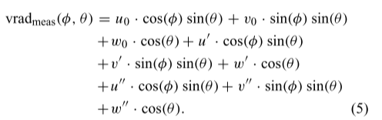
Each echo gives one piece of the wind vector
A radar echo measures the projection of the wind along the Bragg vector.
measured speed = wind · viewing direction
Up
echo 2 sees
another component
true wind
least
Squares
solution
echo 1 sees
this component
East / North plane
Many echoes let us solve for zonal, meridional, and vertical wind.
4

Slide 5
Why interferometry matters
Angle-of-arrival information makes the meteor geometry much better constrained.
Without interferometry
With interferometry
trajectory possible,
But higher uncertainty
arrival angle
constrains the trail
antenna array
Better trajectory → better Bragg vector → better wind projection
5

Slide 6
From many echoes to a wind map
The retrieval repeats the same local calculation in time–altitude bins.
altitude ↑
1 collect echoes
2 group by hour and altitude
3 solve wind vector per cell
4 compare with / without interferometry
1 hour time bin
time →
Each colored cell is one local wind estimate
6

Slide 7
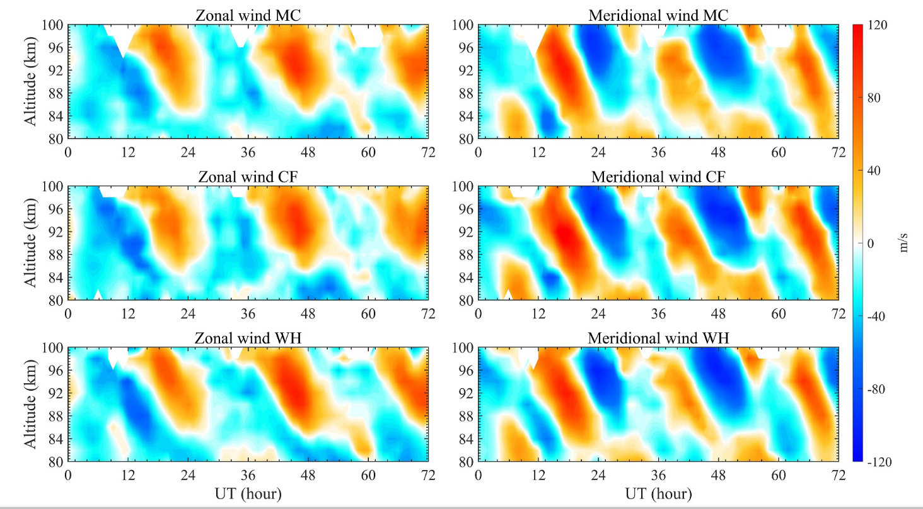
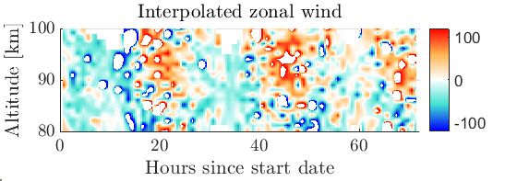
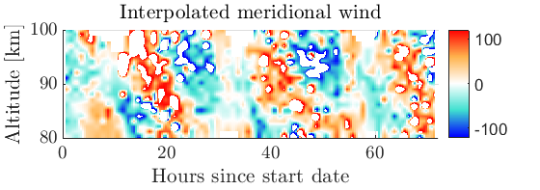
Benchmarking case for code validation
Insert zonal-wind benchmark figure
Validation plot / reference comparison
Good agreement of local minima and maxima
Provided data set seems to have holes
7

Slide 8
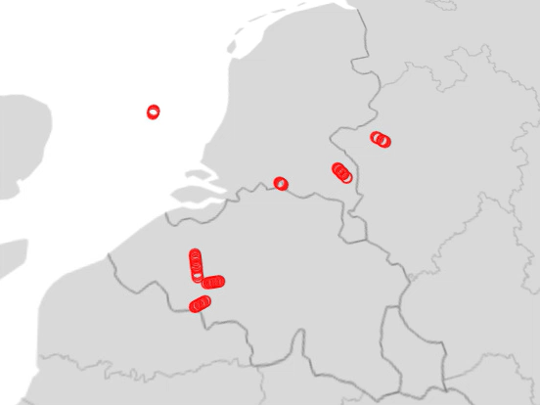
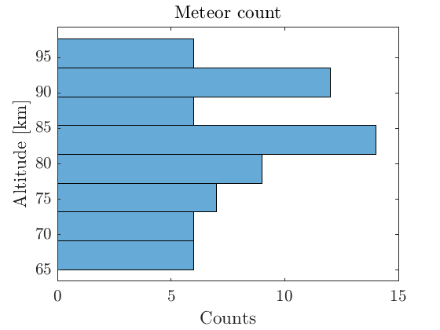
First BRAMS data set: geometry and altitude coverage
BRAMS, 01/04/2026 00:00–01:00 UTC — one hour of specular reflection points and meteor counts per altitude bin.
Insert histogram
Counts of meteors per altitude bin
Specular reflection points
Altitude of specular reflection points
(bin width ≈ 4 km)
8

Slide 9
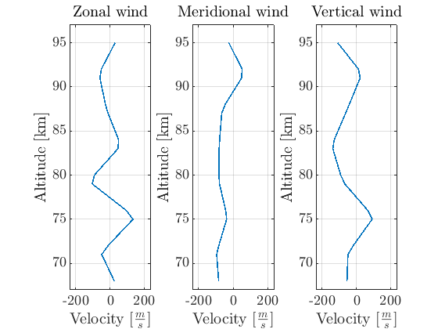
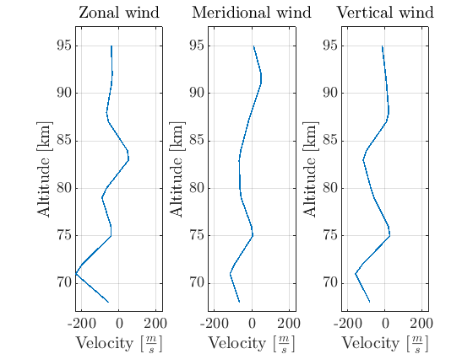
First wind-retrieval result from BRAMS – a first impression 3D
Retrieved zonal and meridional winds.
Velocity based on highest SNR Doppler frequency – 4 km bins
Velocity based on weighted SNR Doppler frequency – 4 km bins
Reference scale for 0th-order winds
Waldteufel & Corbin (1979), Table 1, p. 536: u₀, v₀ ≈ 10–30 m/s and w₀ ≈ 5–10 m/s
9

Slide 10
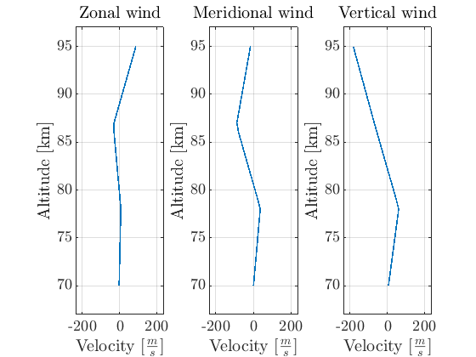
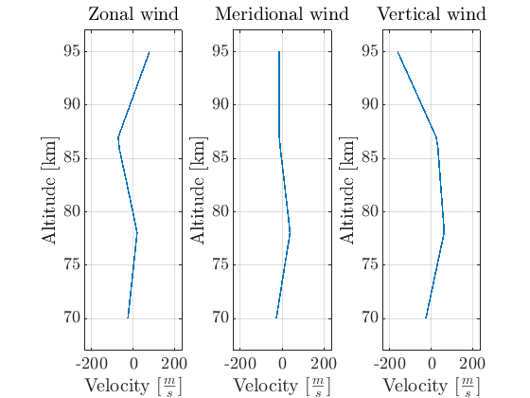
First wind-retrieval result from BRAMS – a first impression 3D
Retrieved zonal and meridional winds.
Velocity based on highest SNR Doppler frequency – 10 km bins
Velocity based on weighted SNR Doppler frequency – 10 km bins
Reference scale for 0th-order winds
Waldteufel & Corbin (1979), Table 1, p. 536: u₀, v₀ ≈ 10–30 m/s and w₀ ≈ 5–10 m/s
9

Slide 11
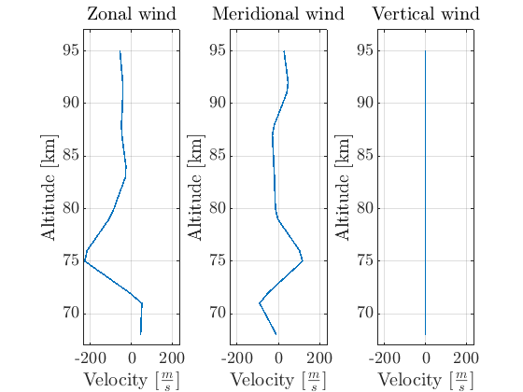
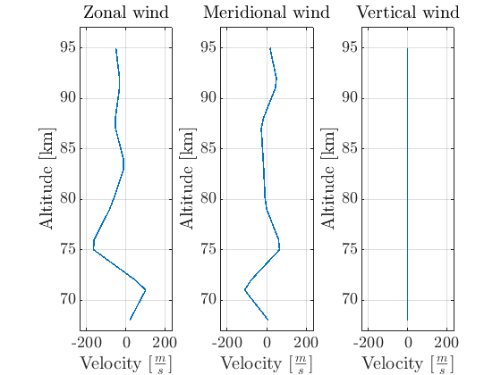
First wind-retrieval result from BRAMS – a first impression 2D
Retrieved zonal and meridional winds.
Velocity based on highest SNR Doppler frequency – 4 km bins
Velocity based on weighted SNR Doppler frequency – 4 km bins
Reference scale for 0th-order winds
Waldteufel & Corbin (1979), Table 1, p. 536: u₀, v₀ ≈ 10–30 m/s and w₀ ≈ 5–10 m/s
9

Slide 12
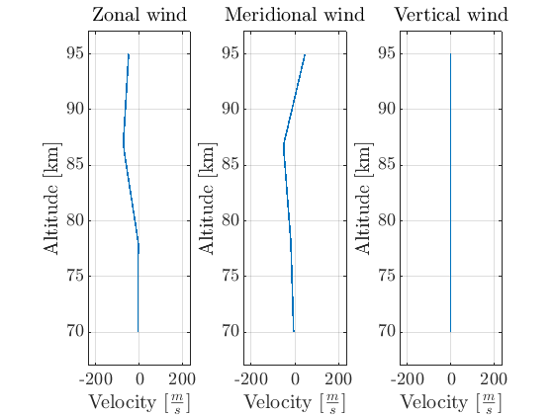
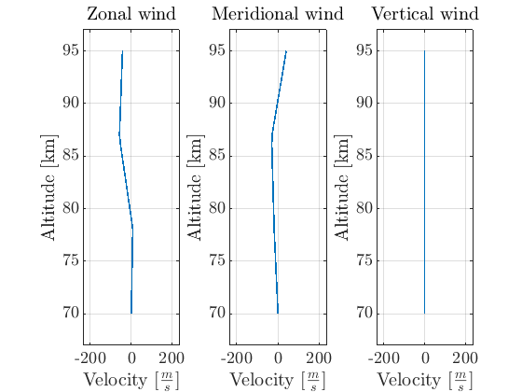
First wind-retrieval result from BRAMS – a first impression 2D
Retrieved zonal and meridional winds.
Velocity based on highest SNR Doppler frequency – 10 km bins
Velocity based on weighted SNR Doppler frequency – 10 km bins
Reference scale for 0th-order winds
Waldteufel & Corbin (1979), Table 1, p. 536: u₀, v₀ ≈ 10–30 m/s and w₀ ≈ 5–10 m/s
9

Slide 13
So what can we conclude?
3D wind retrieval (vertical wind ≠ 0) leads wrong wind fields
  66 useful specular reflection points out of 192 events → increase number of echoes
    Large altitude bin size contain gradients in vertical velocity and increase uncertainty und leads to false vertical wind results
    Small number of events per bin (= smaller bin size) increase uncertainty (10 echoes or more required for sufficient wind retrieval)
    Higher order fluctuations in wind measurement contained → not covered here
2D wind retrieval leads to similar results for single Doppler shift and weighted Doppler shift wind retrieval
Benchmarking case shows proper wind retrieval algorithm
10

Slide 14
What’s next?
Method development
Altitude bin size vs. number of specular points per bin analysis → find trade-off of bin size and meteor count based on existing events
Uncertainty improvement for trajectory and wind retrieval by using interferometry
Higher order wind velocities and uncertainty analysis
Science opportunities
Increase number of echoes per hour (improved pyBRAMS solver meteor echo handling)
Increase number of hours to analyse 24 hours + to visualize tides and compare with data from other radars
11

