Slide 1
Calibration of the BRAMS Interferometers
Johannes Laur
30/05/2026

Slide 2
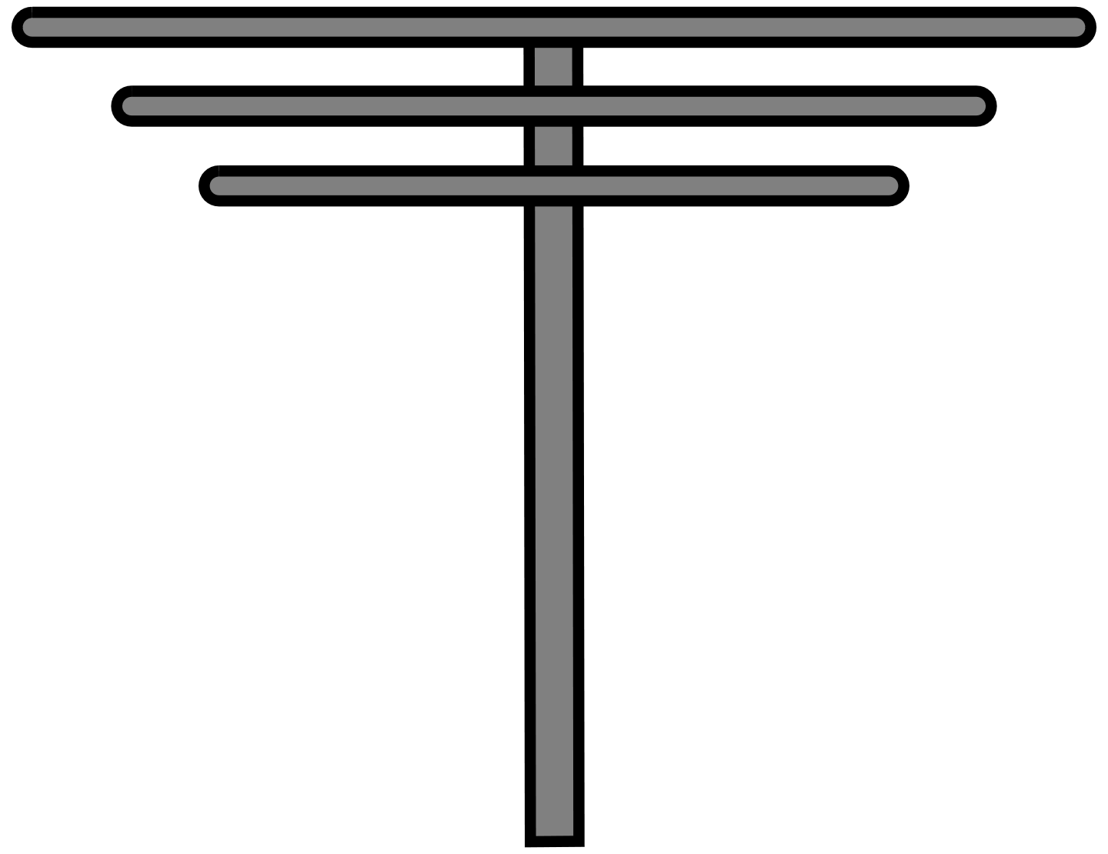
BRAMS Interferometer
Spatial ambiguity due to antenna spacing
> 0.5 ∙ λ
Larger antenna spacing increases accuracy in Angle of Arrival
≈ 15 m (2.5 λ)
≈15 m (2.5 λ)
≈ 12 m (2 λ)
≈ 12 m (2 λ)

Slide 3
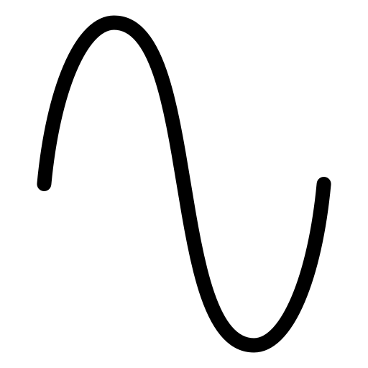
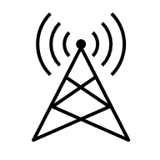
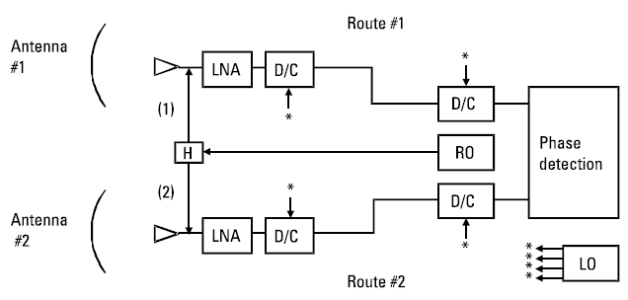







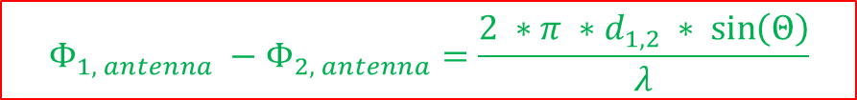
Theory
$$Φ_{1, antenna} −Φ_{2, antenna}=\frac{2 ∗π ∗d_{1,2} ∗ \sin\left(Θ\right)}{λ}$$
$$Φ_{1, antenna}$$
Cable 1
Wave front
Uncertainties
in antenna route
$$Θ$$
$$d_{1,2}$$
$$Φ_{1, measured}$$
?
Rx1
Cable 2
?
Rx2
$$Φ_{2, antenna}$$
$$Φ_{2, measured}$$
$$Φ_{1, measured}=wrappedToPi (Φ_{1, antenna}+mod\left(cable Delay, 2pi\right)+Φ_{offset calibrator}+Φ_{?})$$
$Φ_{?}$ - degradation of components, temperature,

Slide 4


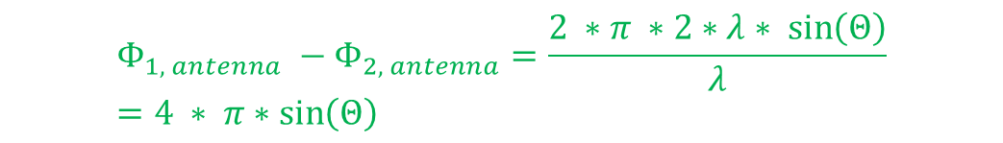







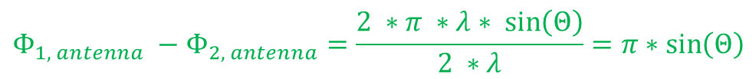

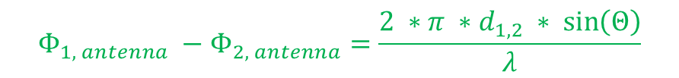
Theory
$$Φ_{1, antenna} −Φ_{2, antenna}=\frac{2 ∗π ∗d_{1,2} ∗ \sin\left(Θ\right)}{λ}$$
$$Φ_{1, antenna}$$
$$Φ_{1, antenna}$$
Wave front
Wave front
$$Θ$$
$$Θ$$
$$d_{1,2}$$
$$d_{1,2}$$
$$Φ_{2, antenna}$$
$$d_{1,2}≤0.5 ∗ λ$$
$d_{1,2}>0.5 ∗ λ (let^{′}s say 2∗π$)
$$Φ_{2, antenna}$$
$$Φ_{1, antenna} −Φ_{2, antenna}=\frac{2 ∗π ∗λ∗ \sin\left(Θ\right)}{2 ∗λ}=π∗\sin\left(Θ\right)$$
$$Φ_{1, antenna} −Φ_{2, antenna}=\frac{2 ∗π ∗2∗λ∗ \sin\left(Θ\right)}{λ}=4 ∗ π∗\sin\left(Θ\right)$$
$$⇒Φ_{1, antenna} −Φ_{2, antenna} ∈[−π, π]$$
$$⇒Φ_{1, antenna} −Φ_{2, antenna} ∈[−4∗π, 4∗π]$$

Slide 5
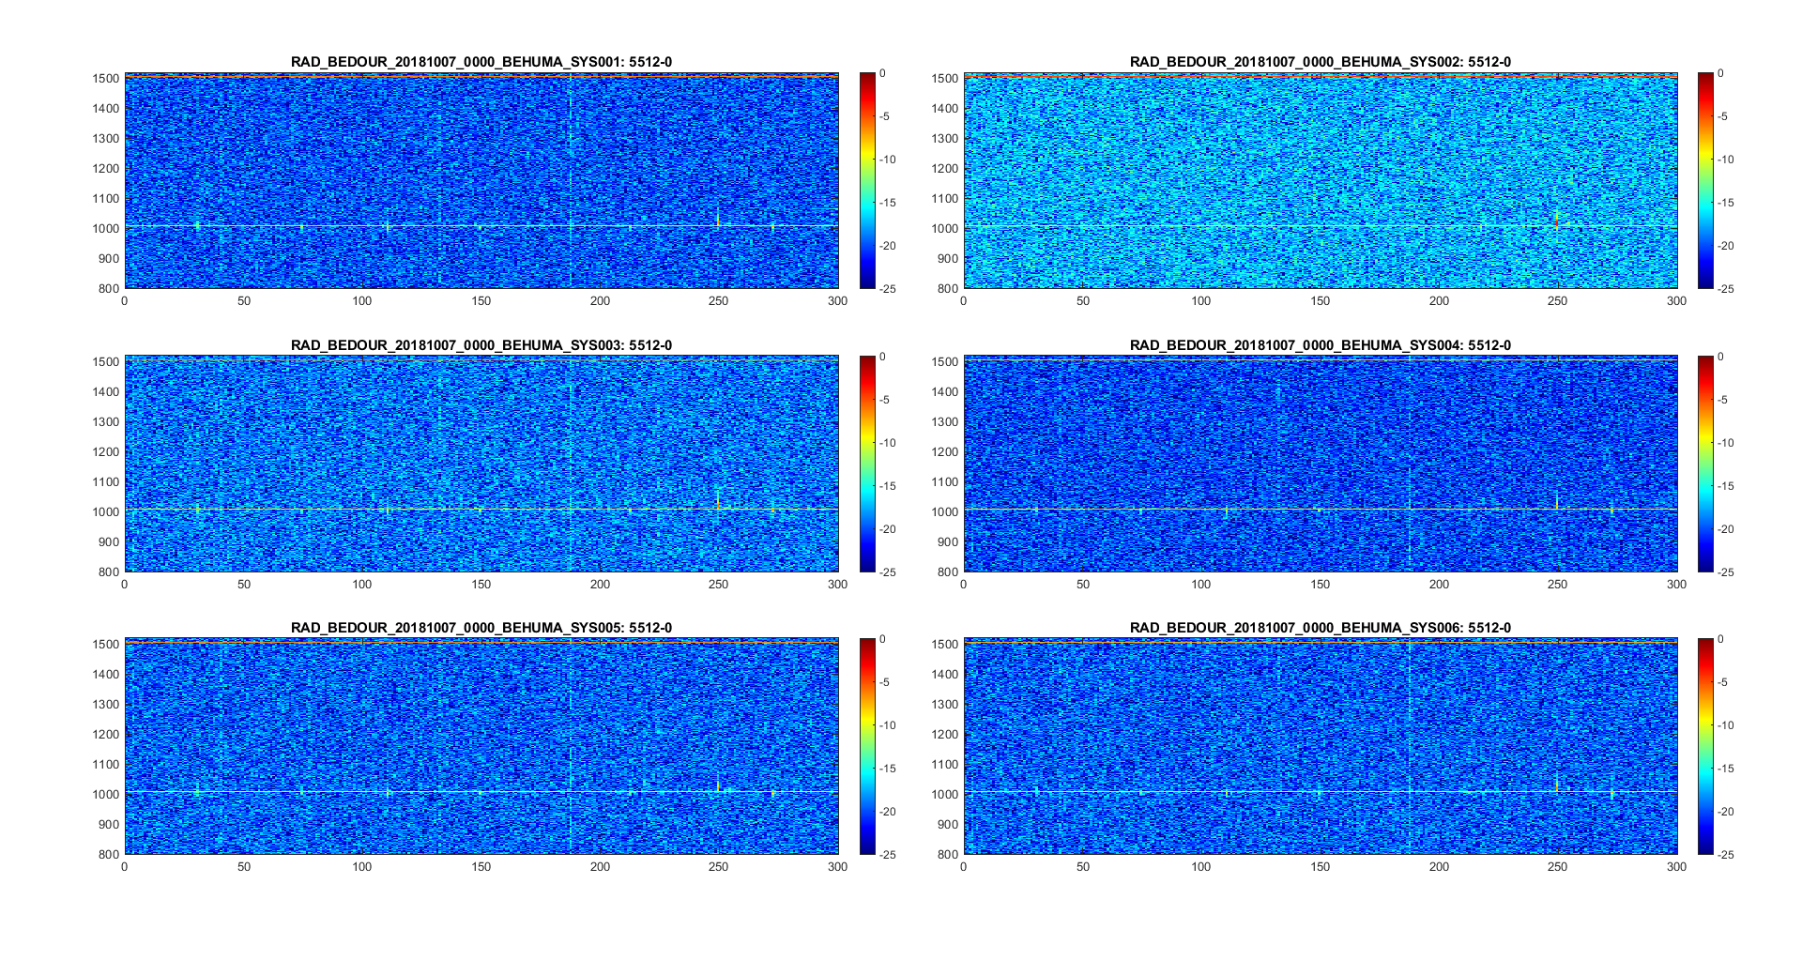
Sanity Check and Calibrator Stability Humain
07/10/2018 00:00 h

Slide 6
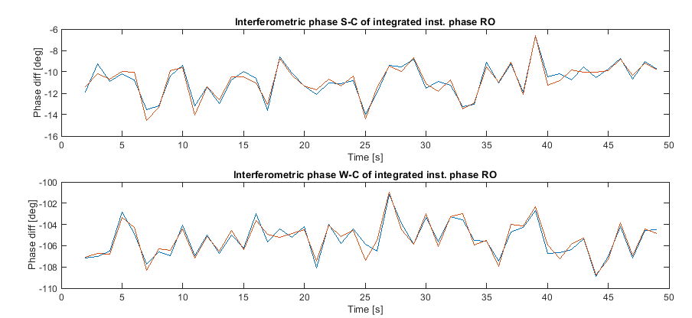
Sanity Check and Calibrator Stability Humain
07/10/2018 00:00 h
± 2.5º
→ expected accuracy/stability ± 0.5°

Slide 7
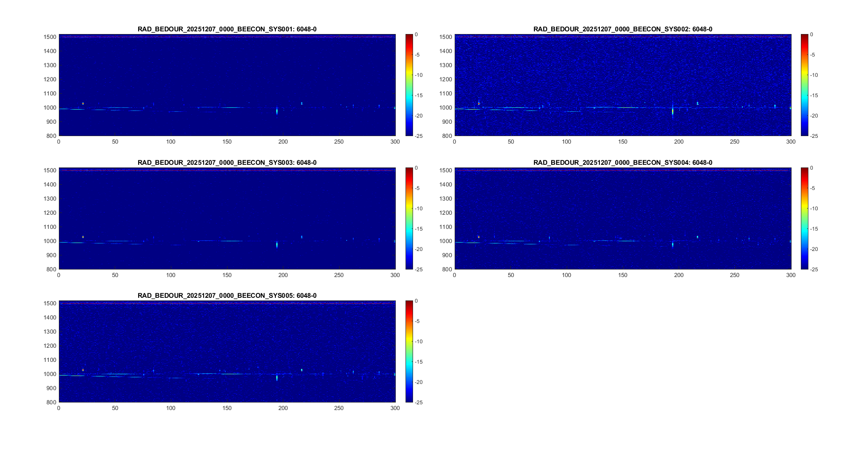
Sanity Check and Calibrator Stability Ecotron
07/10/2025 00:00 h

Slide 8
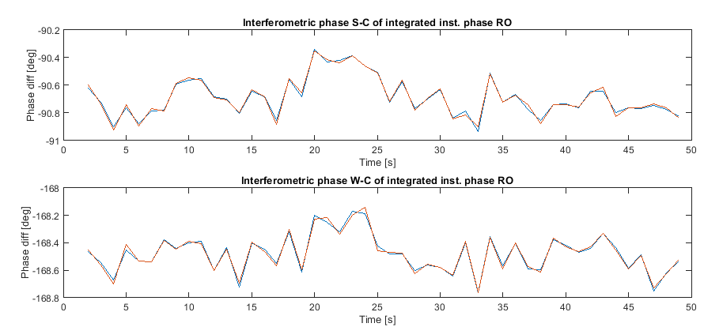
Sanity Check and Calibrator Stability Ecotron
07/12/2025 00:00 h
± 0.35º
→ expected accuracy/stability ± 0.5°

Slide 9
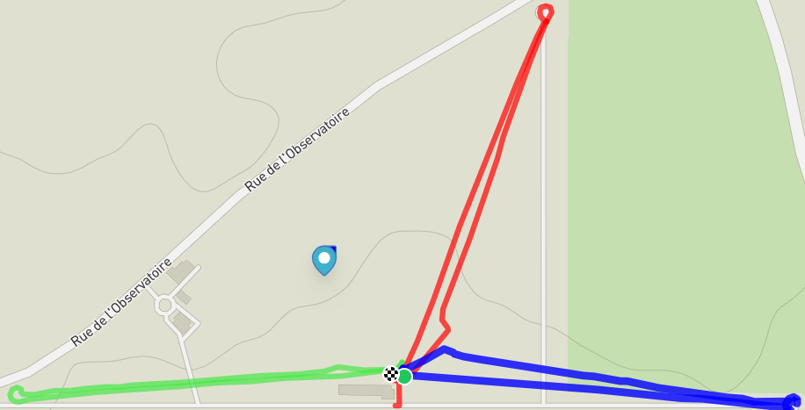

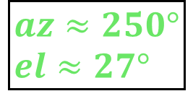
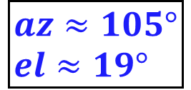
Drone Flight Calibration Campaign Humain
$$az≈39°$$
$el≈26°$
Interferometer
$$az≈250° \\ el≈27°$$
$$az≈105° \\ el≈19°$$

Slide 10
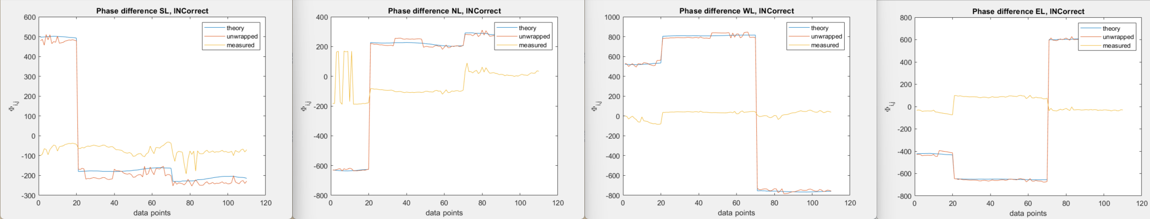
Drone Flight Calibration Campaign Humain
$$Φ_{i,j_true}=Φ_{i,j_antenna}+\frac{360}{2∗π}∗round\left(\left(−2∗\frac{π}{λ}\right)∗\left[\begin{matrix}\left(x_{ant,i}−x_{ant,j}\right) & \left(y_{ant,i}−y_{ant,j}\right) & \left(z_{ant,i}−z_{ant,j}\right)\end{matrix}\right]\left[\begin{aligned}\cos\left(elevation\right)∗\sin\left(azimuth\right) \\ \begin{aligned}\cos\left(elevation\right)∗\cos\left(azimuth\right) \\ \sin\left(elevation\right)\end{aligned}\end{aligned}\right]−Φ_{i,j_antenna}\right)$$
Drone1
Drone2
Drone3
Drone1
Drone2
Drone3
Drone1
Drone2
Drone3
Drone1
Drone2
Drone3

Slide 11
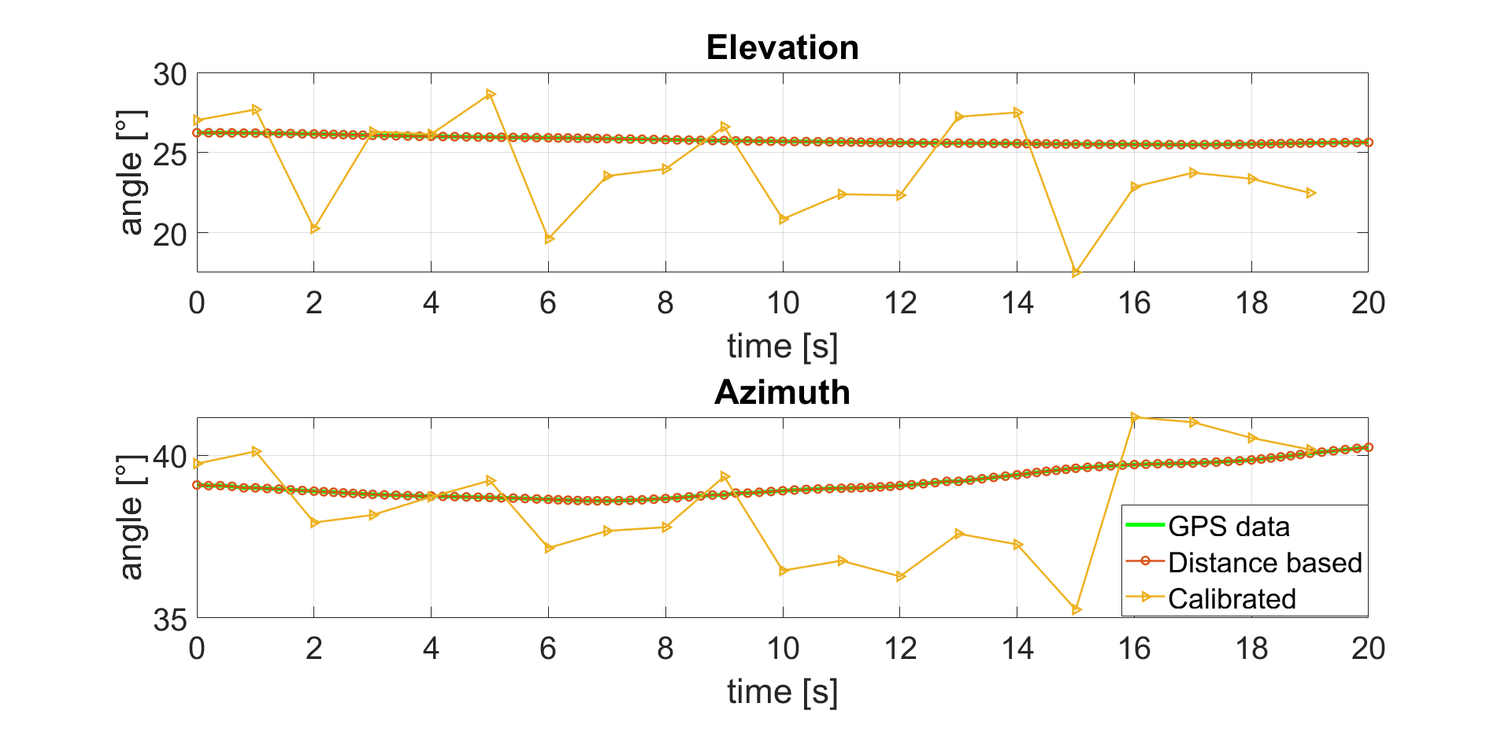
Drone Flight Calibration Campaign Humain
≈ 7º
Drone1
≈ 4.3º

Slide 12
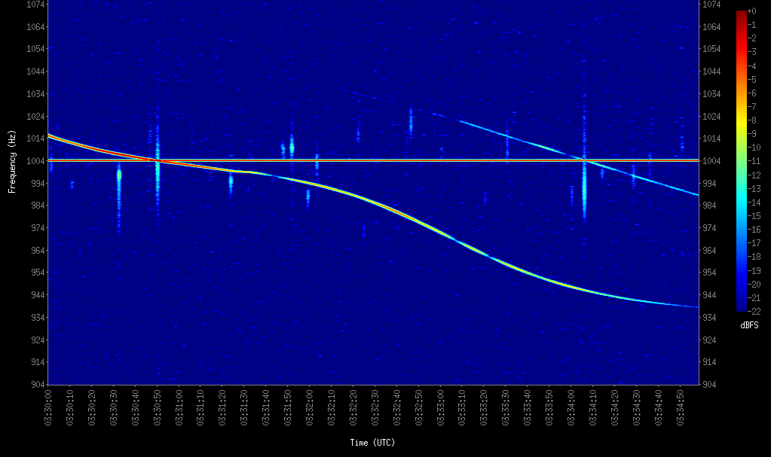
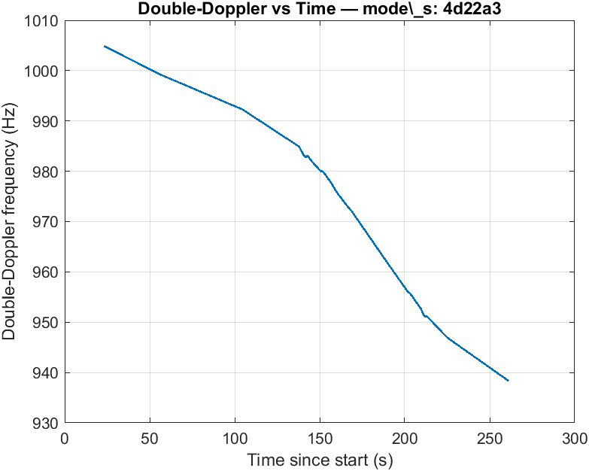
Plane Flight Calibration Campaign Ecotron

Slide 13
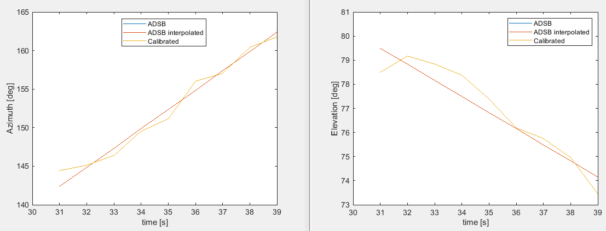
Plane Flight Calibration Campaign Ecotron
≈ 1º
< 1º
≈ 1.3º
≈ 2.1º

Slide 14
What’s next
New drone flights
  Humain:
    Existing receivers
    New receivers
  Ecotron: TBD
Calibration for system offset (self-calibration)
  Implementing the “dtm” – Method to analyse and calibrate the existing data
    Analysis on required number of time step (*.wav files)
    Identification of phase change over time (reboot, etc.)

