Slide 1
Status of the BRAMS network
H. Lamy
BRAMS Annual Meeting
Grimbergen, 30/05/2026

Slide 2
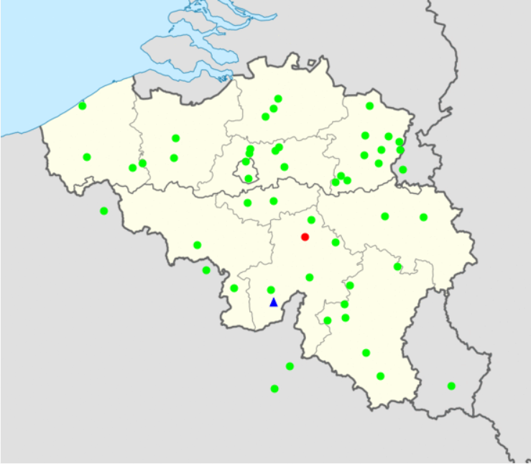
BRAMS receiving stations
52 stations
4 stations with ICOM left : BEOTTI, BEKAMP, BEGRIM, BEREDU
7 Boxes with Rock 4SE instead of Rpi : BEHARE, BELANG, BEGENT, BESIVR, BELIEG, BELEUZ, FRMAUB
2 stations with very poor SNR : BEOOSE, BEMAAM

Slide 3
New remote control and data transfer
Reverse ssh is used for both data transfer and remote control
This replaces respectively transfer to our web server (brams_communicator) and Hamachi

Slide 4
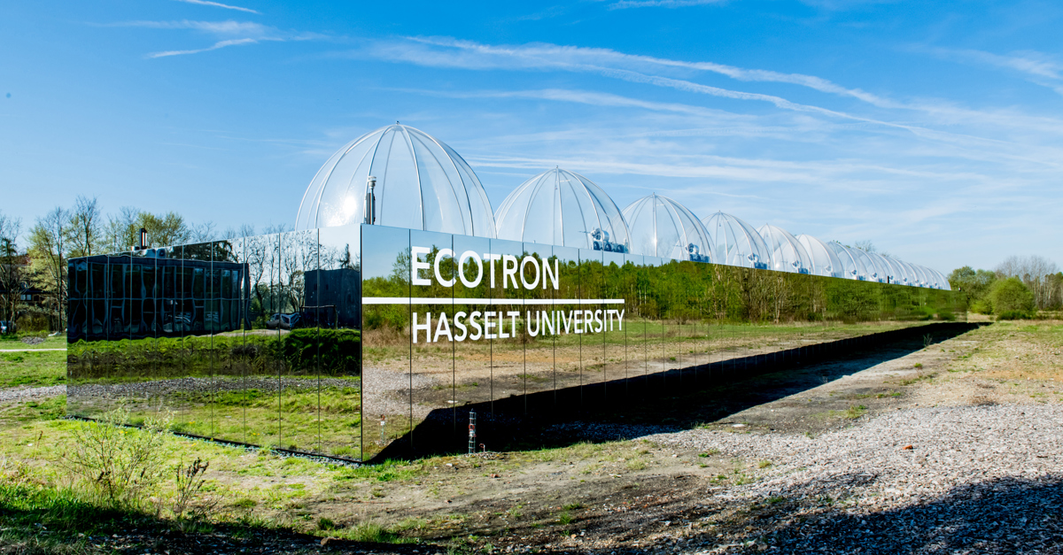
One new interferometer in Ecotron
Excellent site in terms of SNR

Slide 5
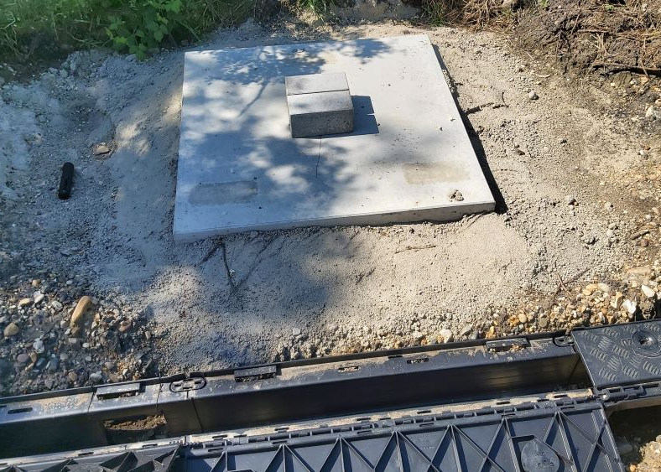
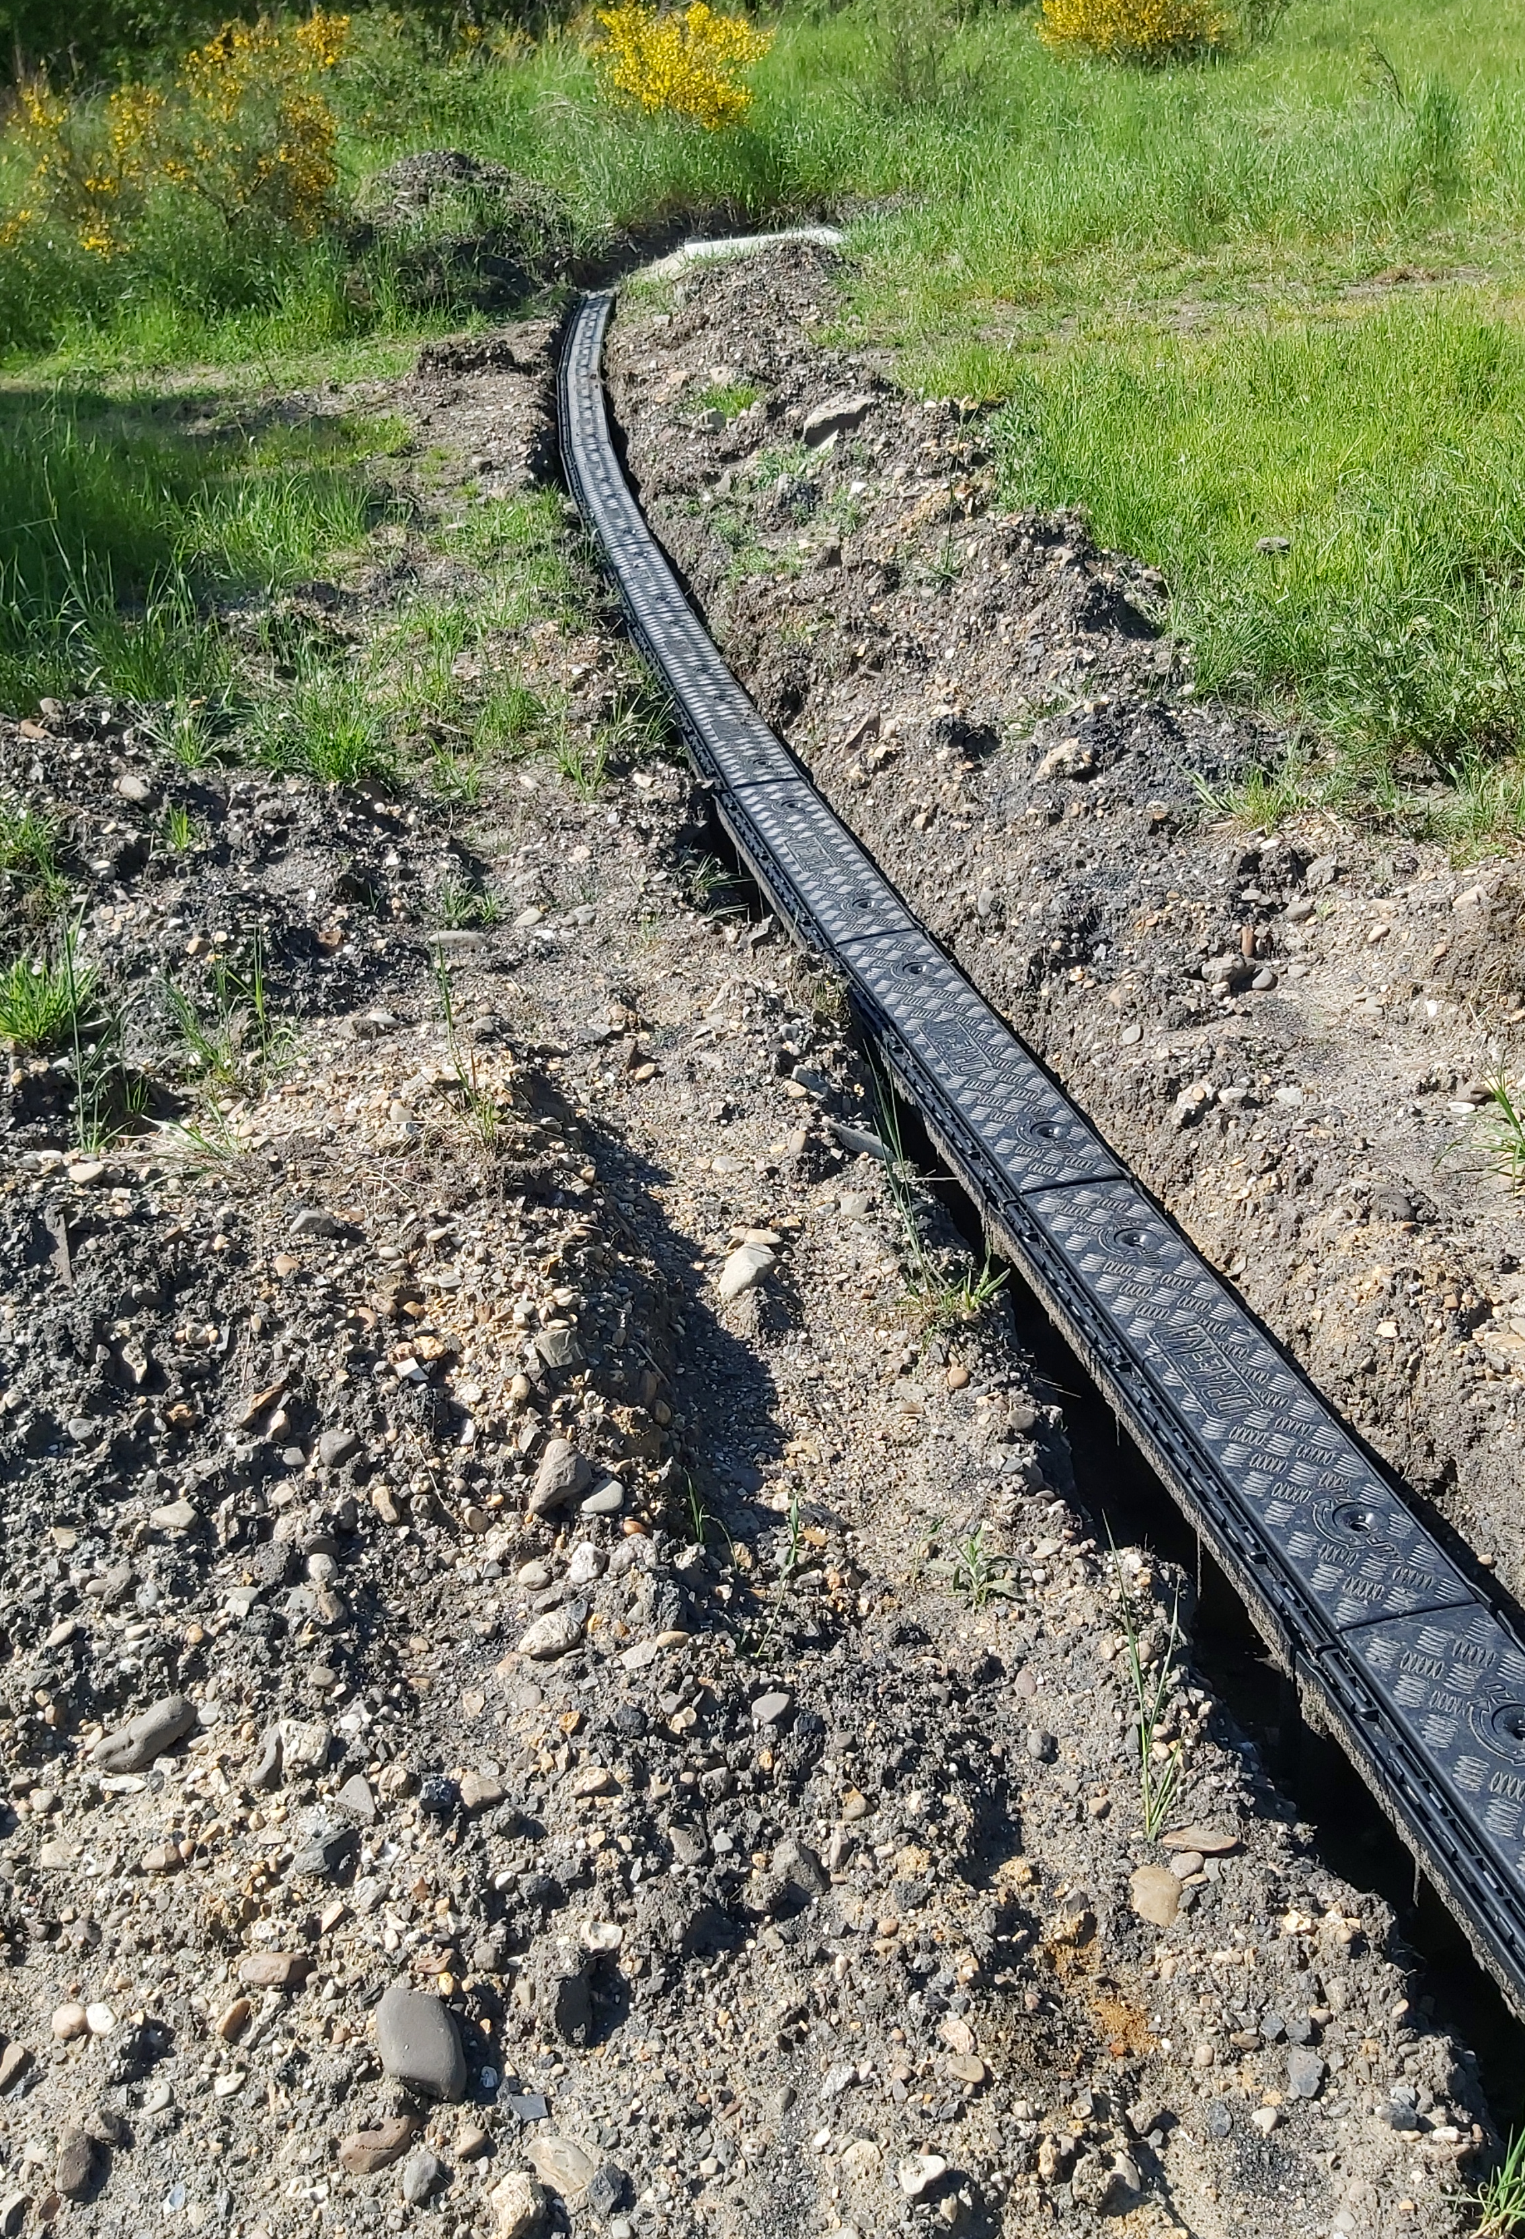
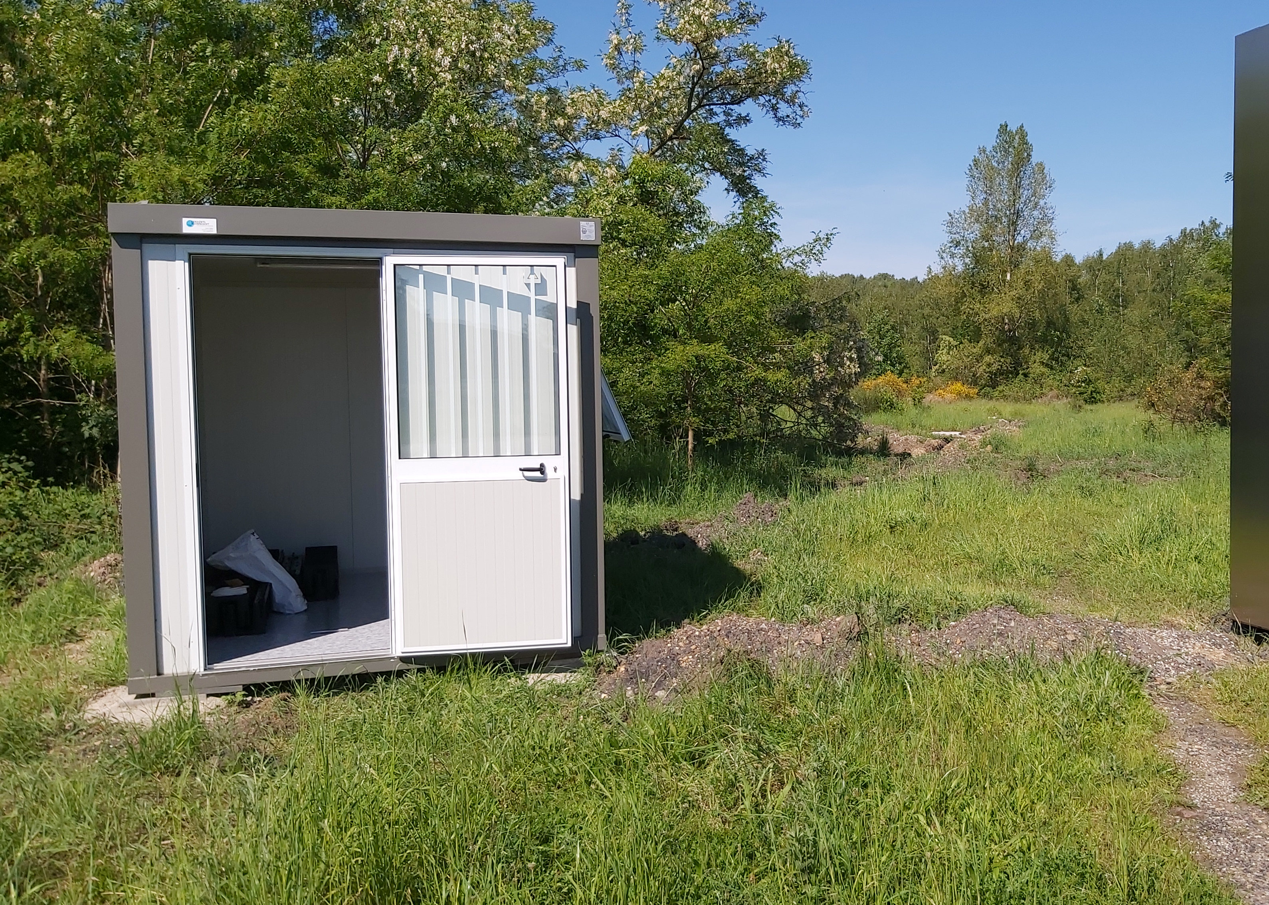
One new interferometer in Ecotron

Slide 6
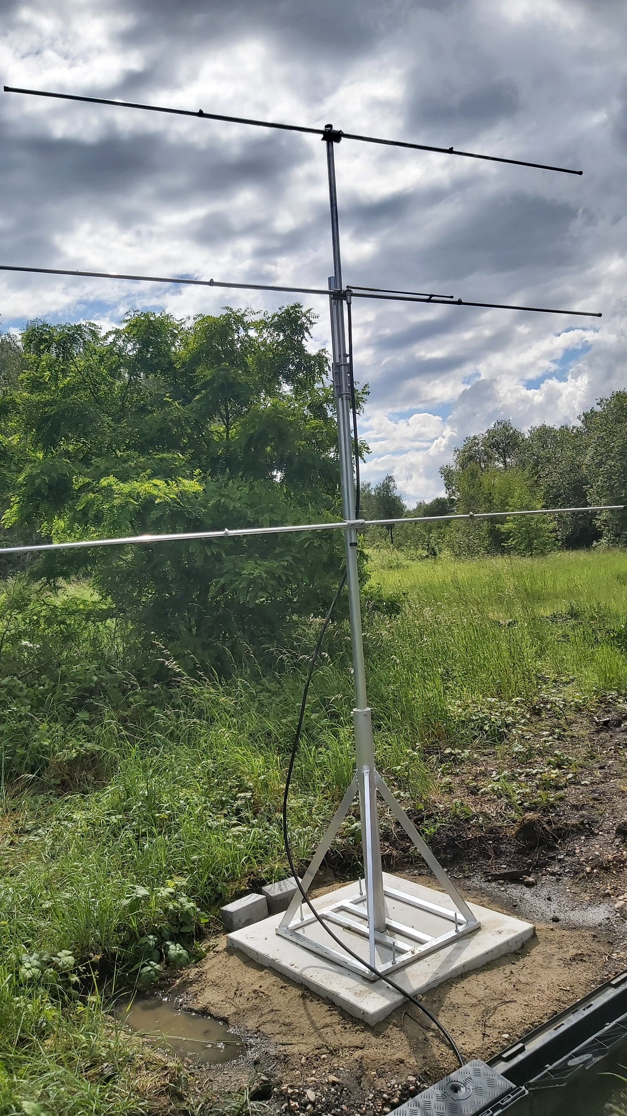
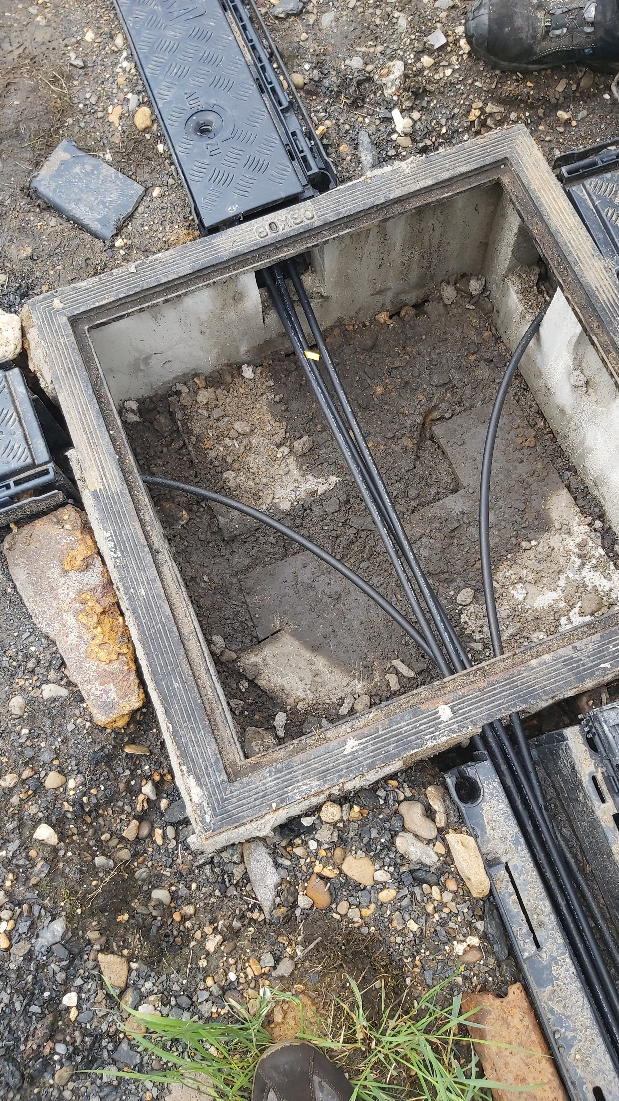
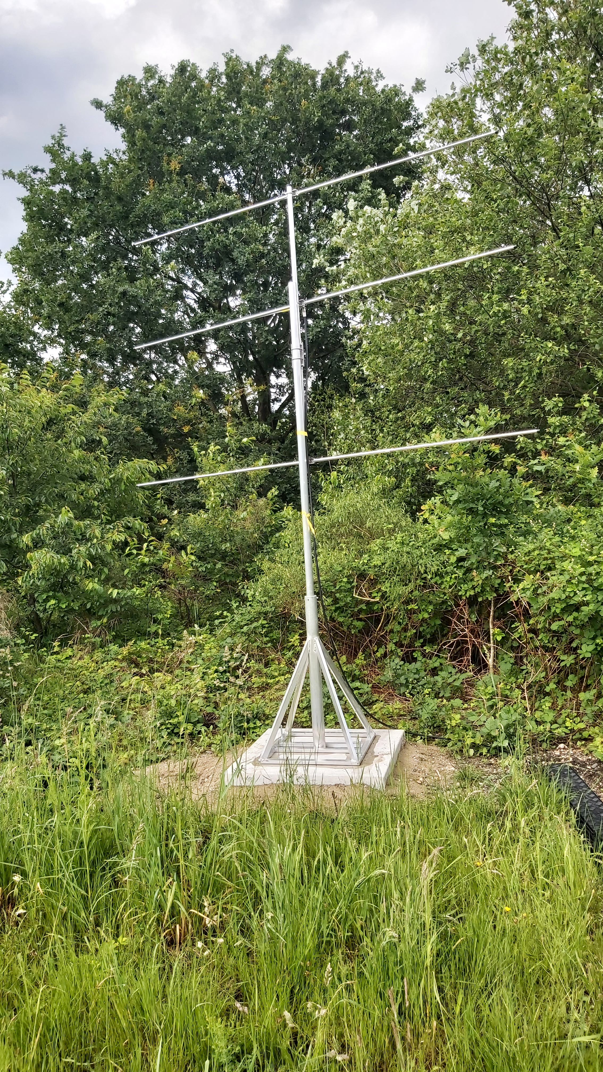
One new interferometer in Ecotron

Slide 7
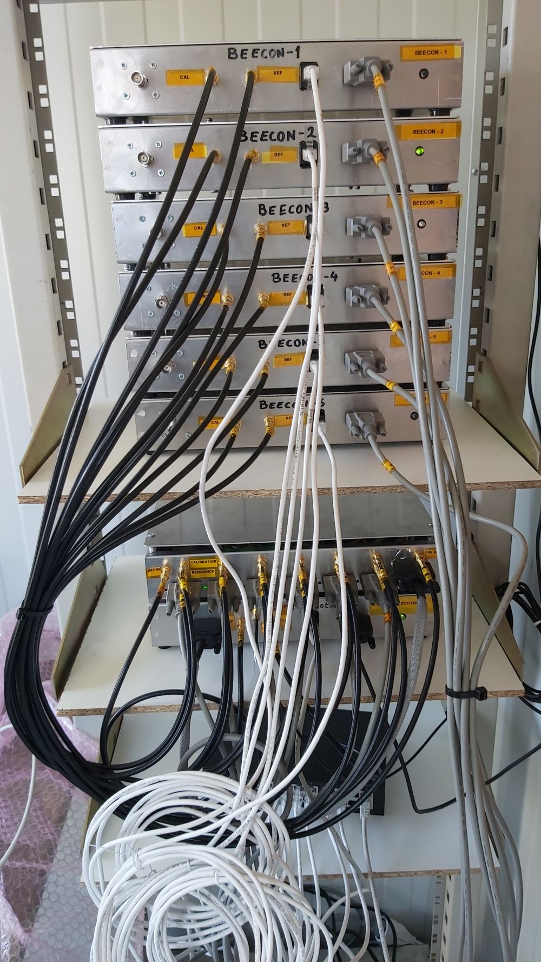
One new interferometer in Ecotron
One Master Box
One Distribution box (Calibrateur, GPSDO for 24 MHz reference, GPS for 1PPS+NMEA)

Slide 8
Lessons learnt from interferometer in Humain
Use of gutters → easier to install and possibly replace the coaxial cables
Center phases of antennas at same height (within 1-2 cm)
Matching elements of antennas protected with self-fusing tape → no problem with intensity of the calibrator signal
Linux, no more Windows → better stability
Better stability of the sampling frequency (previous sampler in Humain was not controlled by an external frequency reference)
Additional difficulty : sampling is made independently for each Rx and controlled by different Rpi → lack of synchronicity due to various states of OS on the Rpis → solution : modified calibrator (see talk by Michel)

Slide 9
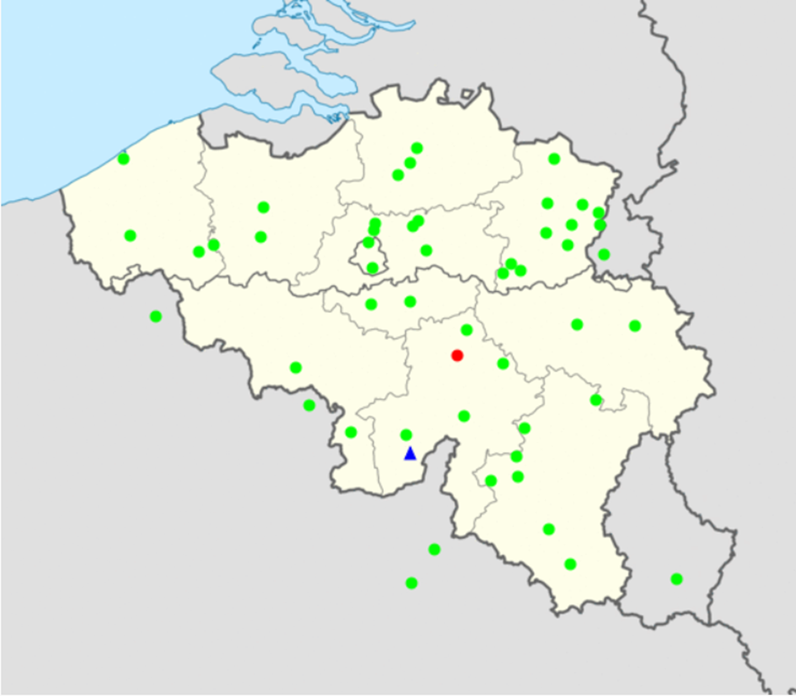
New stations
Lonzée (near Gembloux)
Loupoigne (near Genappes)
Havelange (near Marche-en-Famenne)
Durbuy
Bocholt
Candidates?

Slide 10

Second transmitter?
Idea : have a second Tx transmitting 2 KHz above the current beacon such that meteor echoes will appear around 1 KHz for BRAMS beacon 1 and 2 KHz for BRAMS beacon 2
Double number of pairs Tx-Rx
Location : not much has been done → contact with SCK-CEN, TABLOO …. But nothing concrete yet
Any suggestion?

Slide 11
Projects
SORBET → Ending in 2026
PhD Hugo Joly → until December 2029
MAMBO (Mass and ionisAtion of Meteoroids from BRAMS observations) → P4S Call → not selected
MIMBO (Mass and Ionisation of Meteoroids from BRAMS observations) → FNRS call → answer around mid-June → if not selected, the candidate Zara Zaman (CAN) will present a similar project at FRIA later this year
INTERCEPTOR ( sIgNaTure of hypERsoniC objEcts: dual aPplicaTiOn of fiReballs, VKI leads) → DEFRA call → answer by mid-September
STCE (Solar Terrestrial Center of Excellence)

