Slide 1
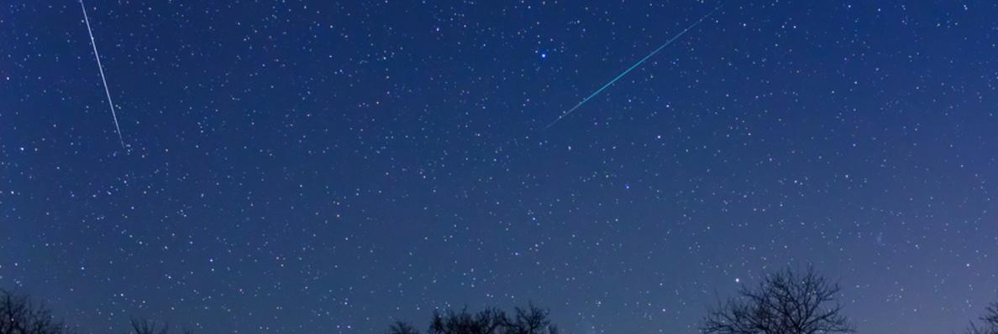




From radio meteor count rates to real meteor shower activity
S. Calders, J. De Keyser, H. Lamy, K. Kolenberg
ROYAL BELGIAN INSTITUTE FOR SPACE AERONOMY

Slide 2

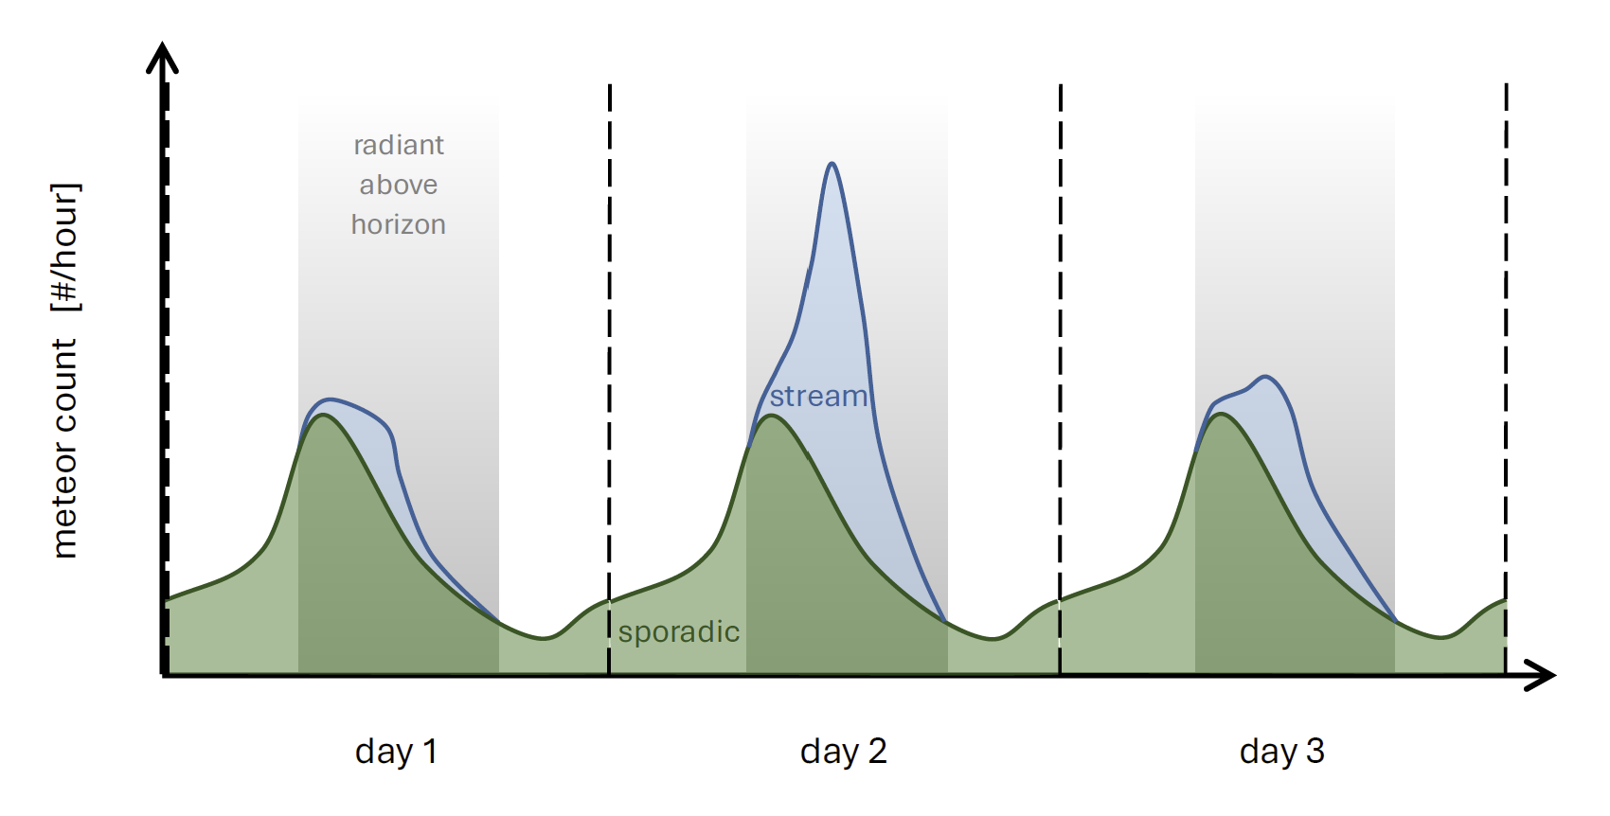
Observed count rates are not intrinsic shower activity
Notes:
Count rates are affected by:
sporadics
station observability
noise
We want to recover the intrinsic shower activity.
How can we statistically distinguish which meteors belong to a specific shower, given that single-station radio forward scatter data alone cannot reliably separate shower meteors from sporadic background activity?
Forward scatter radio data from a single or a small number of stations are not enough to say whether a detected meteor belongs to a shower or is part of the sporadic background.
This means that any separation between shower activity and background must be done statistically.

Slide 3
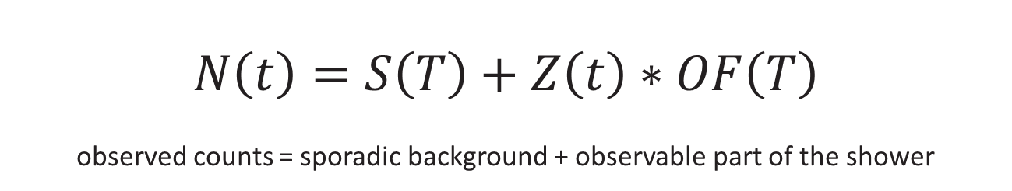
Core idea
$$N\left(t\right)=S\left(T\right)+Z\left(t\right)∗OF\left(T\right)$$
observed counts = sporadic background + observable part of the shower
Known from observations:
N(t): observed meteor count rate
Unknown components:
S(T): daily sporadic background
OF(T): station-dependent observability
Z(t): intrinsic shower activity
Goal: recover Z(t), the intrinsic shower activity
Steyaert et al. (2006), WGN, 34, 87–93
Notes:
Briefly summarize Steyaert’s original approach:
The number of observed meteors is the sum of the number of sporadic meteors and the number of observed shower meteors.
Uses a double-exponential profile for shower activity.
But not all shower meteors can be observed, e.g. when the radiant is below the horizon. The OF captures the fraction of shower meteors that can be observed.
Fits count-rate profiles per local time independently.

Slide 4
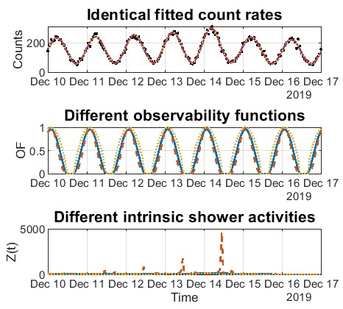
This problem is ill-posed
Different combinations of S(T), OF(T) and Z(t) can produce identical count rates
Good fits do not guarantee unique physical solutions
Multi-station data and constraints help break these degeneracies
Calders et al. (2026), WGN, 54:1, 15–19
Notes:
At first sight, the problem looks simple: we observe count rates and fit a model.
(wijs naar bovenste panel)
“Here, the three fitted curves are essentially identical from the point of view of the observations.”
(wijs naar middelste panel)
“But these fits correspond to very different observability functions.”
(wijs naar onderste panel)
“And therefore also to very different intrinsic shower activity profiles.”
→ So a good fit does not automatically imply a unique physical solution.
This is the core degeneracy problem in single-station count-rate inversion.
That is why we need additional constraints, uncertainty estimation, and ideally multi-station observations.

Slide 5
How do we improve this?
Steyaert already mentioned some limitations, that we tried to solve:
  Weighted fitting using Poisson statistics
  Multi-station support
  A priori constraints / regularization
  Monte Carlo uncertainty estimation
De Keyser et al. (2026), Planetary and Space Science
Notes:
A priori constraints:
Forced sporadic variation
OF=0 when radiant below horizon
Regularization: e.g. sporadic variation is smooth
Adding more stations doesn’t help, but you can assume shared shower parameters

Slide 6
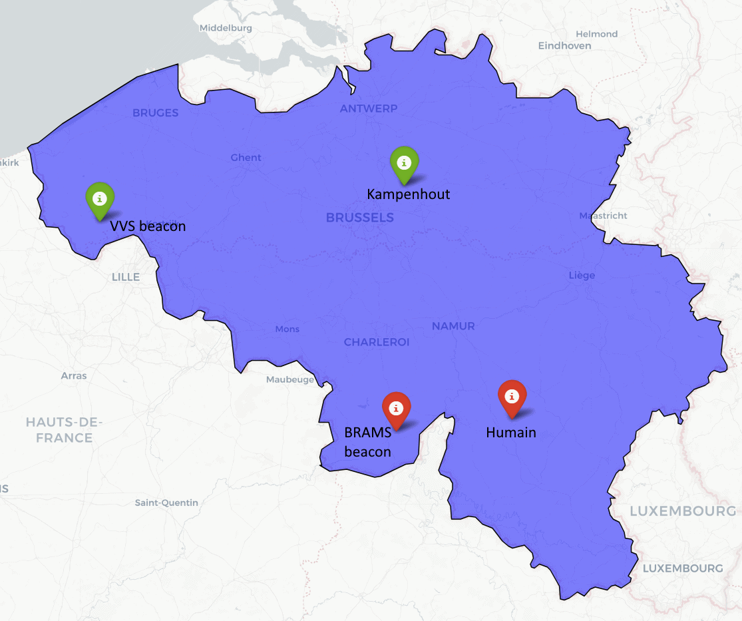
Example: Geminids 2019 with two stations
Notes:
Both are forward scatter, but using different transmitter/receiver. One station observing the VVS beacon, one the BRAMS beacon.
Mention RMZ

Slide 7
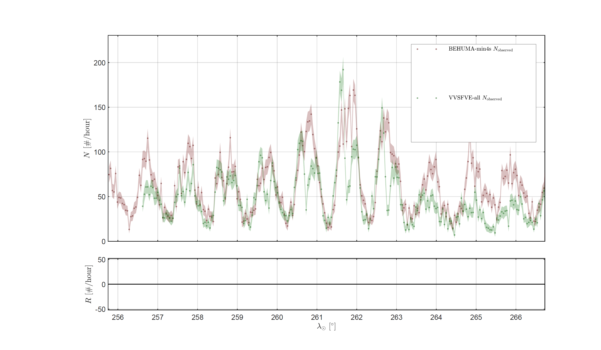
2019 Geminids forward scatter radio data from BEHUMA and VVSFVE
Observed meteors
Humain >4 sec
Kampenhout (all)
Notes:
We will fit the meteor shower, assuming shared shower parameters.
9-19 December 2019
Geminids

Slide 8
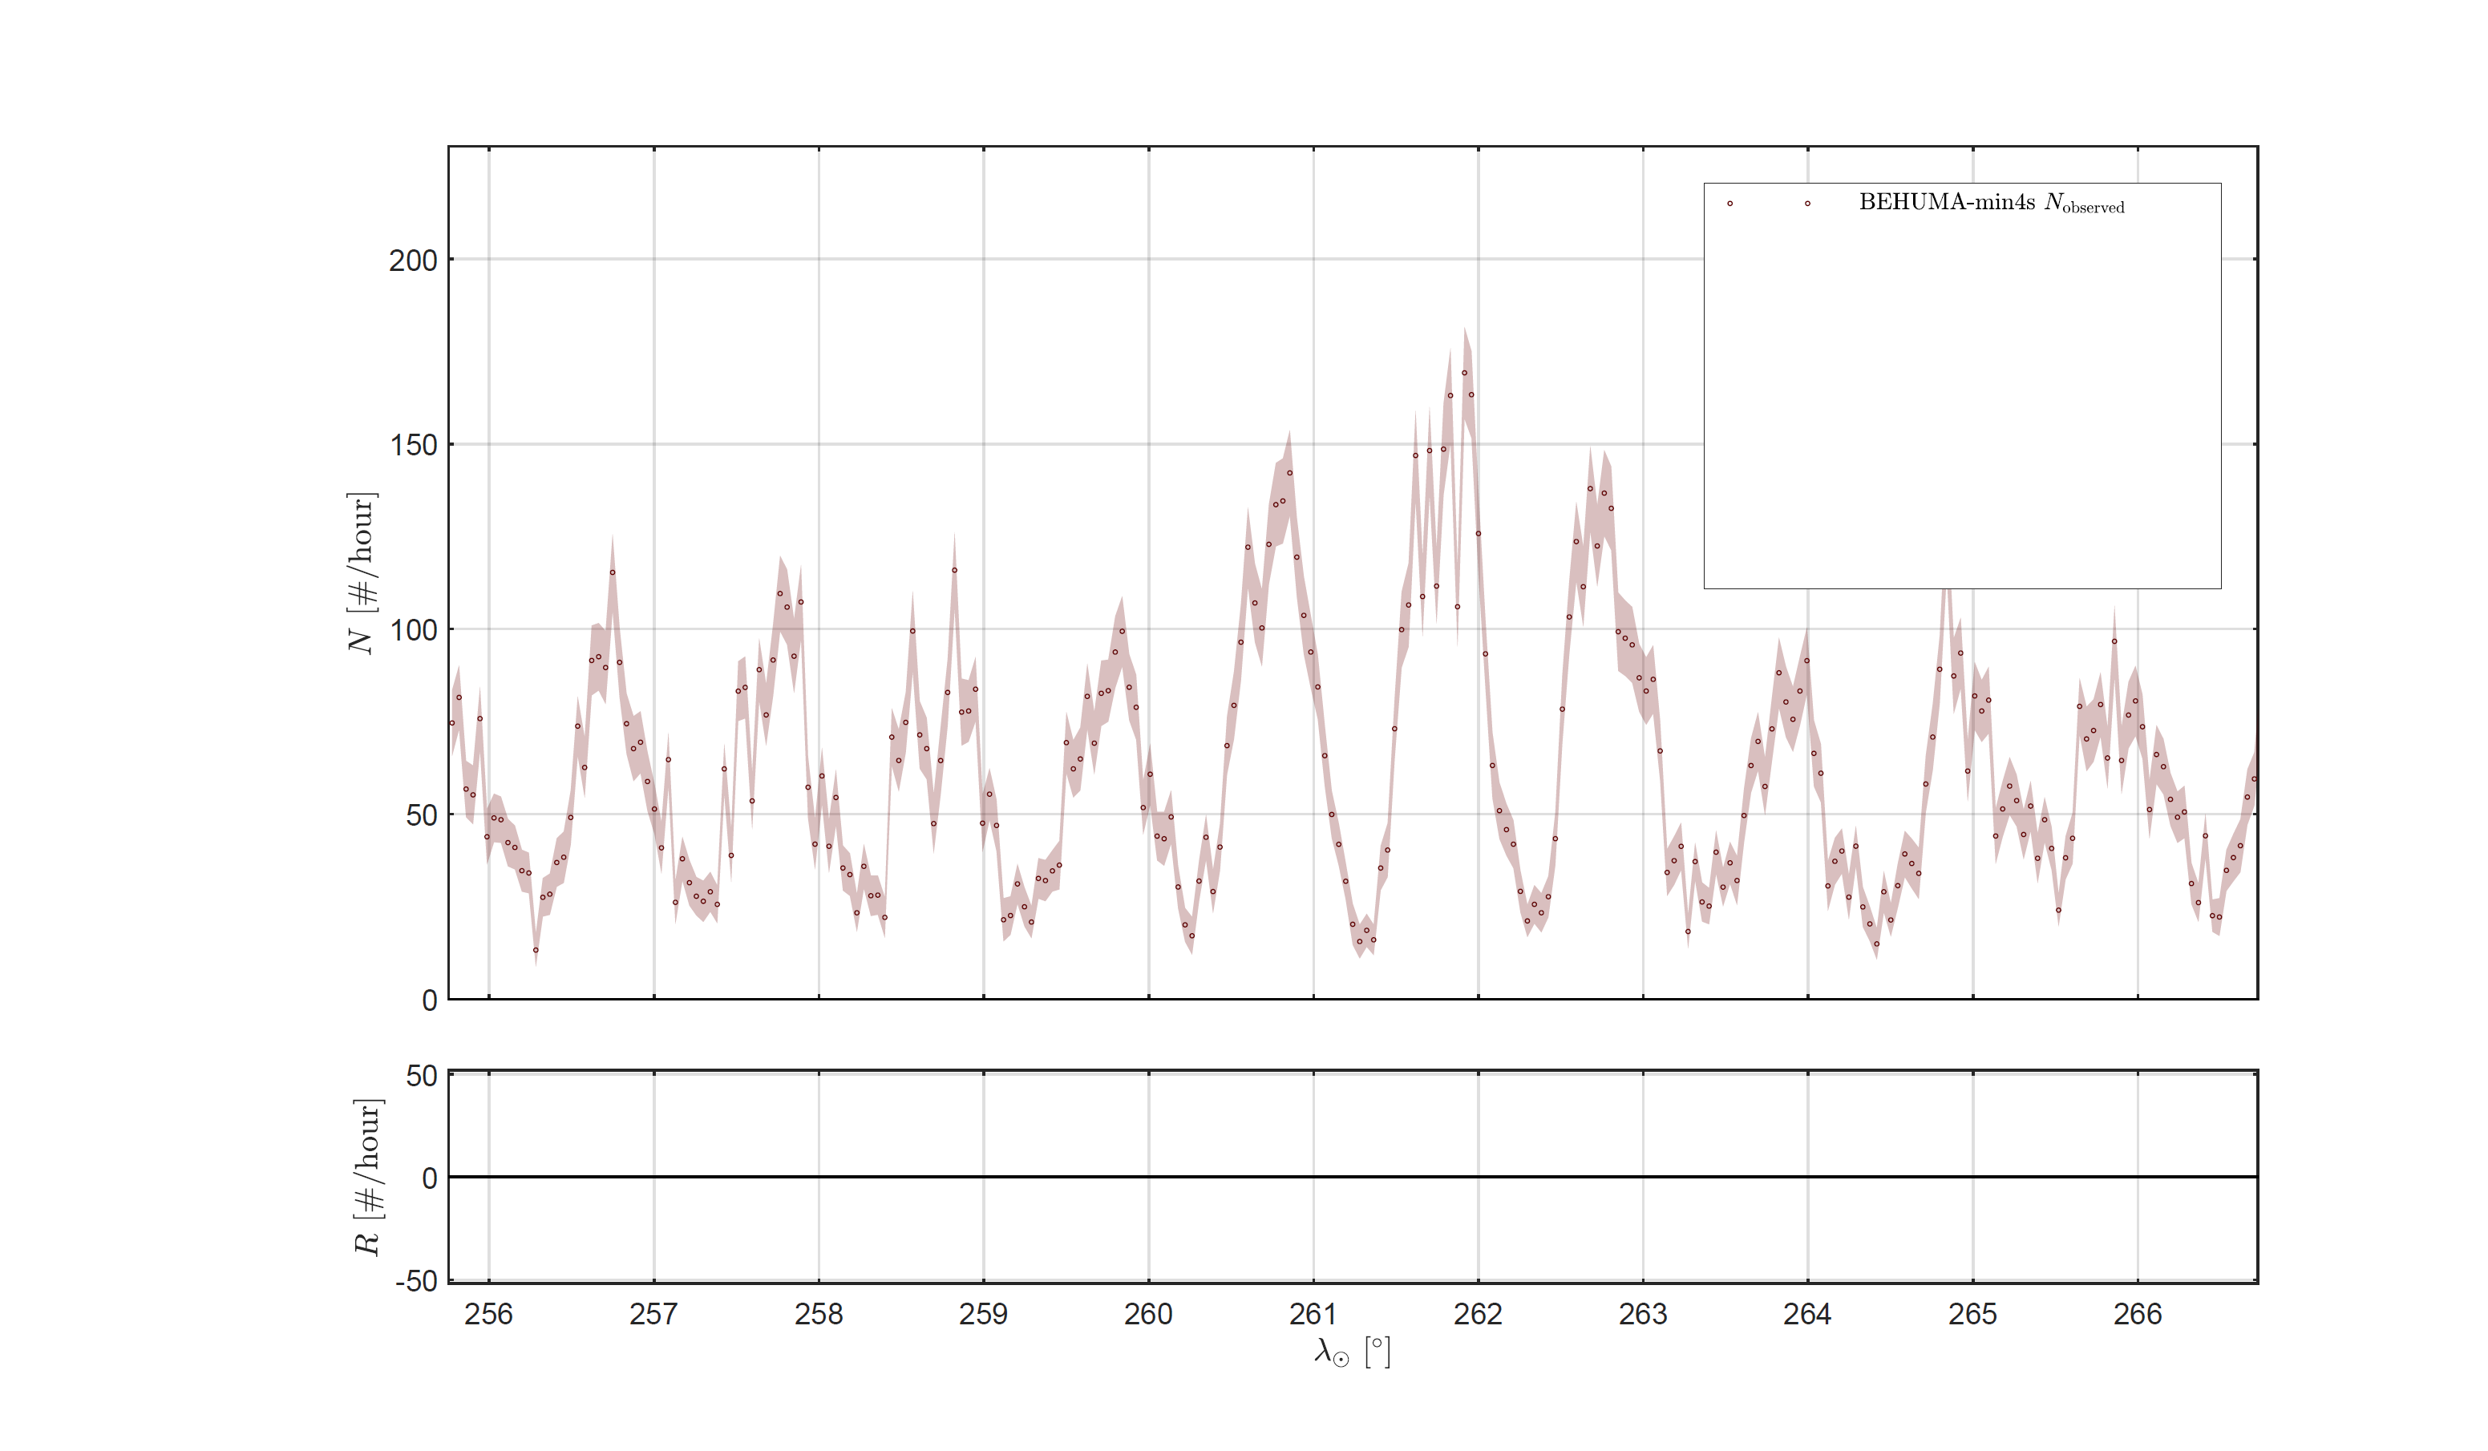
2019 Geminids data from BEHUMA alone
Observed meteors
Humain >4 sec

Slide 9
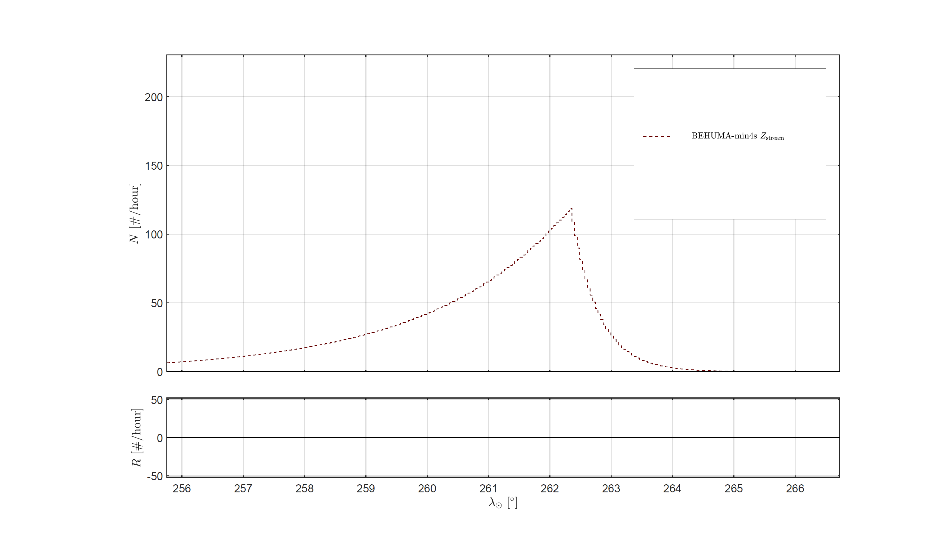
2019 Geminids flux model using a double-exponential profile
Notes:
This would be the number of observed shower meteors if the OF=1

Slide 10
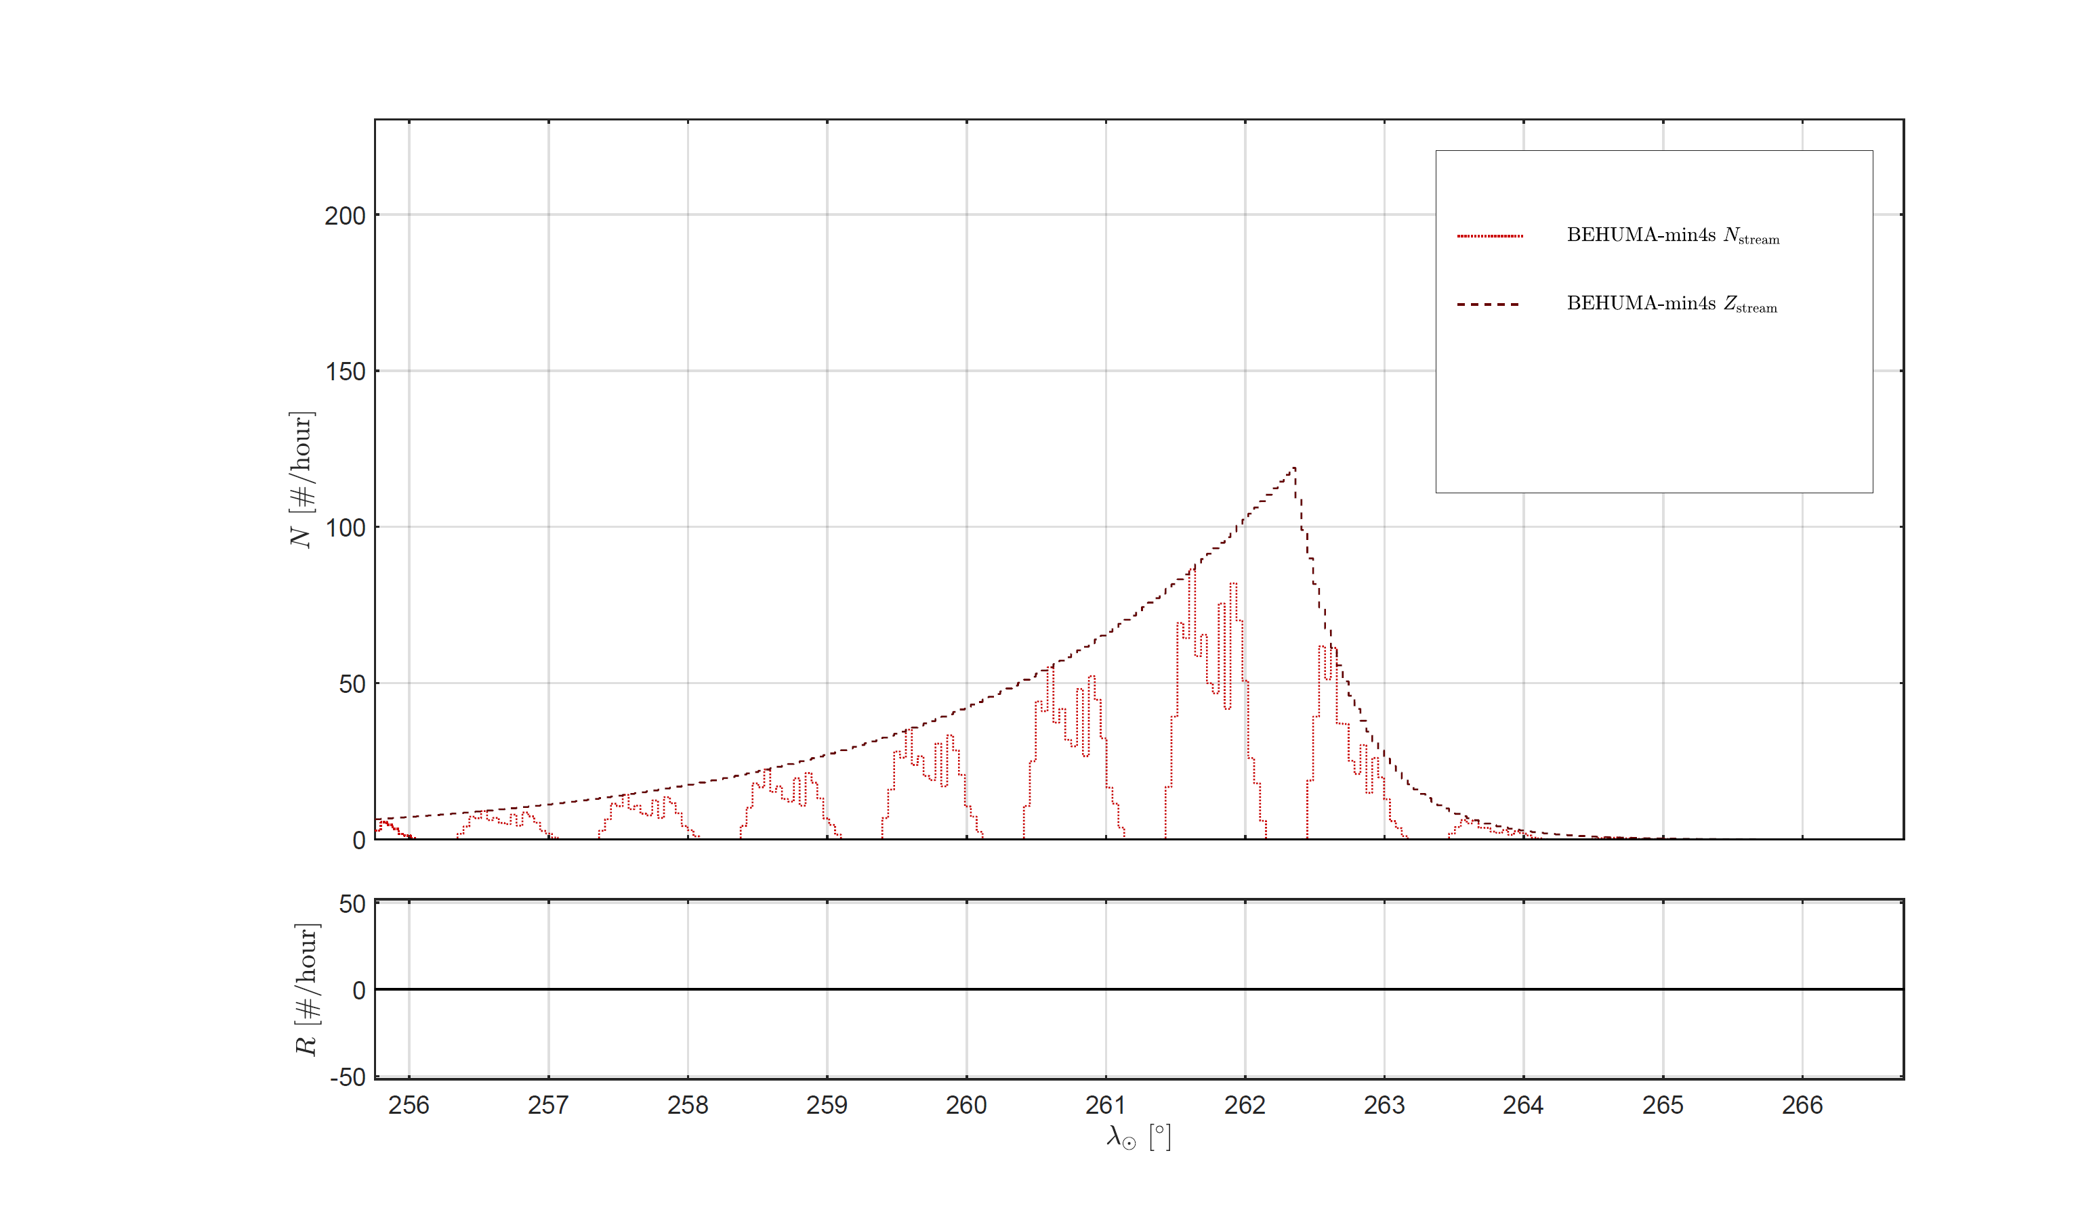
2019 Geminids flux observable at BEHUMA accounting for observability function
Notes:
These are the real observed shower meteors

Slide 11
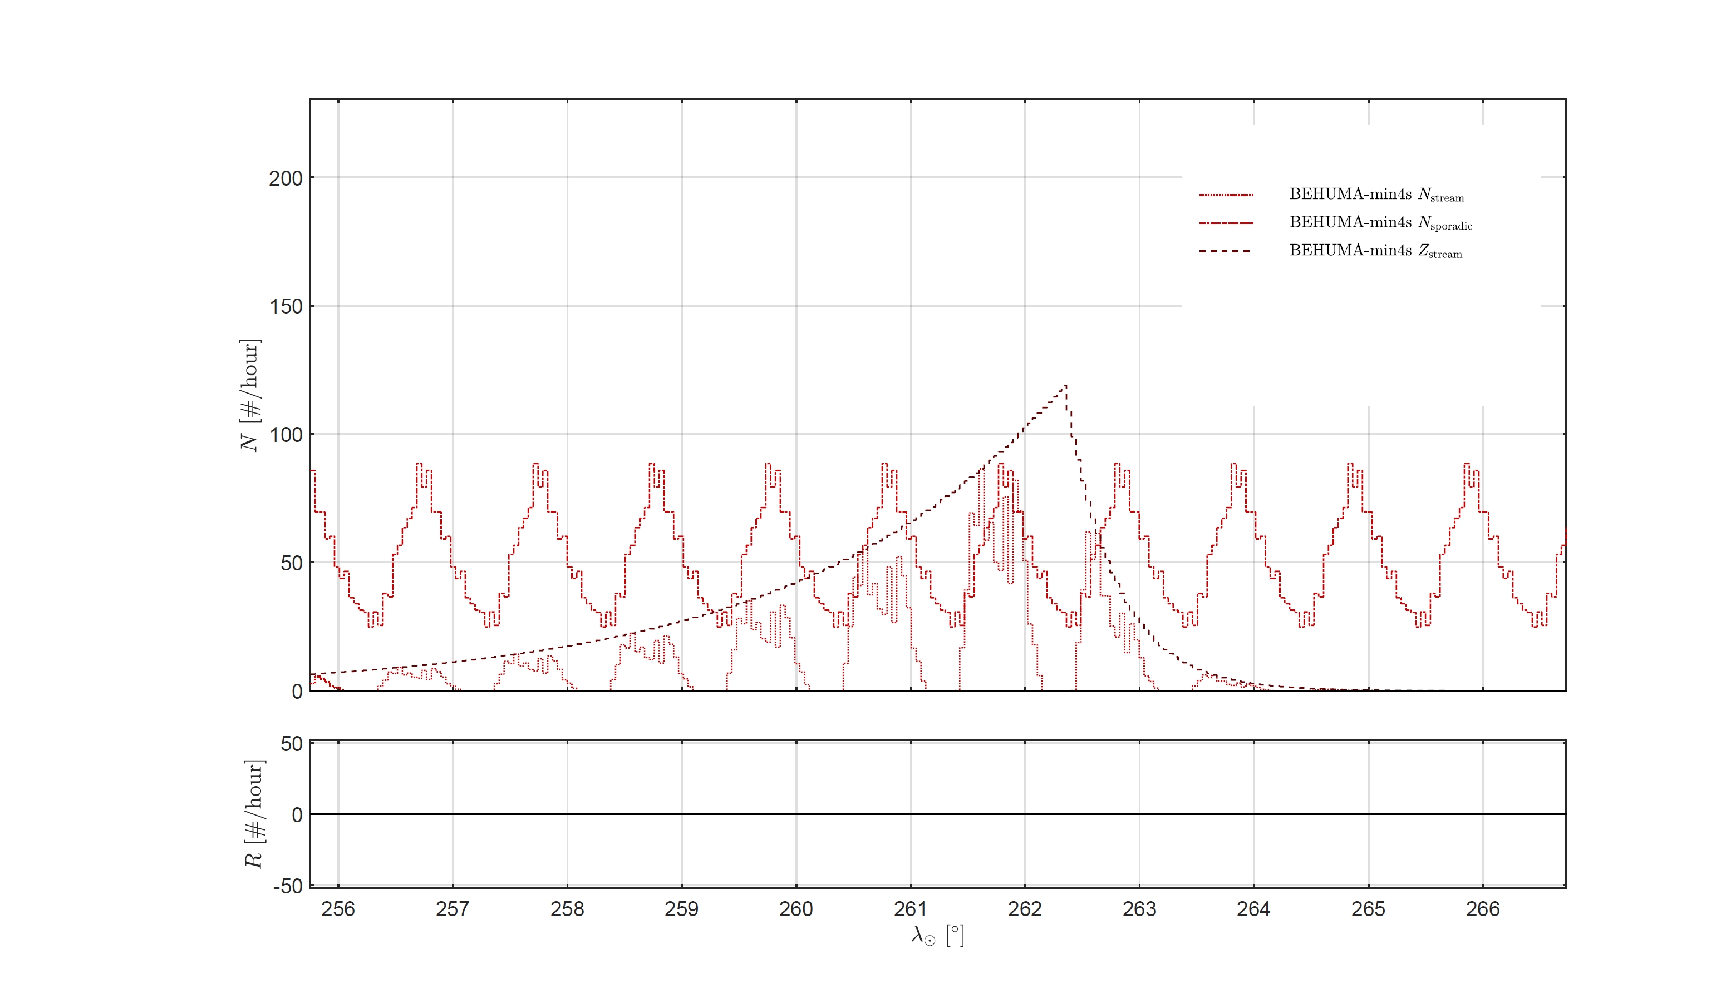
2019 Geminids flux – showing also the sporadic flux
Notes:
The sporadic has a daily variation.
In this case, the OF and the sporadics are in phase. This is coincidence.

Slide 12
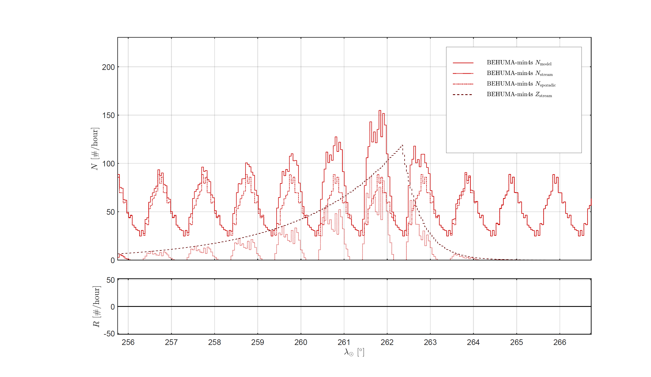
2019 Geminids flux model – sum of stream meteors and sporadics
Notes:
Together they make the total expected meteor activity.
Far from the peak, the sporadics dominate.

Slide 13
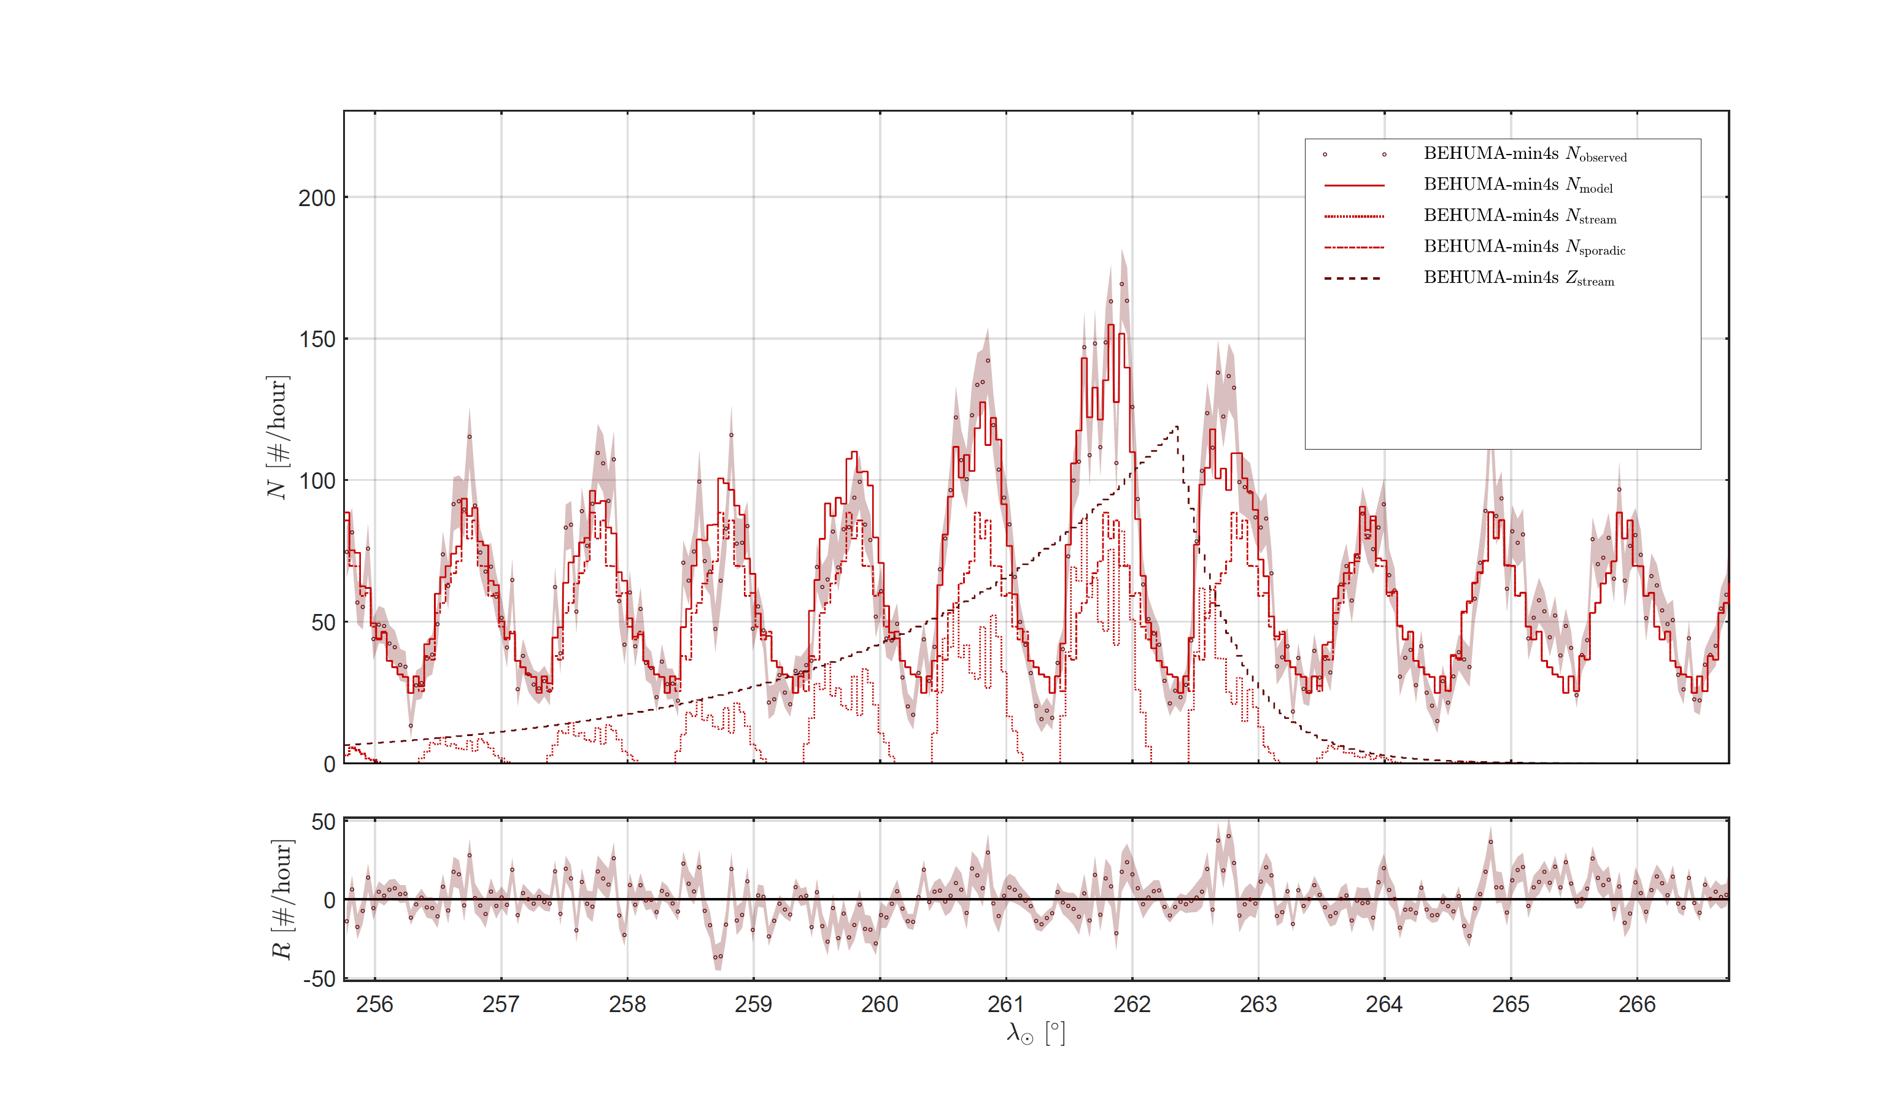
2019 Geminids flux model – comparison with the observations
Notes:
This is close to the observed meteor activity.

Slide 14
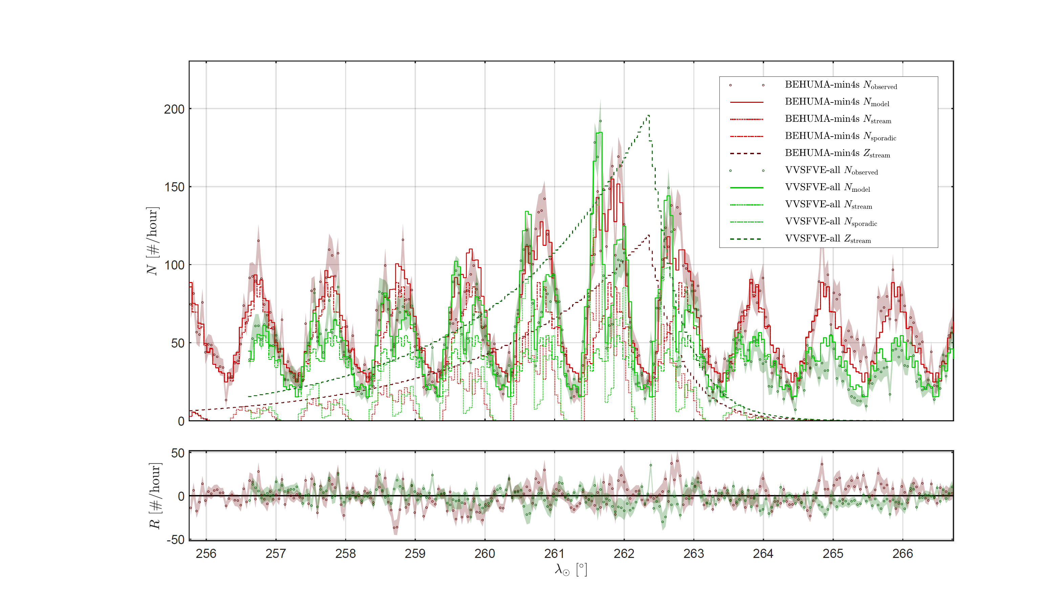
2019 Geminids flux model and observations for both stations
Notes:
The stream parameters are shared.
Mention residuals as a diagnostic for fit quality.

Slide 15
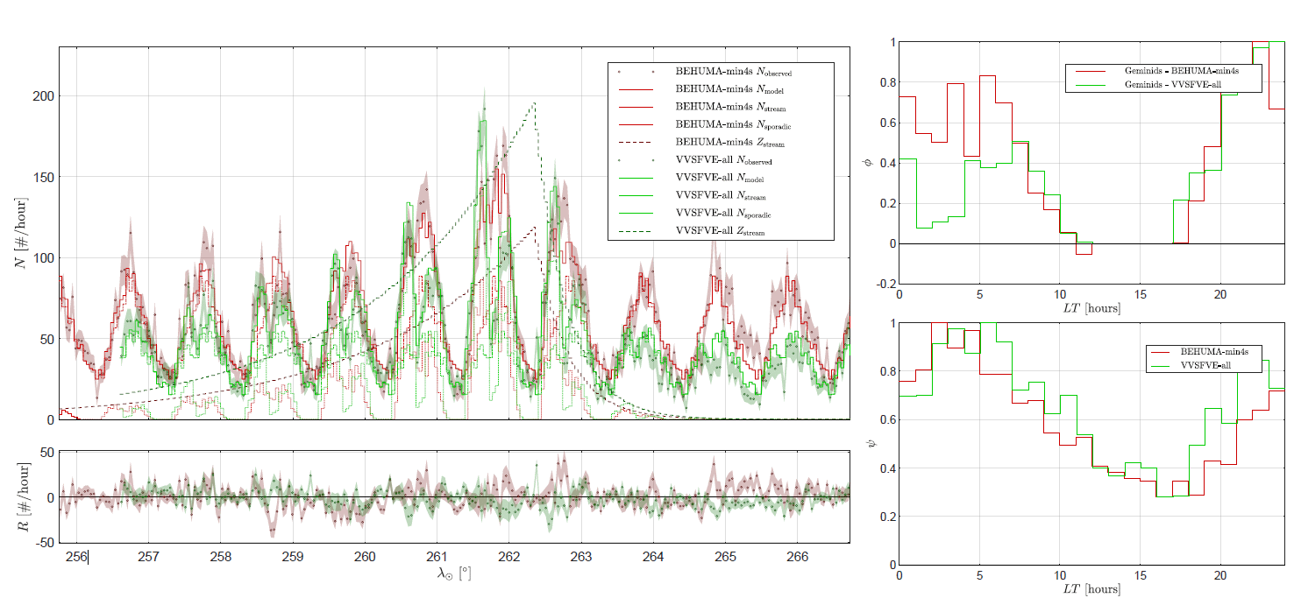
Example fit
OF
Fit
Residuals
Sporadics
Notes:
The normalized sporadic curve is similar between the two stations.

Slide 16
Example fit
OF
Fit
Residuals
Sporadics
Notes:
The OF has a similar shape, although the dip at high radiant elevations for Kampenhout is striking. This is due to the antenna configuration.

Slide 17


Conclusions
You can derive the shower activity from time series.
Key improvements:
Errors estimates on the outputs
Multi-station data
Adding constraints and a priori information
Challenges & solutions:
Overfitting risk: Mitigated by progressive optimization (e.g. starting with simple models and adding complexity).
Note: RMZ volunteer data is reliable and usable in scientific analysis.
Multi-station methodology paper
Synthetic validation paper
Notes:
Key improvements:
Multi-Station Data: Combines observations from multiple stations to better separate sporadic and stream contributions.
Smoothness & Models: Imposes smoothness on sporadic profiles and uses latitude-dependent models to reduce unknowns and improve robustness.
Constraints: Ensures non-negativity of observability functions (OFs) and sets OFs to zero when radiants are below the horizon.
Generalized, more robust method.
Proper error handling and global fitting.
Ready for operational use in multi-station networks.
Mention upcoming paper submission and planned applications.

Slide 18
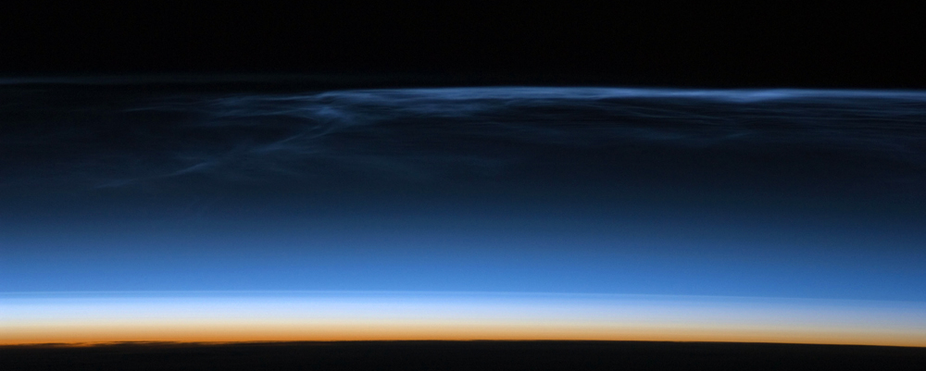

thank you!
Questions?
http://www.radiometeorzoo.org
Stijn.Calders@aeronomie.be

