Slide 1
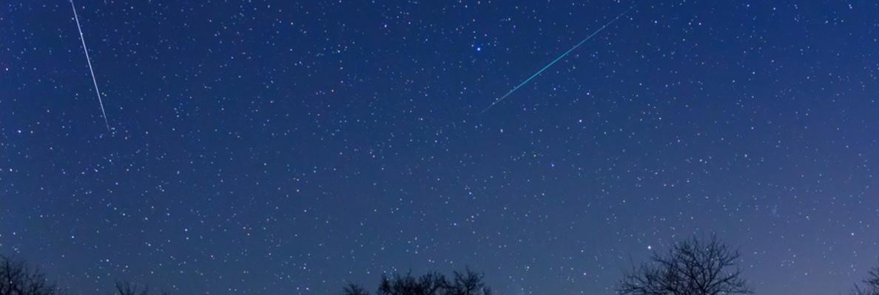




Automatic detection of meteors in BRAMS spectrograms
S. Calders, D. Fernandes, O. Parisot, H. Lamy, K. Kolenberg
ROYAL BELGIAN INSTITUTE FOR SPACE AERONOMY
Notes:
I will talk about automatic detection of meteors in BRAMS spectrograms.
The focus is not only on detecting individual meteors.
The main question is whether automatic detections can produce scientifically useful activity curves.
In particular: can automatic detections reproduce activity curves similar to those obtained with Radio Meteor Zoo?

Slide 2

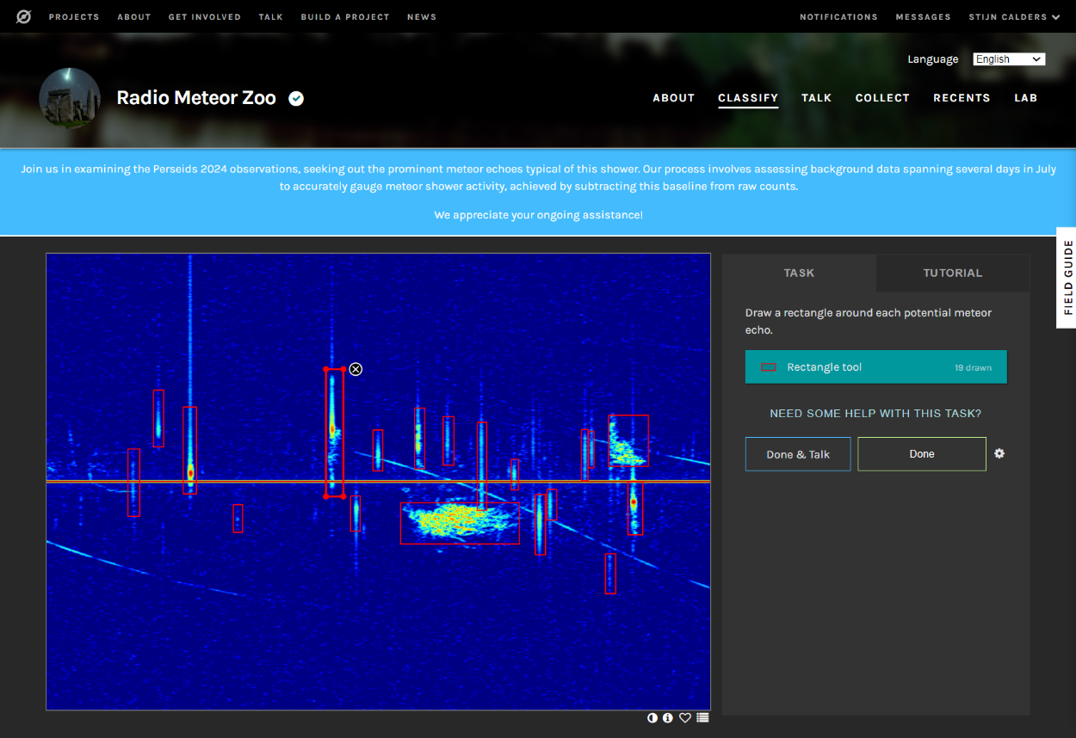
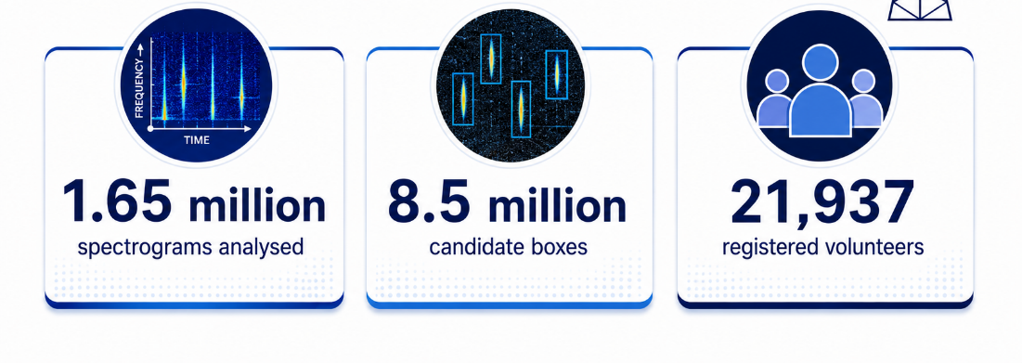
Radio Meteor Zoo: crowdsourced detections
Volunteers identify meteor echoes in BRAMS spectrograms
10 independent classifications per spectrogram
Aggregated detections become count-rate time series
143,500
spectrograms analysed
Notes:
RMZ is not only outreach. It provides human-derived activity curves that we can use as a reference for automatic detection.

Slide 3
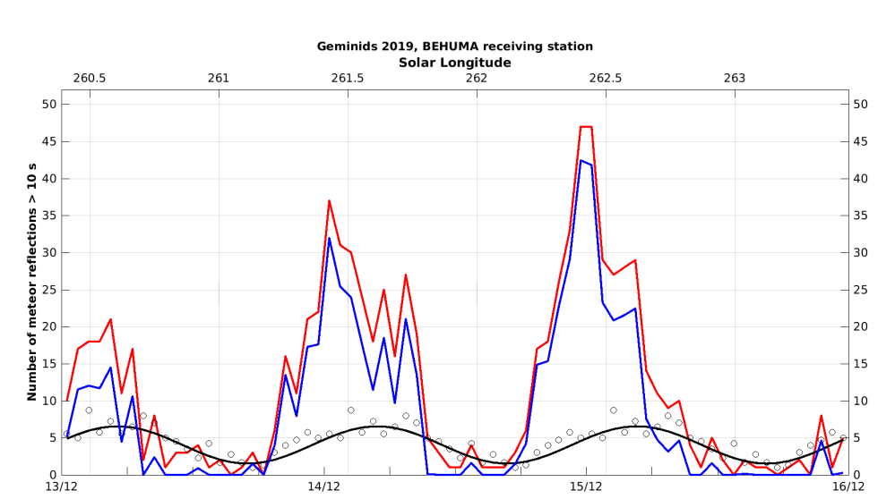
Radio Meteor Zoo: human detections
Notes:
This is an example that I showed you in 2023.
We are no longer looking at individual spectrograms.
We are looking at the temporal evolution of meteor activity.
This is the scientific product I care about.

Slide 4
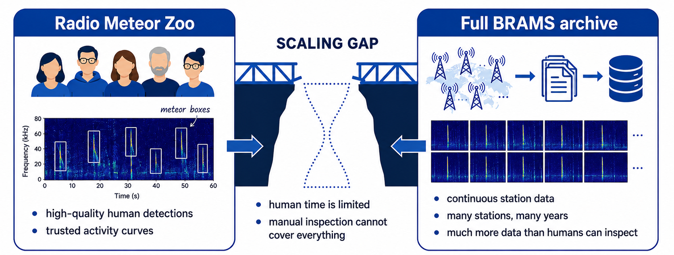
But BRAMS needs scalable processing
Notes:
Radio Meteor Zoo works well. But human time is limited.
Meanwhile, the BRAMS archive keeps growing.
The gap between both sides is the scaling problem. This is where automatic detection becomes necessary.

Slide 5
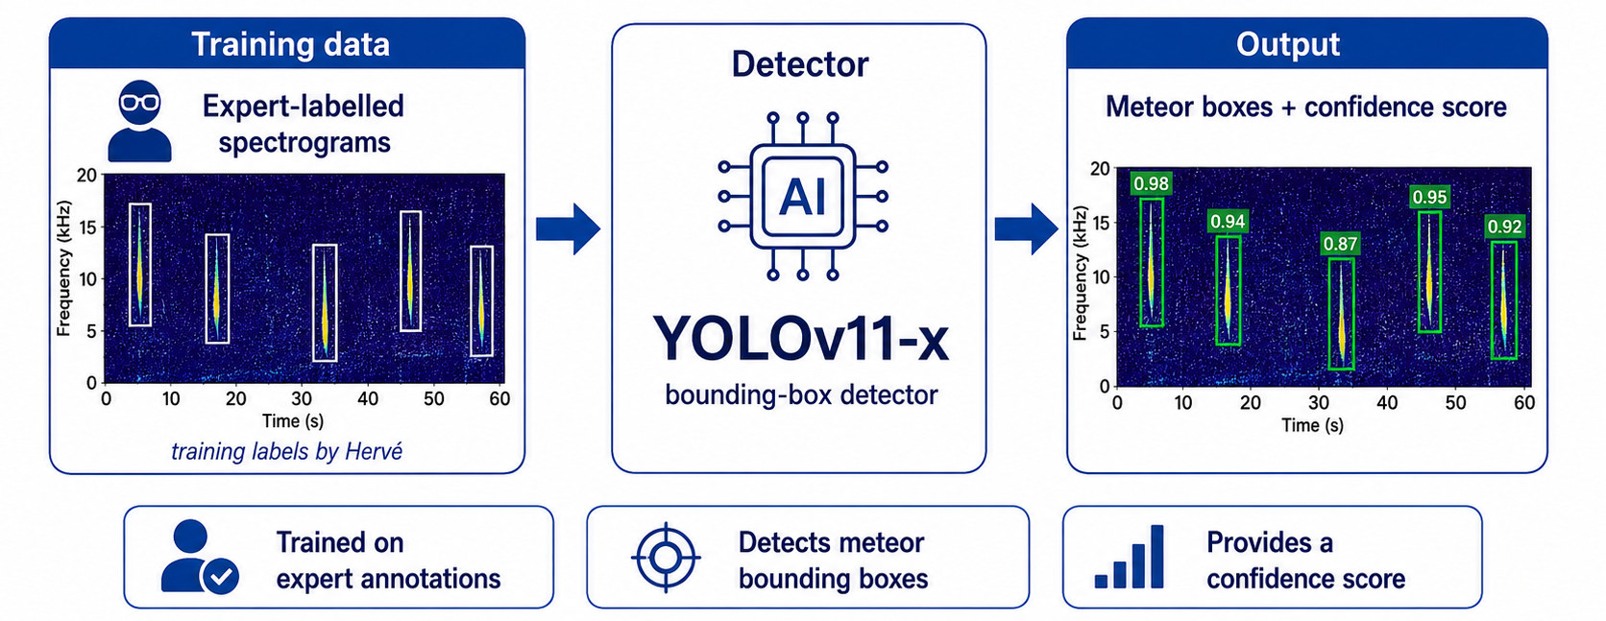
AI to the rescue!
Notes:
LIST, an institute in Luxembourg, trained three different versions of YOLO on training labels from Hervé
Important detail: the training labels are expert annotations, not RMZ consensus labels.
That means RMZ can still be used as an independent validation source. The detector outputs: meteor bounding boxes & confidence scores.

Slide 6
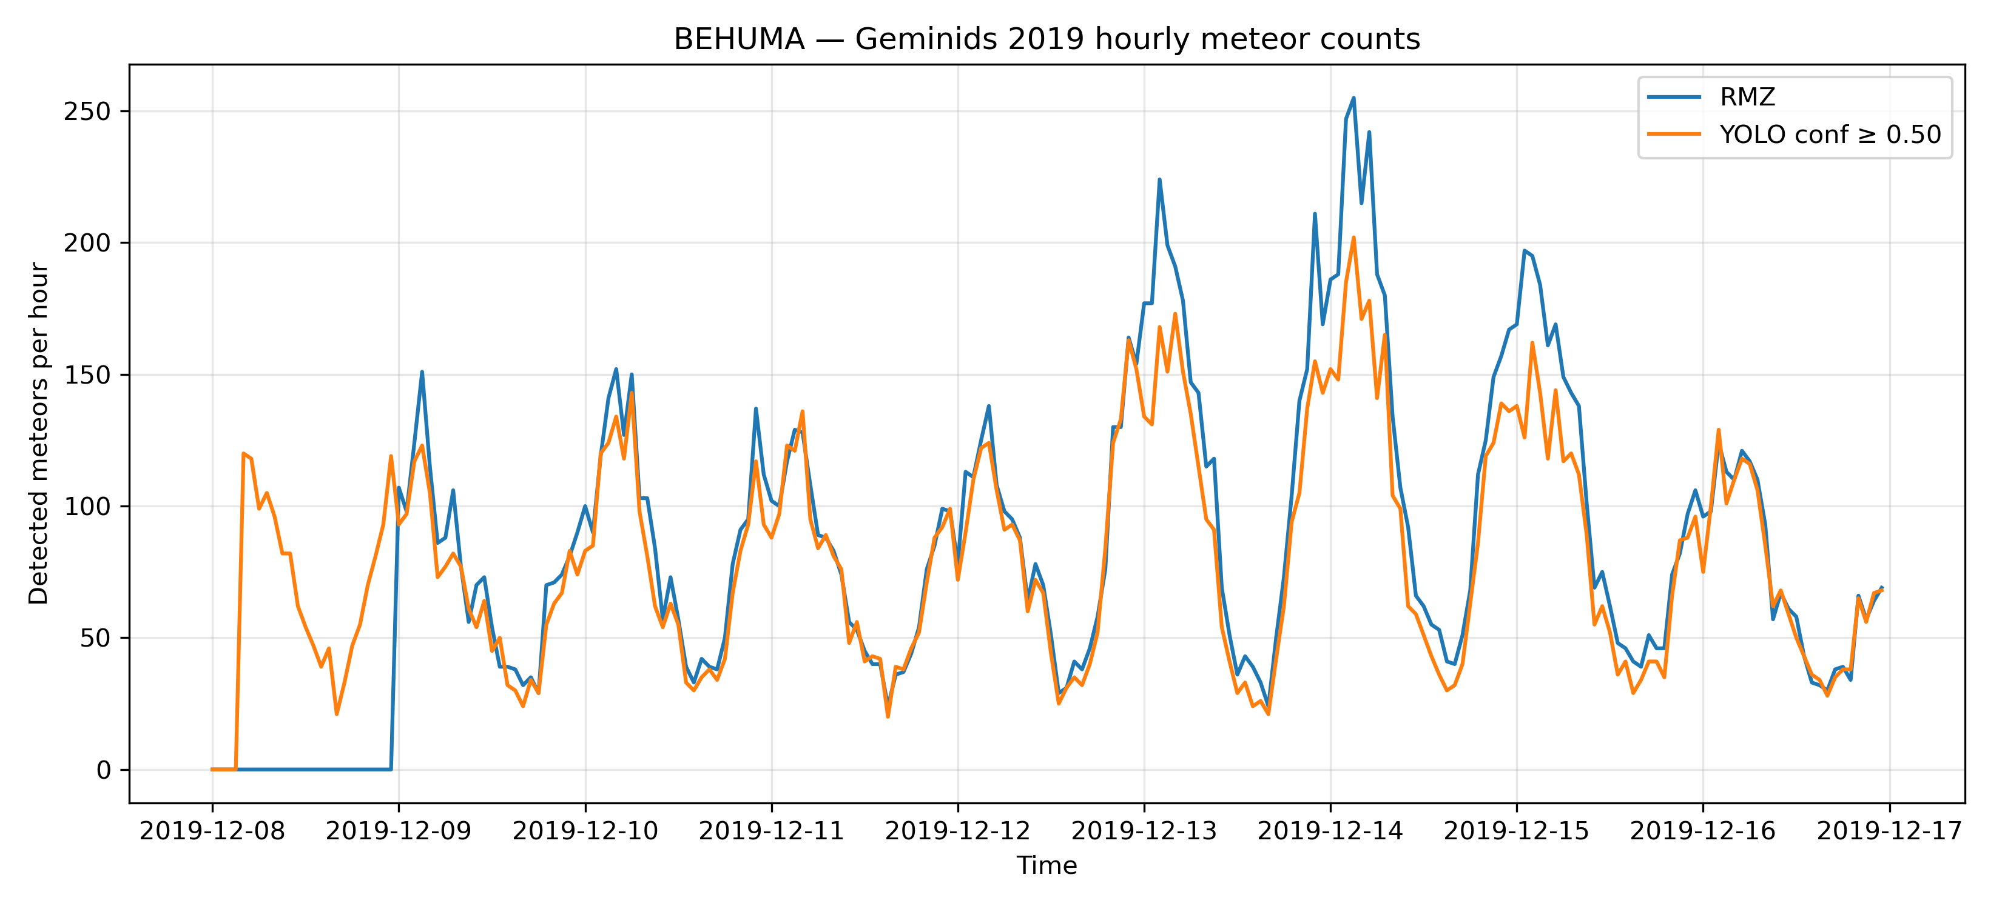
Humain: YOLO follows RMZ classifications
Notes:
We compare the count-rate curve from RMZ with the count-rate curve from YOLO.
Here we see the Humain station during the Geminids 2019 campaign.
There are some amplitude differences, especially during high-count periods.
But the overall activity profile is clearly recovered.

Slide 7
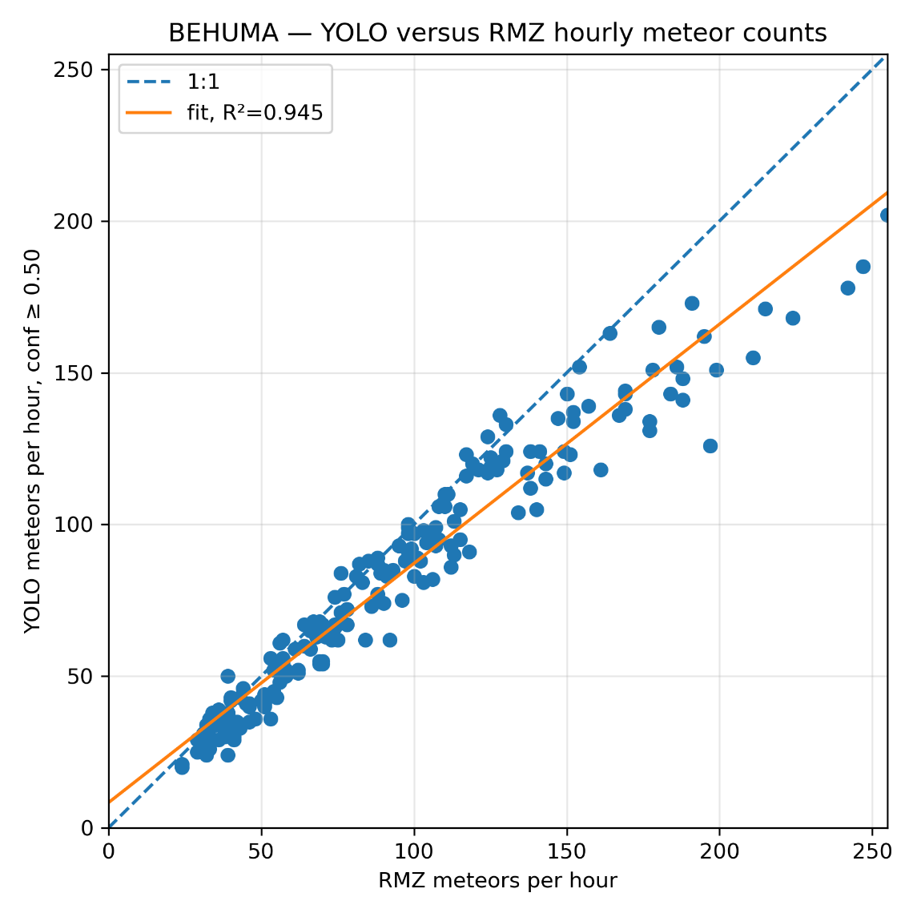
Strong correlation
Notes:
This scatterplot shows the same comparison in another way.
Each point compares the hourly RMZ count with the hourly YOLO count.
The correlation is strong.
The points broadly follow the one-to-one relation.
This means YOLO produces count rates that are consistent with RMZ.
At high count rates, YOLO may slightly underestimate the RMZ counts. That is an important effect to investigate further.

Slide 8
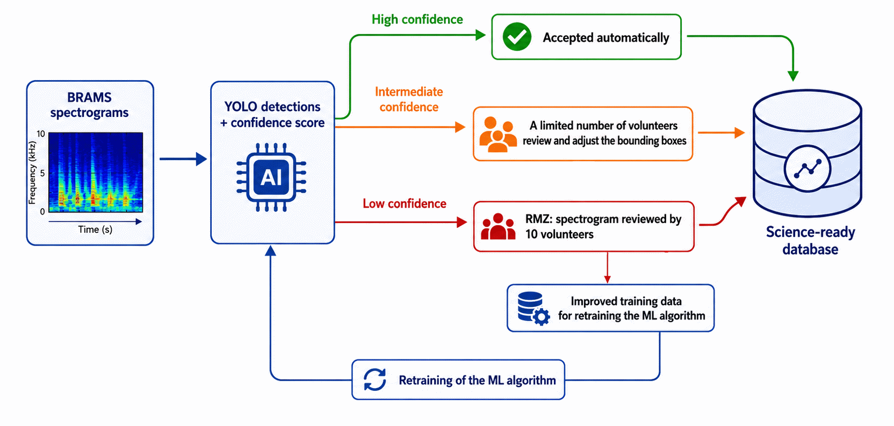
Toward Radio Meteor Zoo 2.0
Notes:
This suggests a hybrid workflow.
High-confidence YOLO detections can go directly into a science-ready database.
Intermediate-confidence detections can be checked by a limited number of volunteers. These volunteers would adjust the bounding boxes if needed.
Low-confidence cases go back to the full RMZ workflow. That means review by 10 volunteers.
These difficult cases are also valuable as new training data.
So RMZ is not replaced. RMZ becomes more focused:
validation,
difficult cases,
improved training data.

Slide 9

Conclusion
YOLOv11-x can reproduce RMZ-like activity curves.
RMZ remains essential for validation, difficult cases, and training data.
BRAMS stations continuously produce valuable science data.

Slide 10


thank you!
Questions?
http://www.radiometeorzoo.org
Stijn.Calders@aeronomie.be
Notes:
Thank you. I am happy to take questions.
And of course, Radio Meteor Zoo is still available online.
If you want to help validate BRAMS detections or follow the project, the link is shown here.

