Slide 1

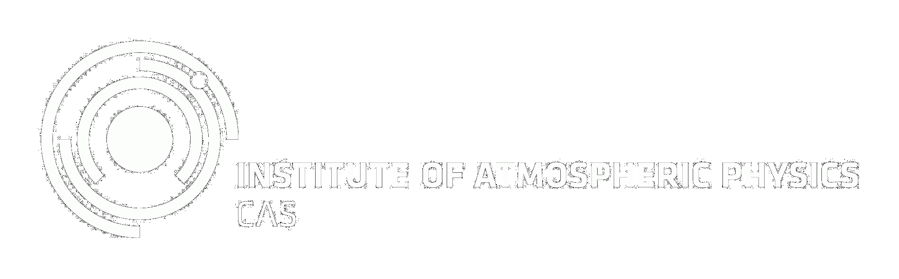


Impact of individual meteors on the midlatitude ionosphere during the
Leonids and Geminids meteor showers, 2019
Presentor: Veronika Barta¹
Co-authors: Szárnya Csilla^{1,2}, Igaz Antal³
Jaroslav Chum⁴, Katerina Podolská⁴, Daniel Kouba⁴,
Petra Koucká Knížová⁴, Zbysek Mošna⁴,
1 Earth Physics and Space Science, Sopron, Hungary
2 Eötvös Loránd University, Doctoral School of Earth Science, Budapest, Hungary
3 Konkoly Thege Miklós Astronomical Institute, Budapest, Hungary
4 Institute of Atmospheric Physics (CAS), Prague, Czech Republic

Slide 2
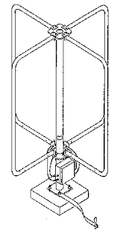
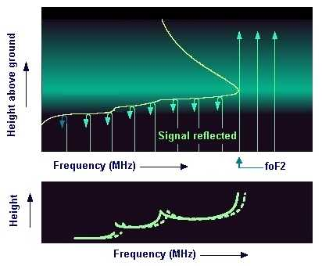
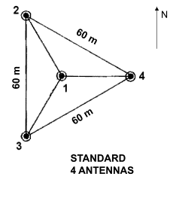
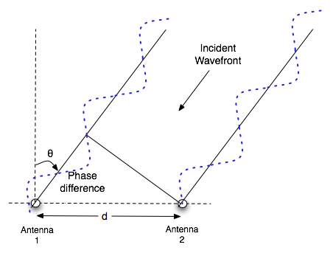
Digisondes
Aim: detect the electron density of the different layers of the ionosphere versus the heights
Method:
Emission of short electromagnetic pulses in the 1-12 MHz frequency range
Advantage: 4 loop receiver antenna
From the received waves we can determine:
  Angle of arrival of the signal based on the phase-difference
  Plasma motion, horisonthal and vertical speed components
2

Slide 3
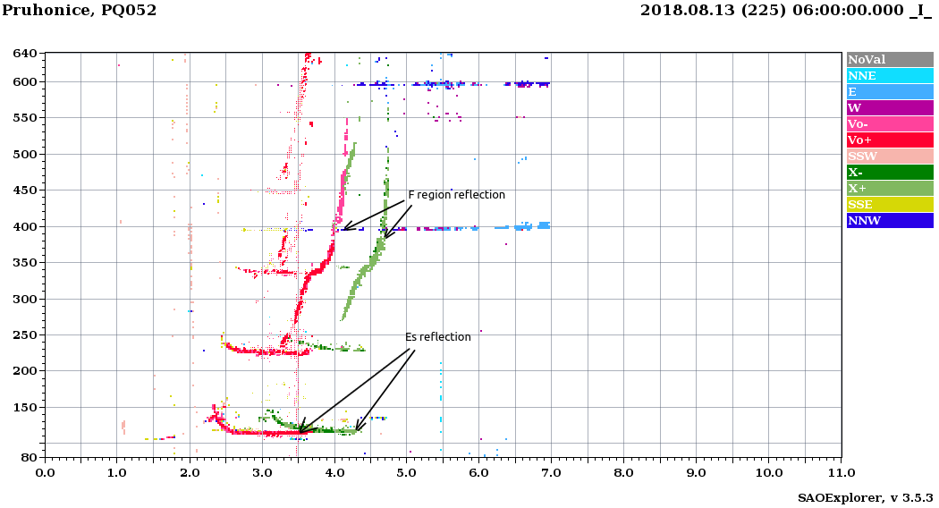
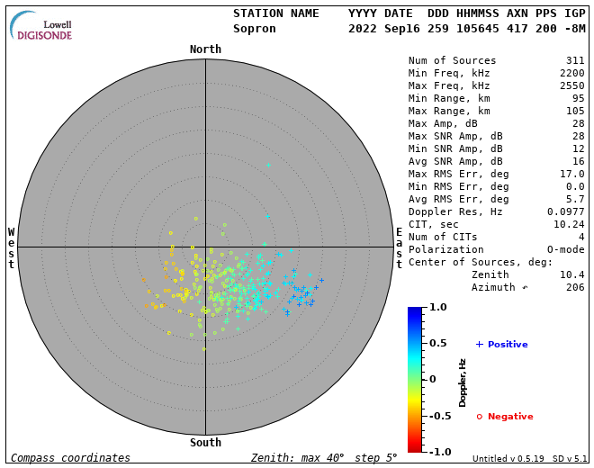
foES – sporadic E
Different directions with different colors on the ionograms
3

Slide 4
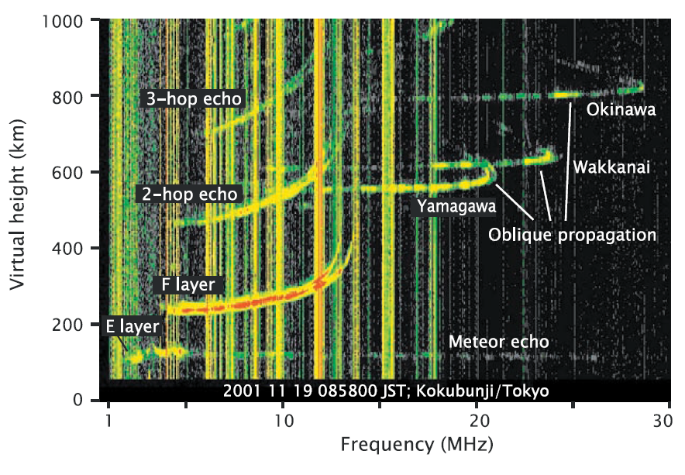
Meteors on ionograms
Ellyett and Goldsbrough, 1976, study of sporadic E behaviour during meteor falls
Maruyama et al., 2003.
campaign measurement during the Leonids, in-depth analysis, refutation of several points of the Ellyett and Goldsbrough, 1976
Fresnel-scattering on meteoric plasma-trails
Meteors appear on the ionograms as a faint sporadic E-like signal

Slide 5
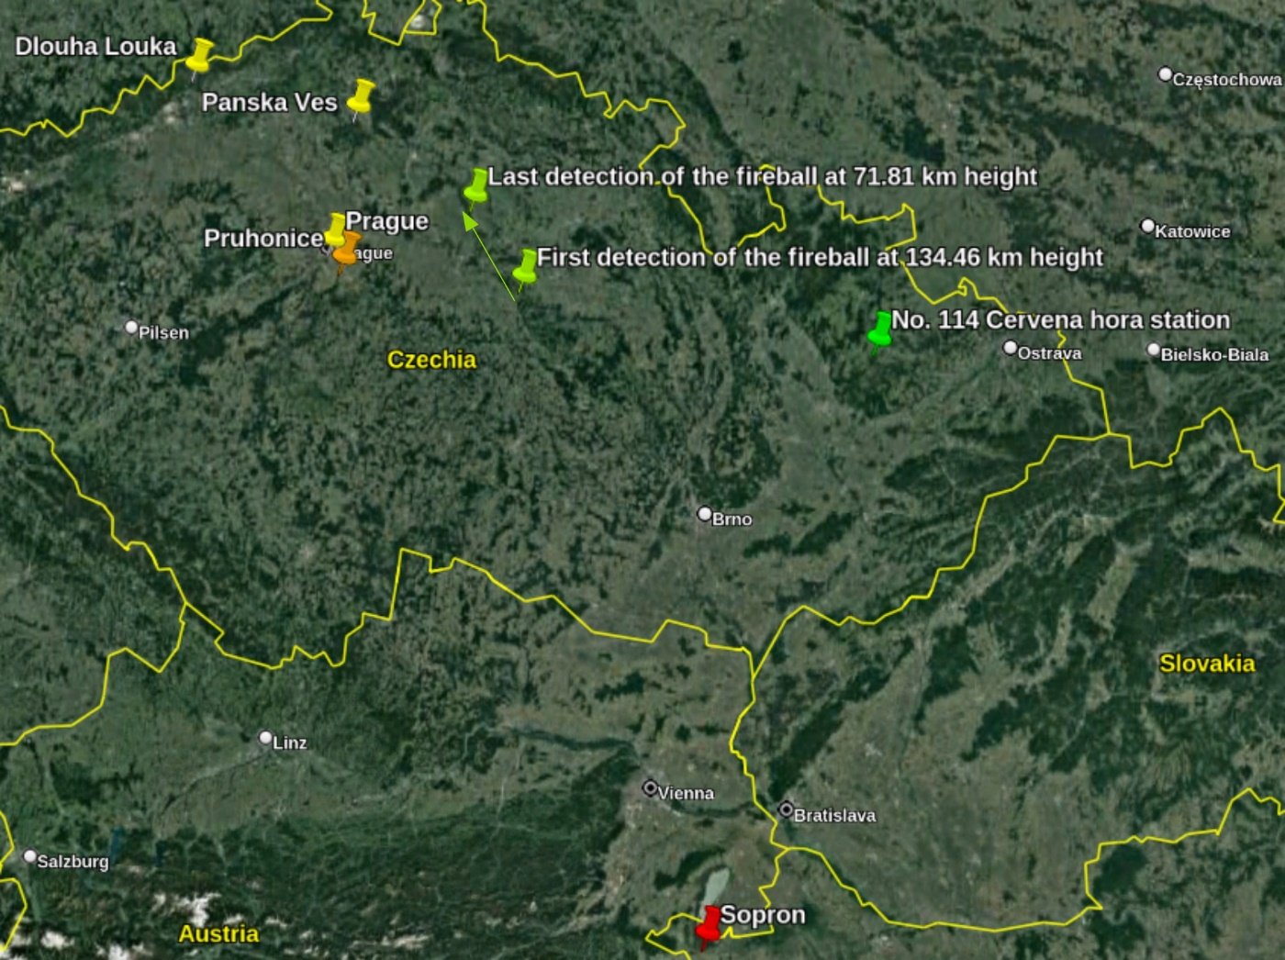
Campaign-measurements, 2019, Leonids, Geminids
Synchronized measurements
2019. November 16-18.
2019. December 10-16.
Pruhonice (Czechia, orange)
Sopron (Hungary, red)
2 measurement/min (between sunset and sunrise)
Optical measurement (Sopron)
Watec 902H2, Ultimate camera focal length of 2.6 mm, 30 mm effective lens aperture, and 122 x 97 deg. field of view toward the zenith
Leonid anomaly (low numbers)
Notes:
The optical data used in this work were recorded by a Watec 902H2 Ultimate camera, equipped with a Computar HG2610AFCSHSP objective (with a focal length of 2.6 mm, 30 mm effective lens aperture, and 122 97 degree field of view toward the zenith.) This station operates with the Metrec (Molau 1999) automatic meteor detection software. Its limiting magnitude is roughly +1 for meteors in this work.

Slide 6
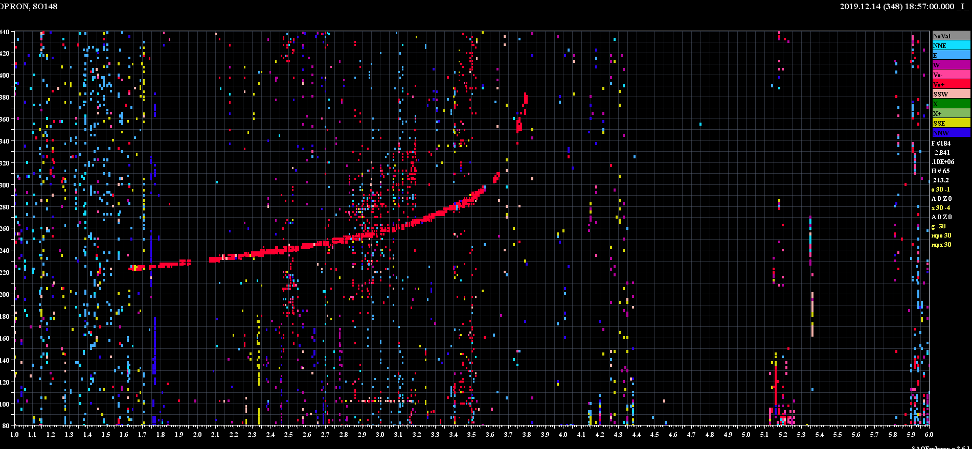
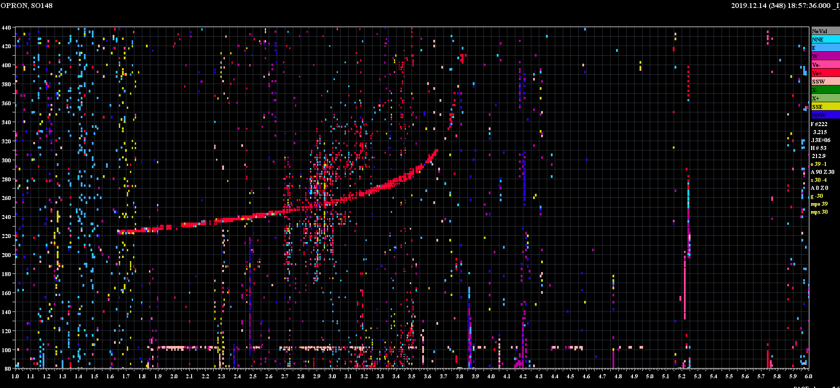
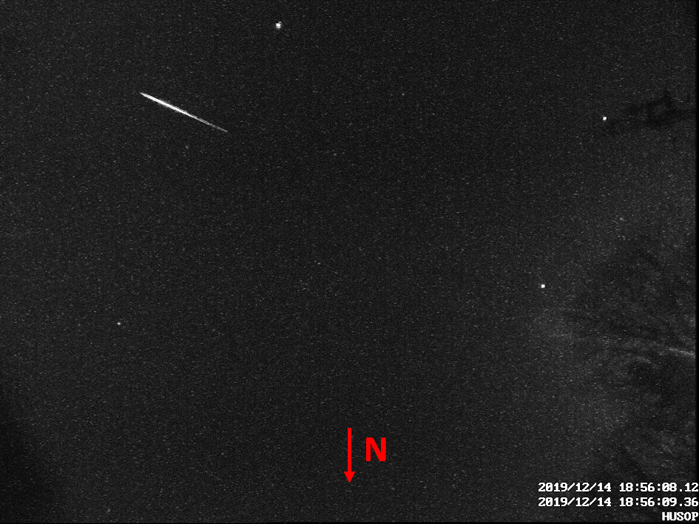
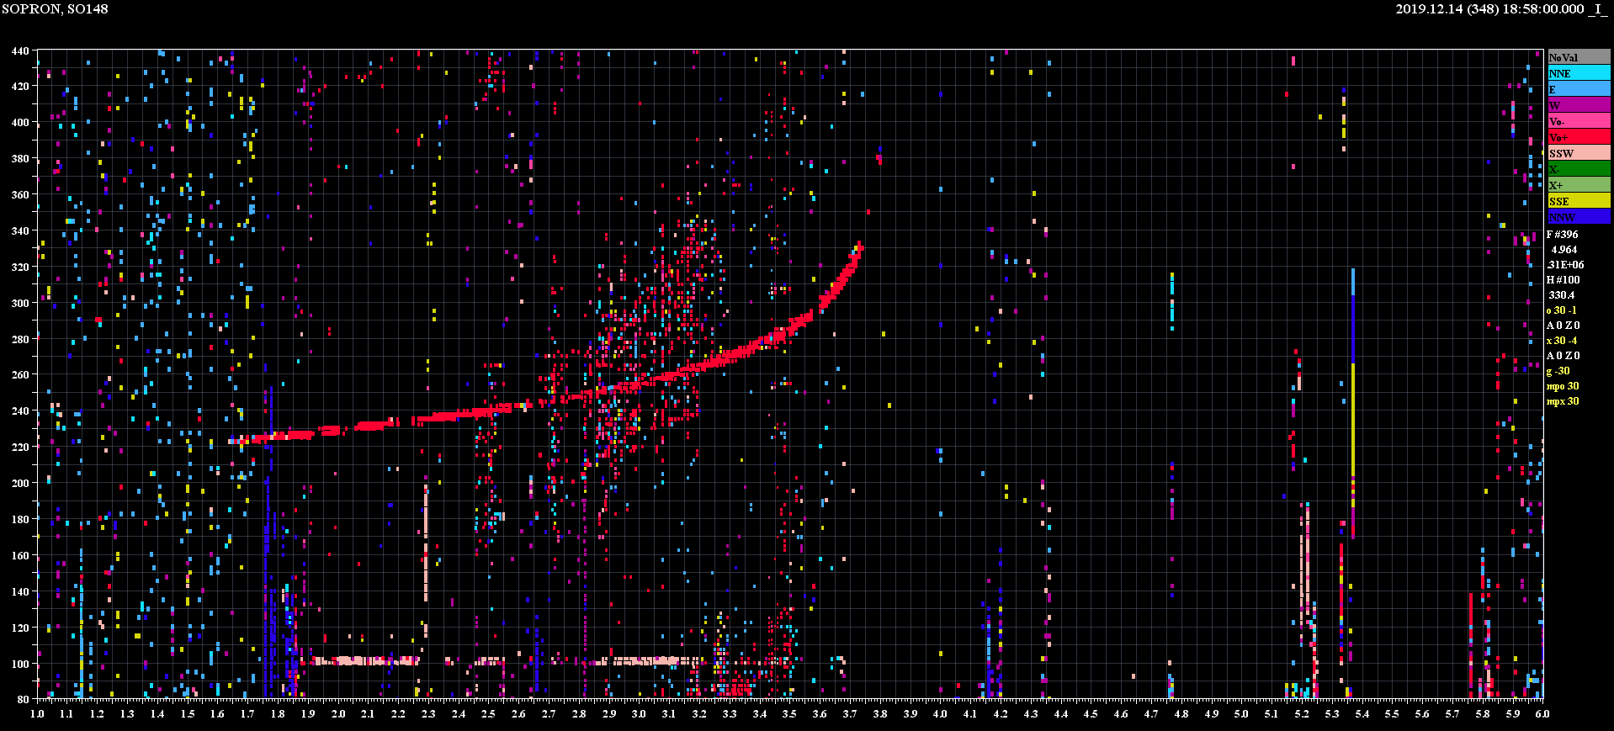
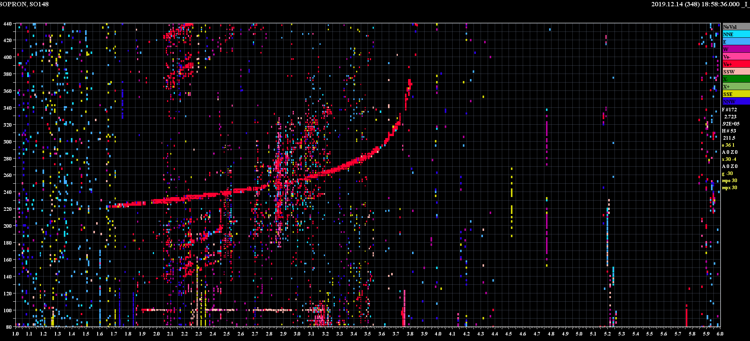
Meteoric traces on ionograms (digisonde)
18:57:00
18:57:36
Example during Geminid: 2019/12/14
18:58:00
18:58:36
The trace completely disappears at 18:59:36

Slide 7
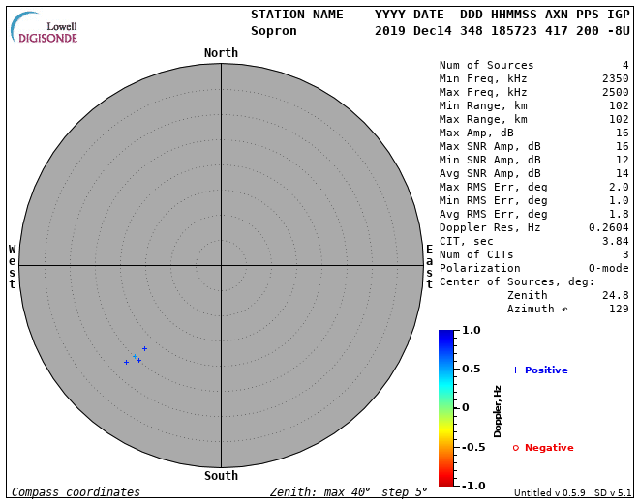
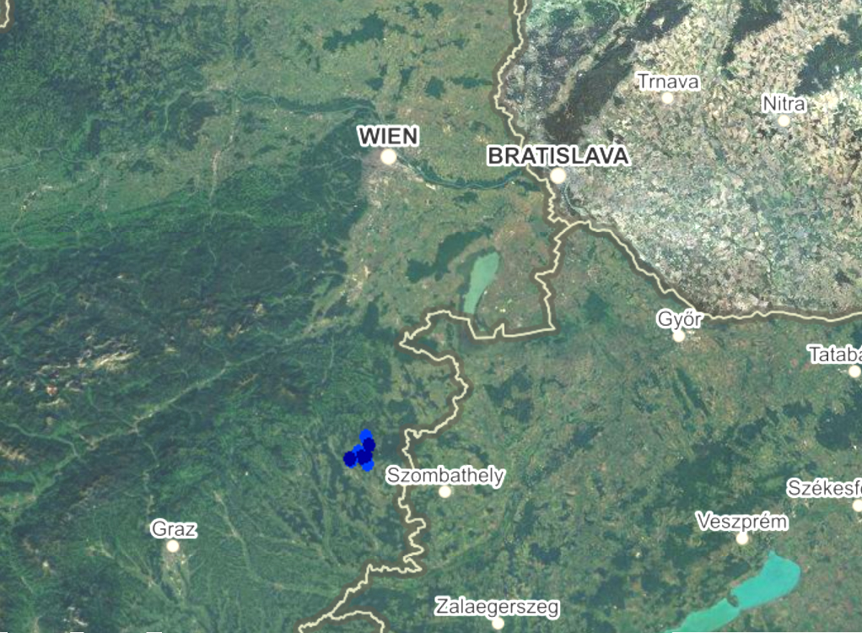

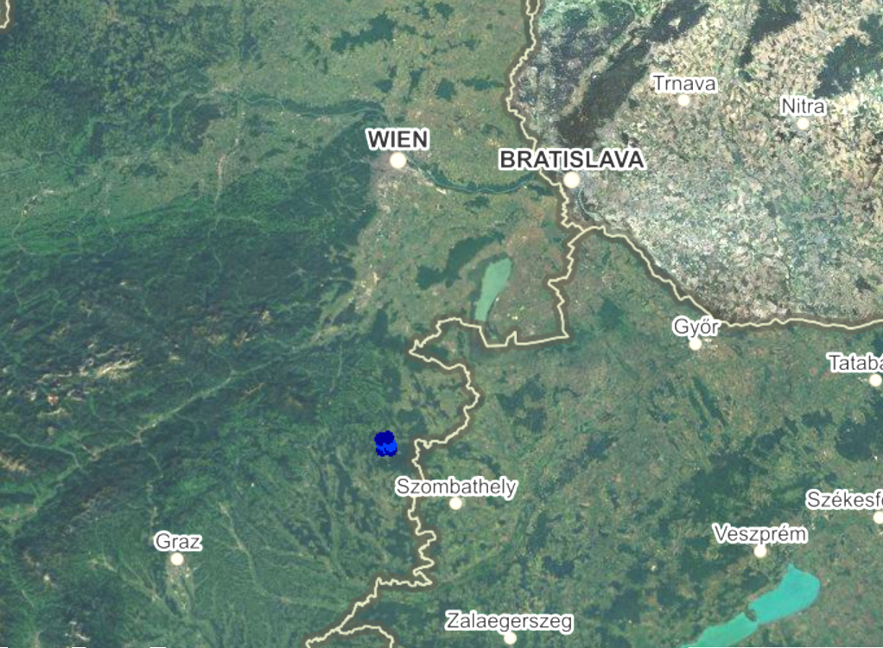
N
W
N
W

Slide 8
Missing parts of the signal, casused by MPA threshold setting
Double trace caused by possibly wind shear or turbulence

Slide 9
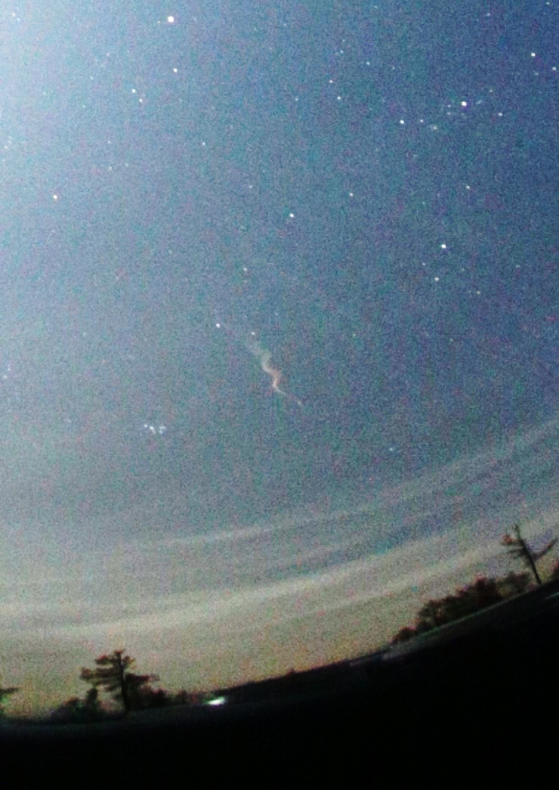
Fireball, 2019.11.17.
Fireball’s trace from Cervena hora.
data were provided by P. Spurný (priv. comm.).
Placement of various equipments of detections

Slide 10
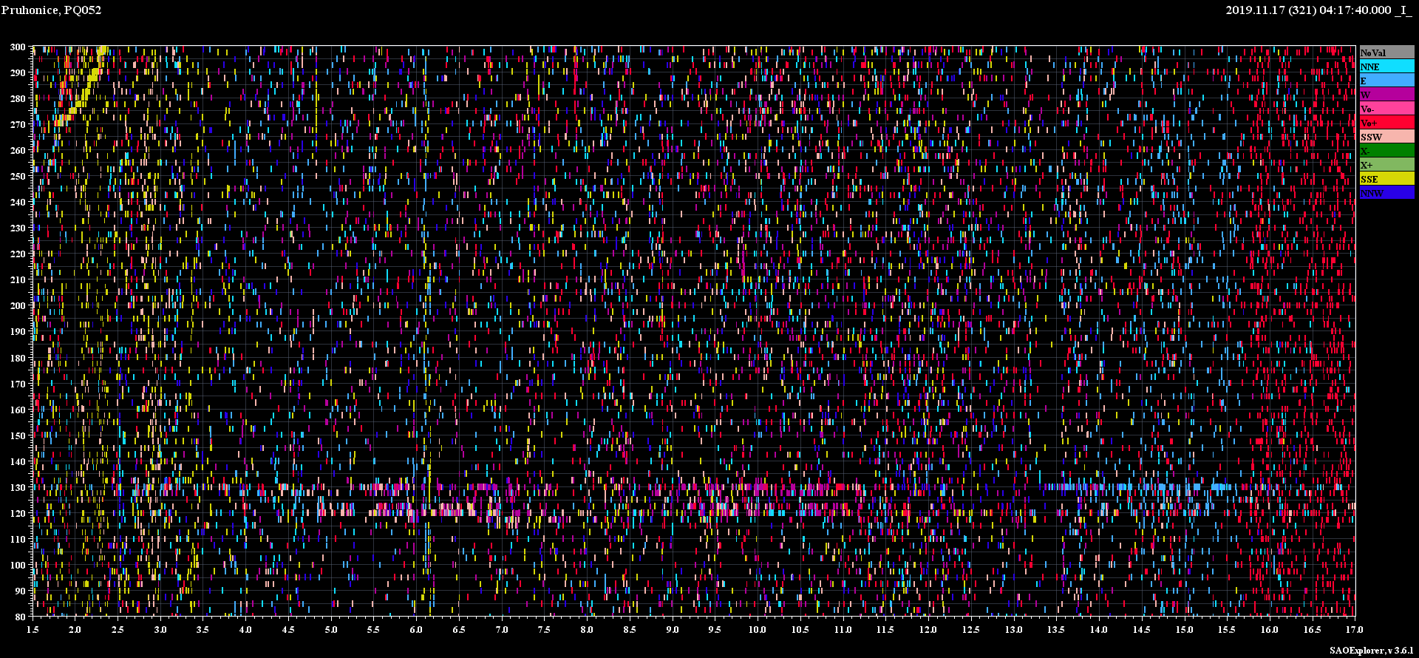
F2 layer (red: vertical yellow:oblique from Sopron)
Fireballs’s trace

Slide 11
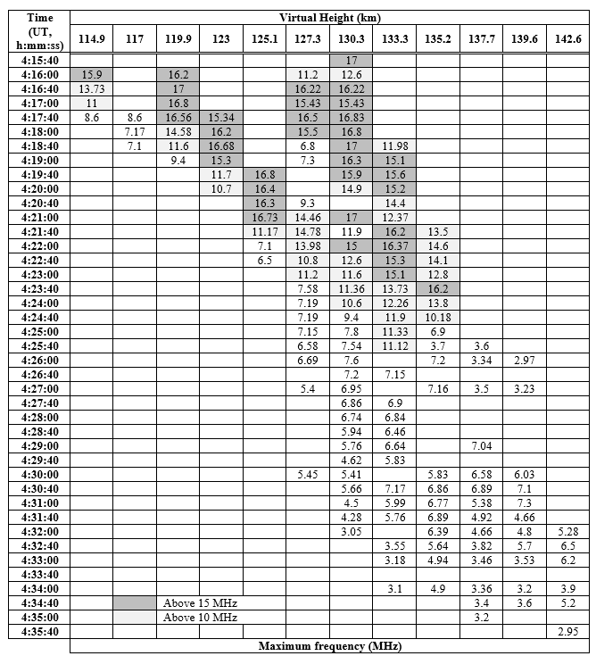
Height changes of the fireball’s trace
Measurement saturation at 17 MHz
Rapid height decrease then slow rise
5 layers
Decreases below 10 MHz after 10 minutes
20 minute persistence

Slide 12
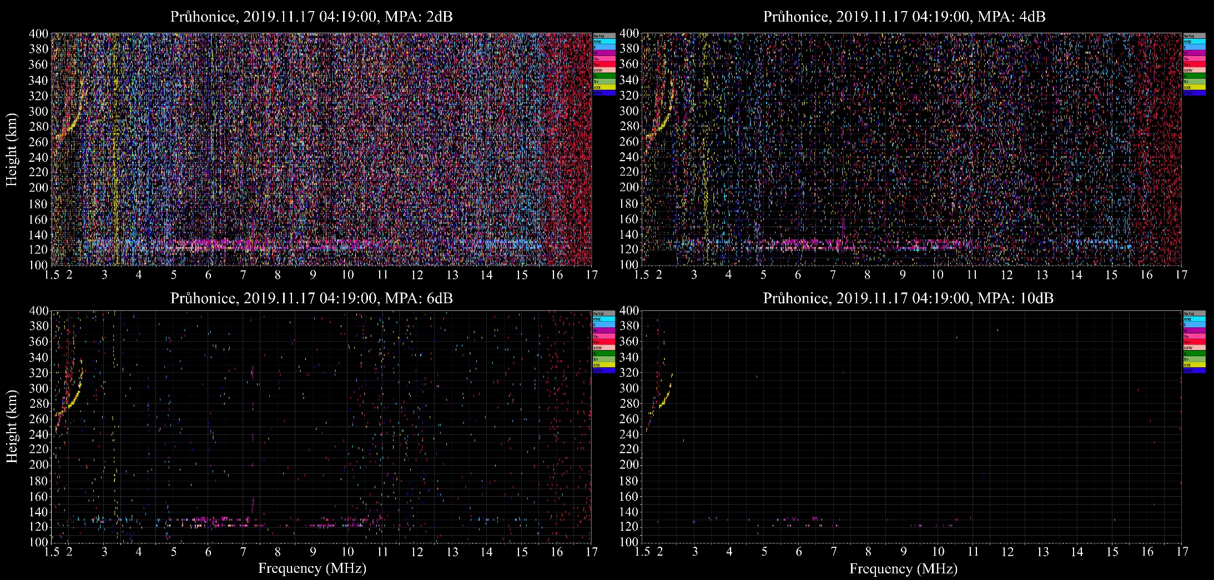

Slide 13
Fireball, 2019.11.17.
Fireball’s trace from Cervena hora.
data were provided by P. Spurný (priv. comm.).
Placement of various equipments of detections

Slide 14
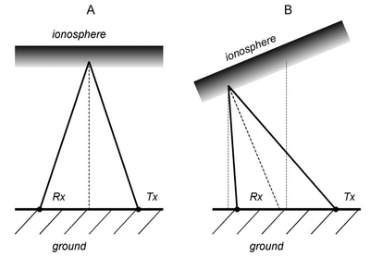
Continuous Doppler Sounding
High temporal resolution Doppler measurements in Western Czechia
Multiple sounding paths, multipule frequencies
First fireball detection on CDS
A sketch of the radio waves emitted by the transmitter (Tx), reflected by the ionosphere and captured by the receiver (Rx).

Slide 15
Fireballs’s diffuse, blip-like trace
Strong, fast southward moving sporadic E layer’s trace

Slide 16
Statistics
Optical meteor detections: 87
Optical findings appearing on ionogram: 25 (+22)
Meteor findings on ionograms 205 (+ 113)
 | Leonids, 2019 |  | Geminids 2019
Optical observations | 10 |  | 77
After optical observations traces appear on ionograms | 6 |  | 19 |  | Sure
 | 3 |  | 19 |  | Has to be investigated
Meteor finding only with digisonde | Pruhonice | Sopron | Pruhonice | Sopron
 | 22 | 17 | 87 | 79 | 6 dB MPA
 | 10 | 13 | 48 | 42 | 4 dB MPA

Slide 17
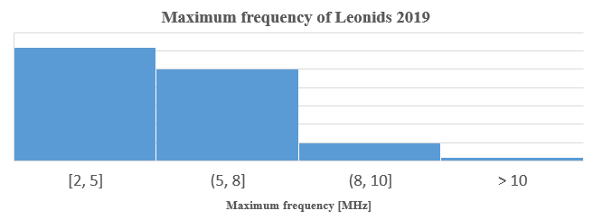
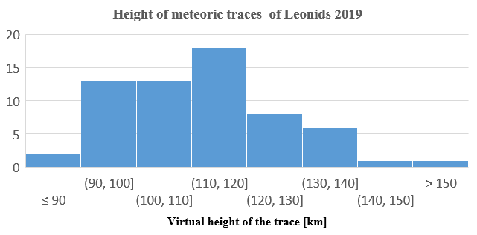
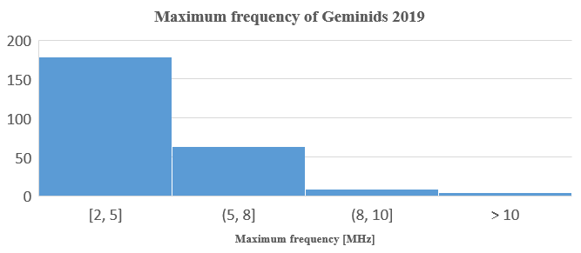
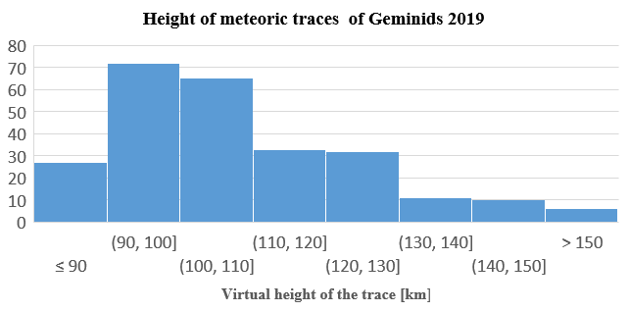
The frequency and height of the traces

Slide 18
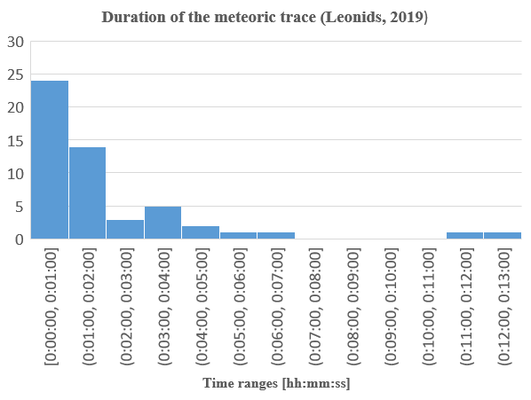
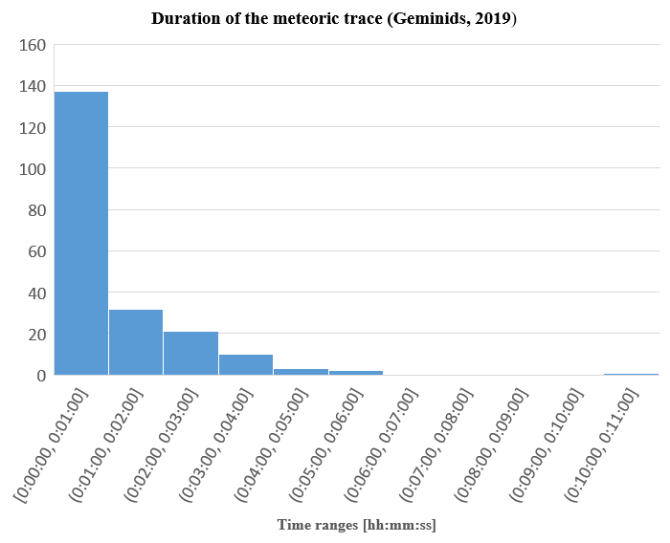
Time duration of the meteoric traces

Slide 19
Summary
It is possible to detect individual meteors with digisonde
  2 ionogram / minute resolution is the best
Some of them can appear on the SkyMAPs, too
It is also possible to detect fireballs, especially if their trace has a long (> 10 minute) lifespan
The direction determination of the digisonde is not reliable, it often has a 180º error
The MPA threshold setting – both in the saving of the raw measurement and in the proccessing software – has to be taken into account
Paper: Szárnya et al., 2023, Multi-instrumental detection of a fireball during Leonids of 2019, Front. Astron. Space Sci.

Slide 20
Acknowledgement
We would like to thank Czech Fireball Network, especially J. Borovička and P. Spurný for very kindly providing the data
The work was supported by GINOP-2.3.2-15-2016-00003 (titled “Kozmikus hatások és kockázatok”) Hungarian national project. This work was made possible by the “Multiinstrumental investigation of the midlatitude ionospheric variability” bilateral project of the Czech Academy of Sciences and Hungarian Academy of Sciences (MTA-19-03 and NKM 2018-28). The support under the grant GA21-03295S by the Czech Science Foundation is acknowledged. The contribution of VB was partially supported by Bolyai Fellowship (GD, no. BO/00461/21).

