Slide 1
Overview of major shower observations 2016-2017 by the BRAMS network
Cis Verbeeckbeeck, Hervé Lamy, Stijn Calders,
Cédric Tétard, Antonio Martínez Picar

Slide 2
BRAMS network
One transmitter at Dourbes (left)
Frequency: 49.970 MHz
Power: 150 W
26 receiver stations in Belgium

Slide 3
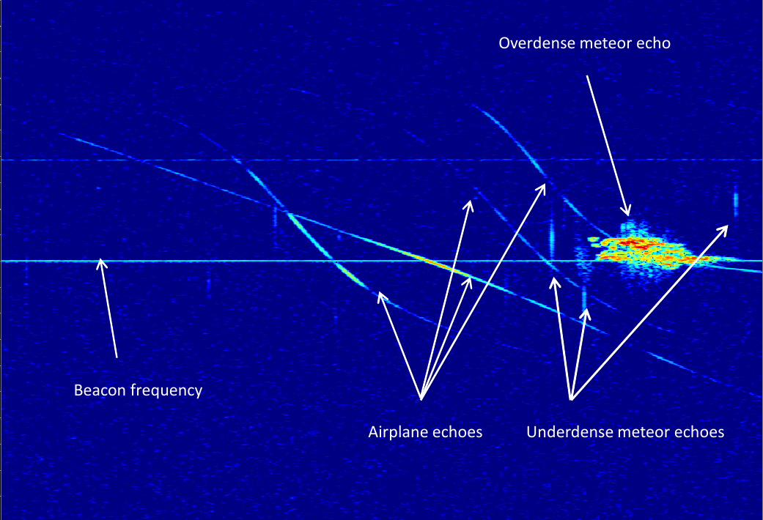
Spectrograms
Vertical axis: frequency
(BW=200 Hz)
Horizontal axis: time (duration = 5 minutes)
Notes:
Explain what a spectrogram is

Slide 4
Why you didn’t see BRAMS meteor activity plots yet…
One spectrogram every 5 minutes
288 spectrograms per day
Over a “spectrokilogram” for a few days of shower observations
Too much to manually detect meteors in all spectrograms ourselves
Automatic detection of meteors not yet up to the task
Royal Belgian Institute for Space Aeronomy (BIRA-IASB)
Institut royal d’Aéronomie Spatiale de Belgique (IASB)
Koninklijk Belgisch Instituut voor Ruimte-Aëronomie (BIRA)

Slide 5
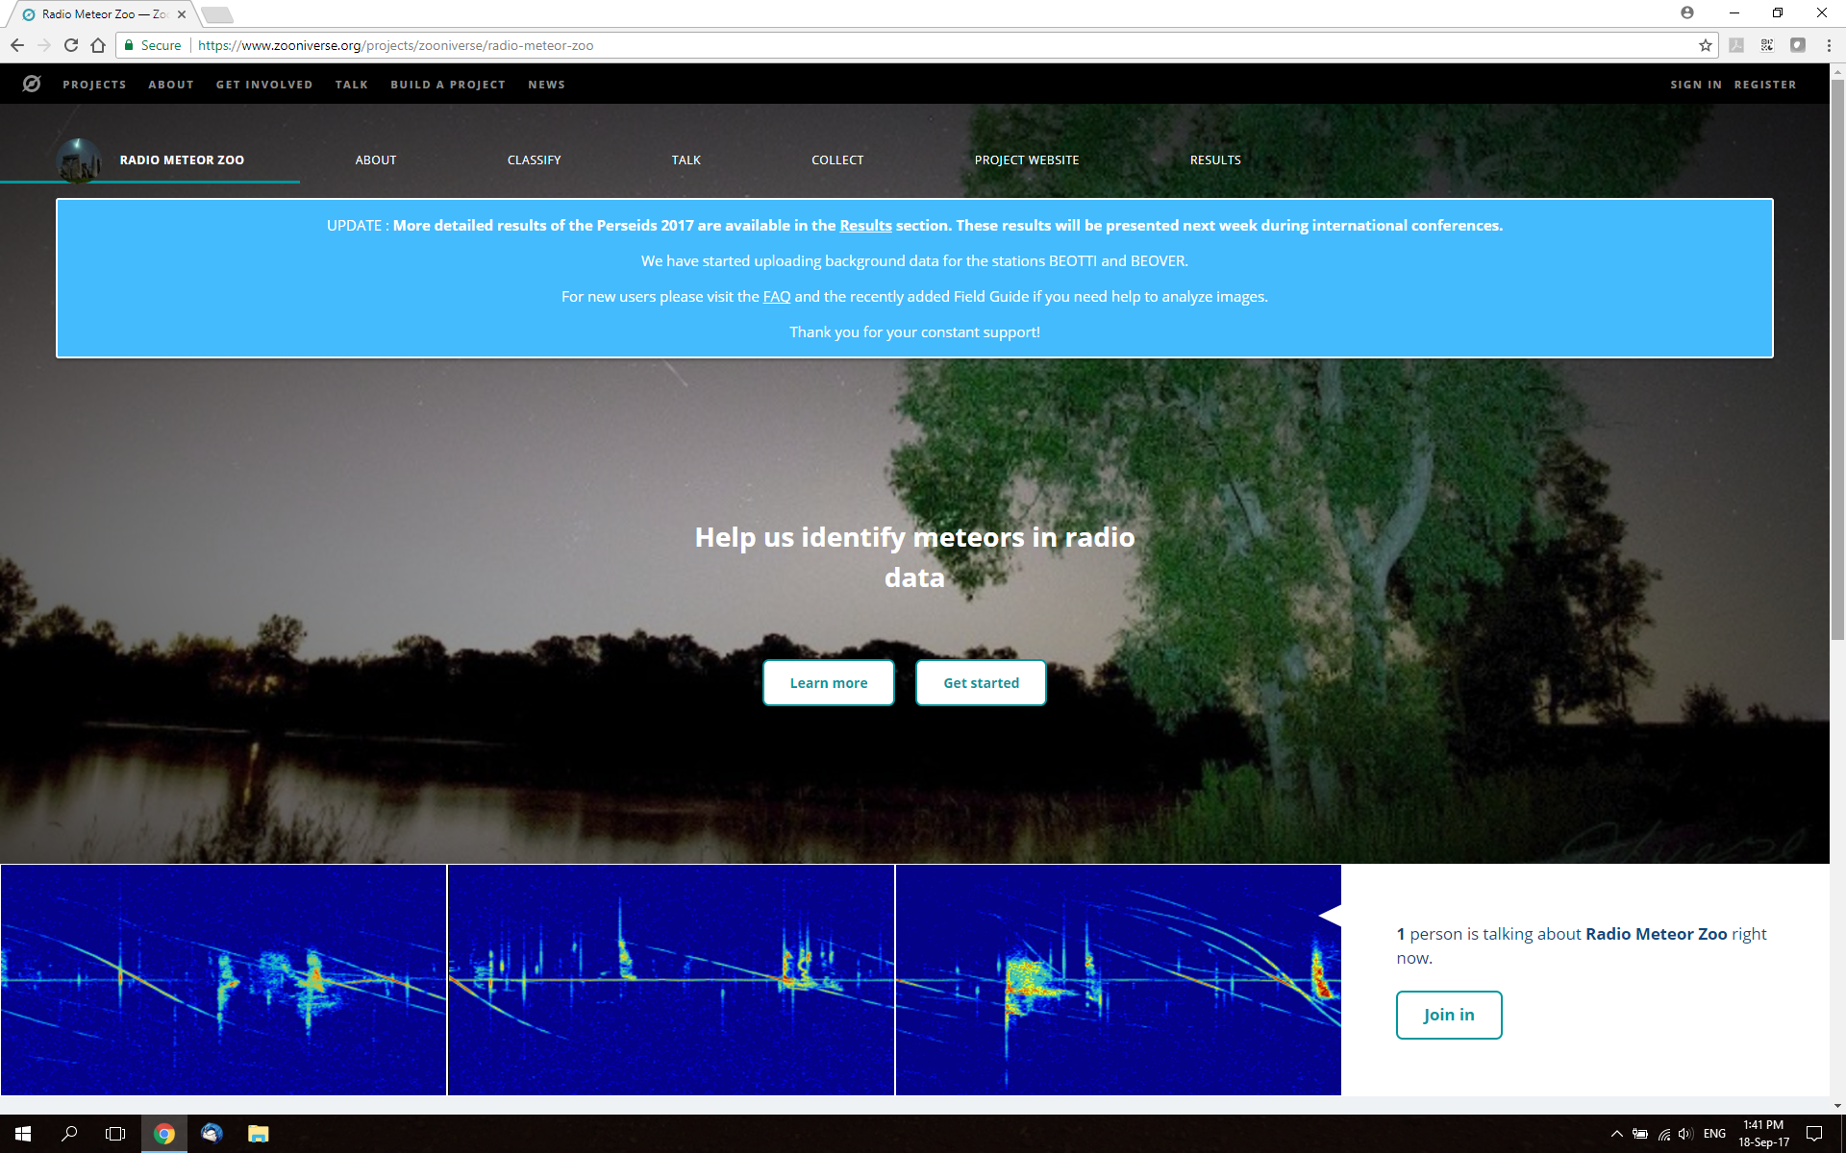
Why we finally present BRAMS meteor activity plots now…
https://www.zooniverse.org/projects/zooniverse/radio-meteor-zoo

Slide 6
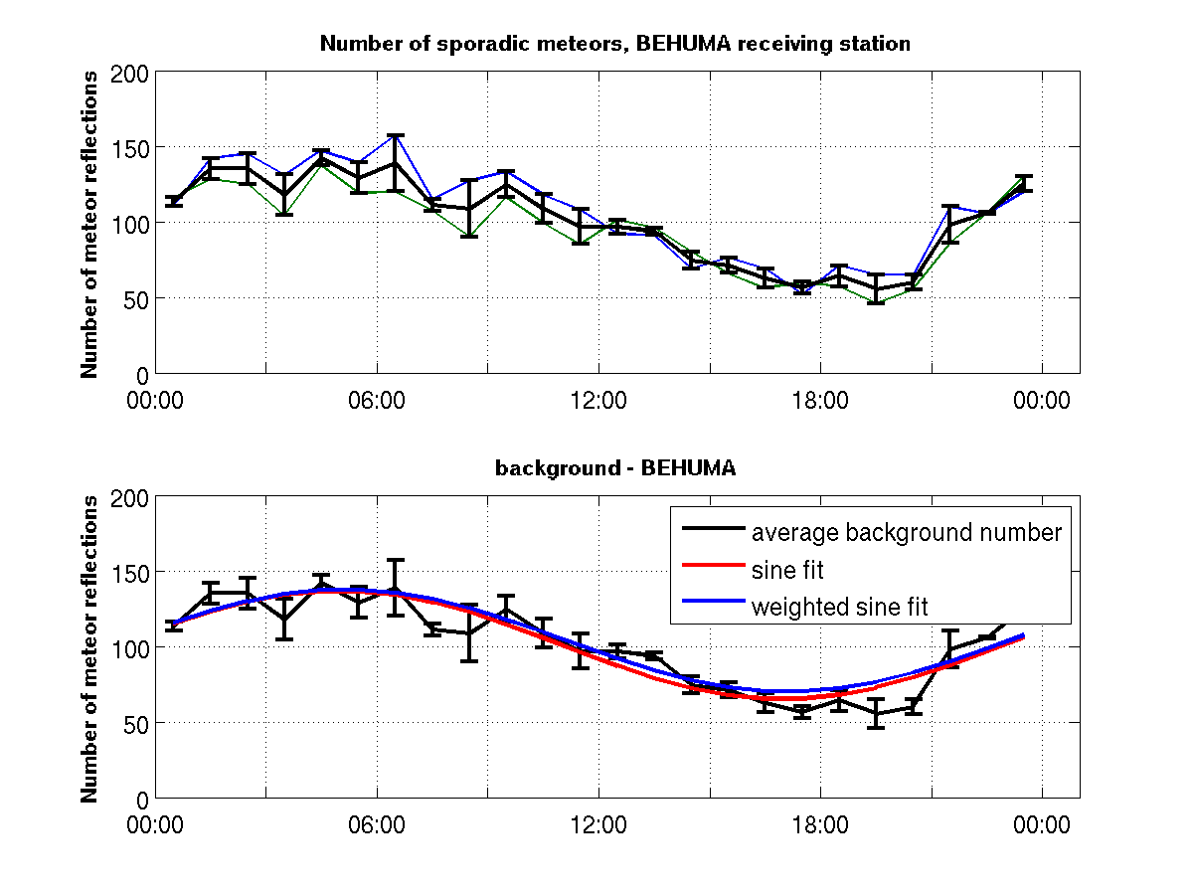
Perseids 2016, Humain: sporadic background

Slide 7
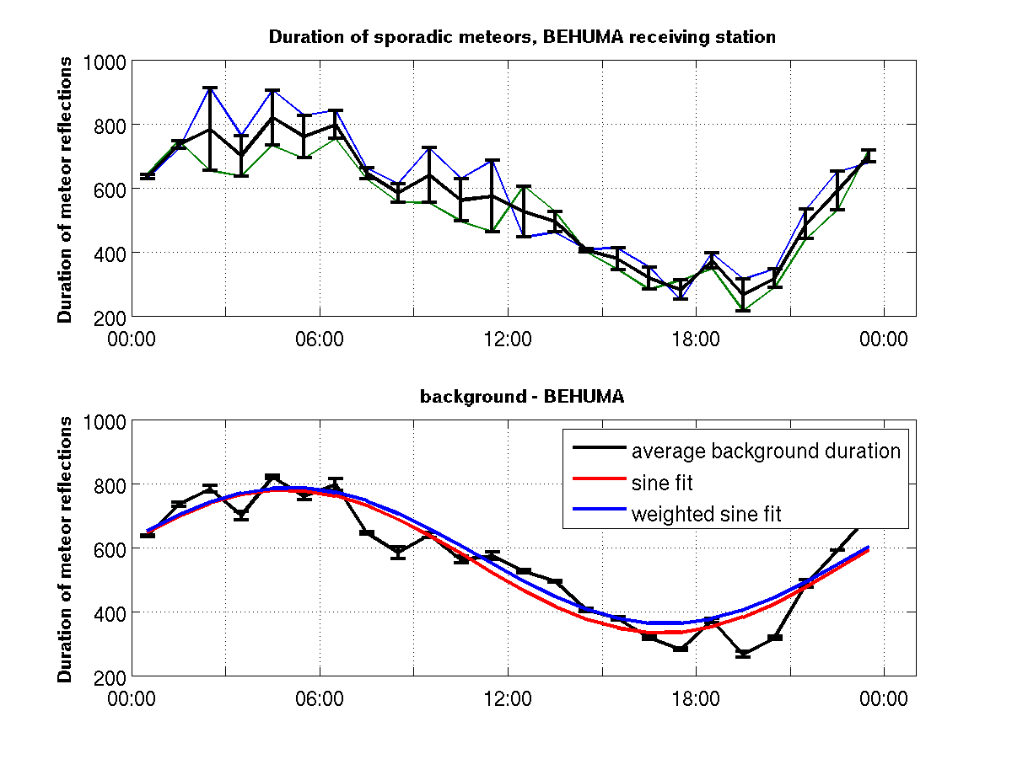
Perseids 2016, Humain: sporadic background
Number of meteor reflections
Total duration of meteor reflections

Slide 8
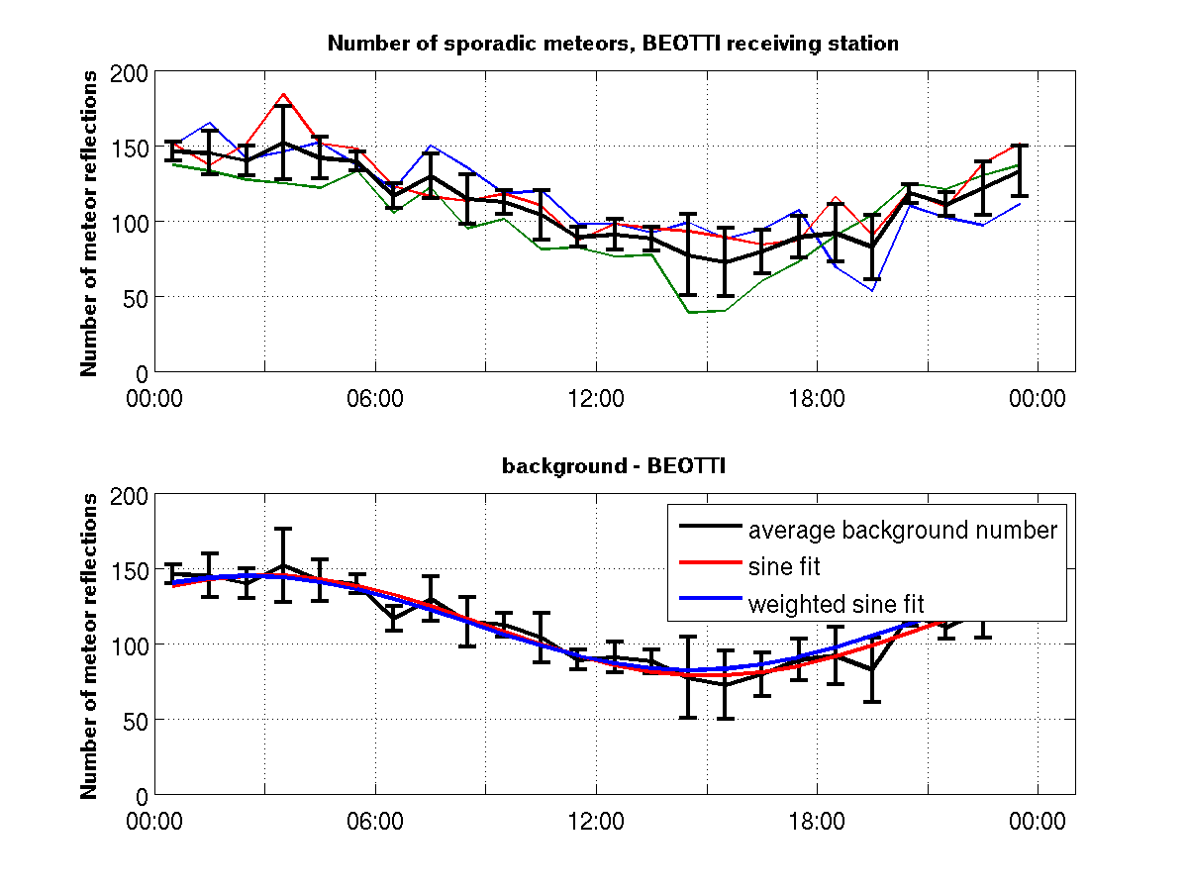
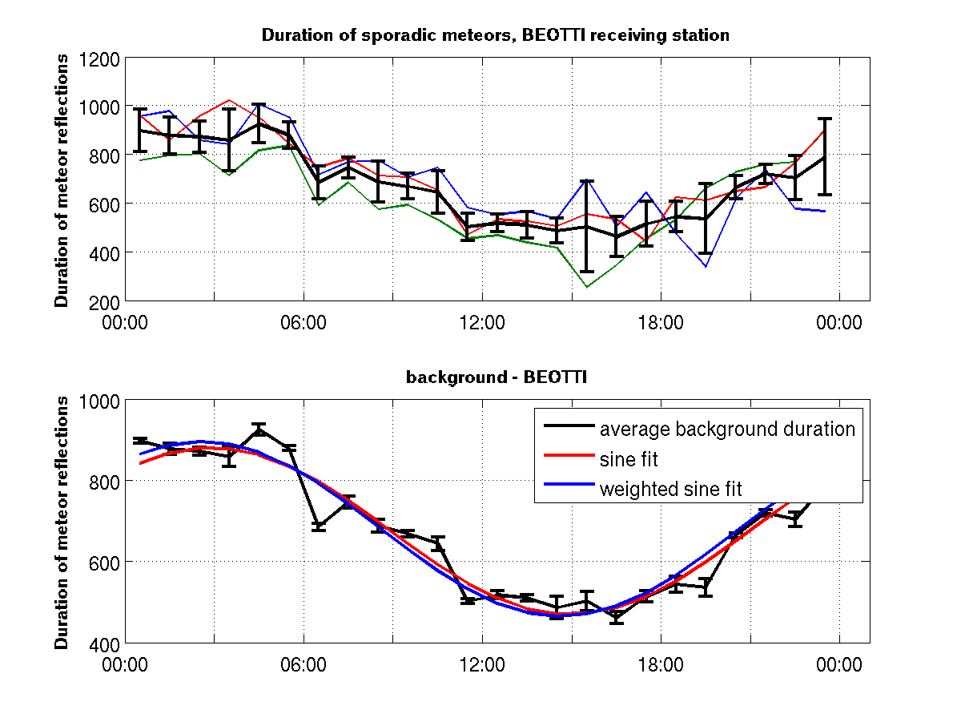
Perseids 2016, Ottignies: sporadic background
Number of meteor reflections
Total duration of meteor reflections

Slide 9
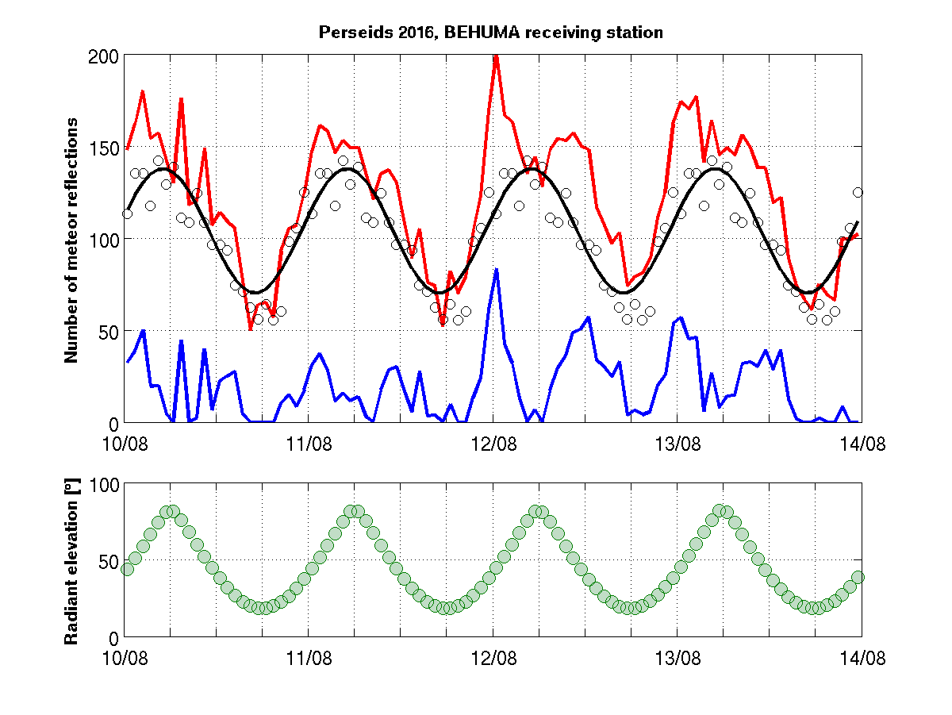
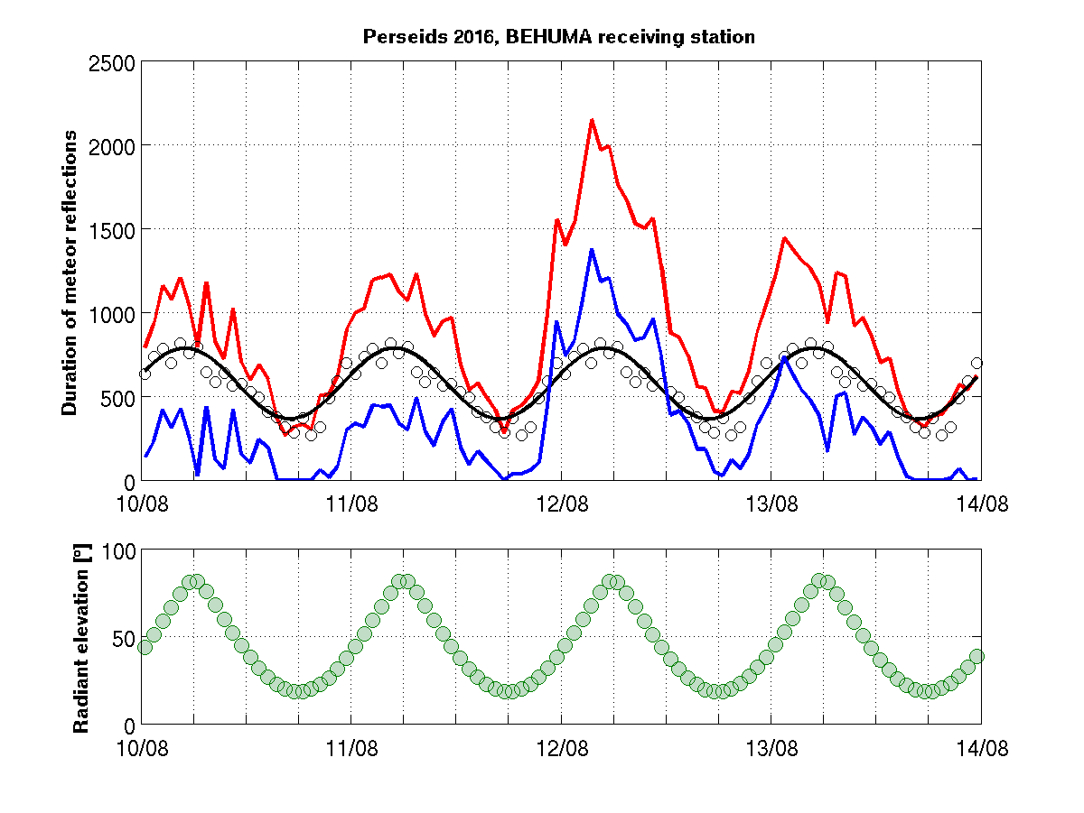
Perseids 2016, Humain
Number of meteor reflections
Total duration of meteor reflections

Slide 10
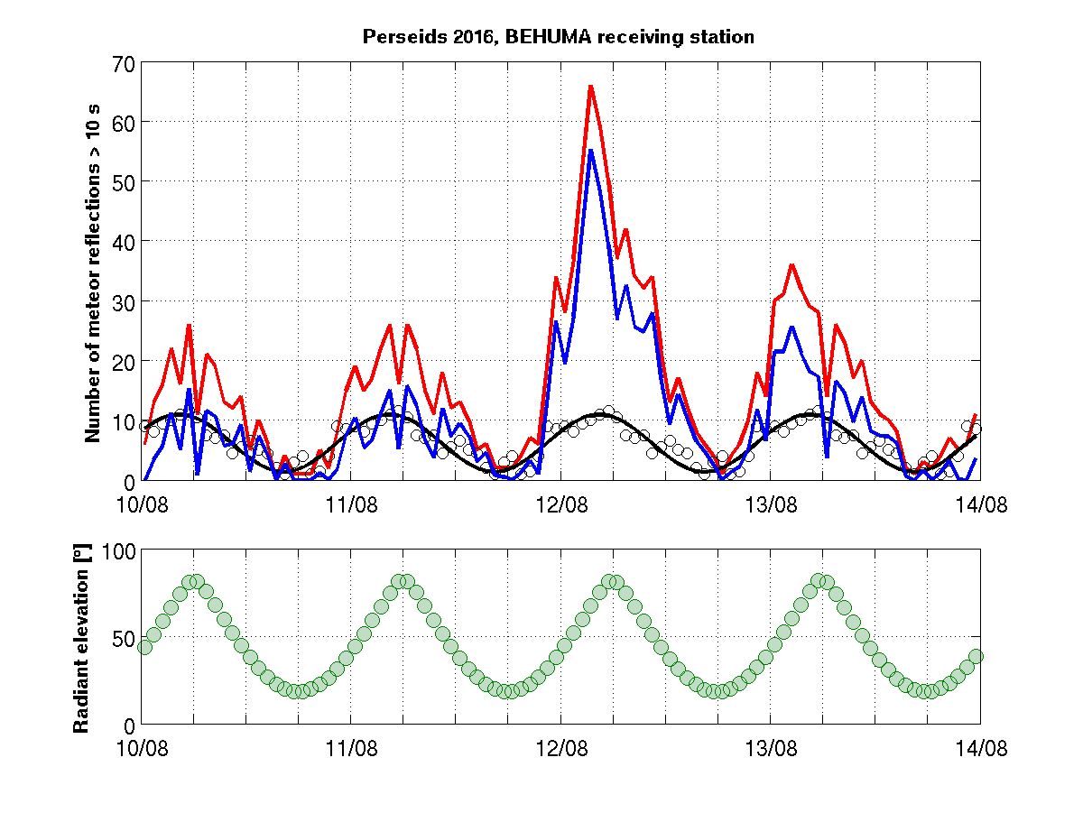
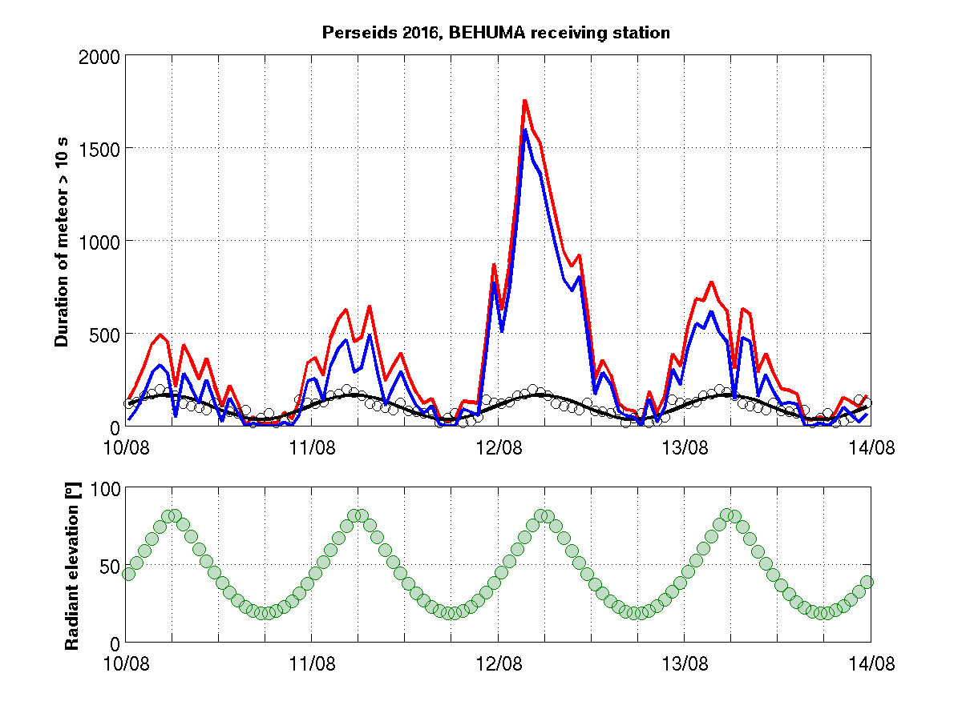
Perseids 2016, Humain
Number of meteor reflections > 10 s
Total duration of meteor reflections > 10 s

Slide 11
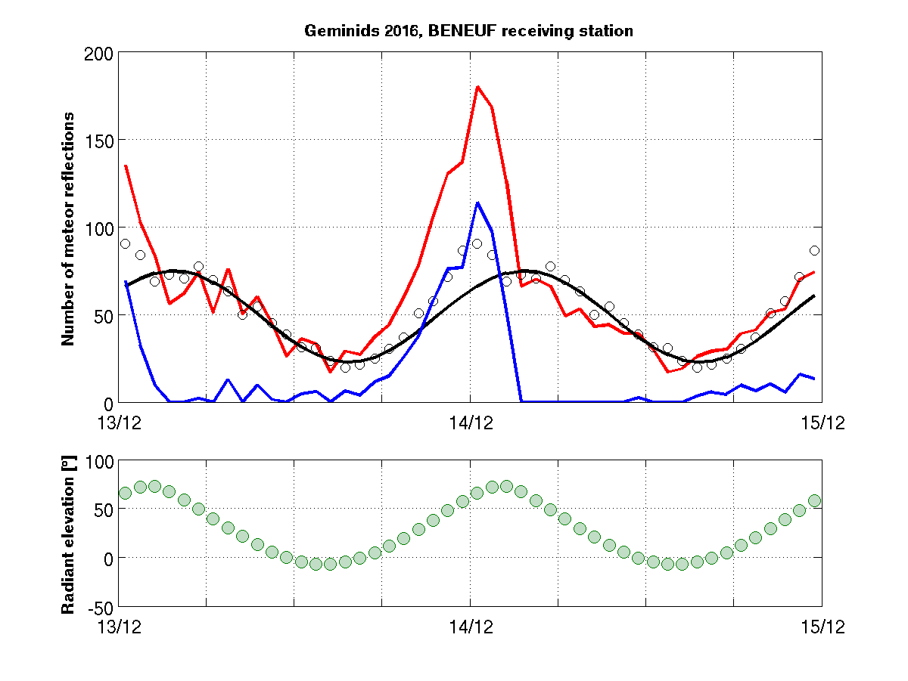
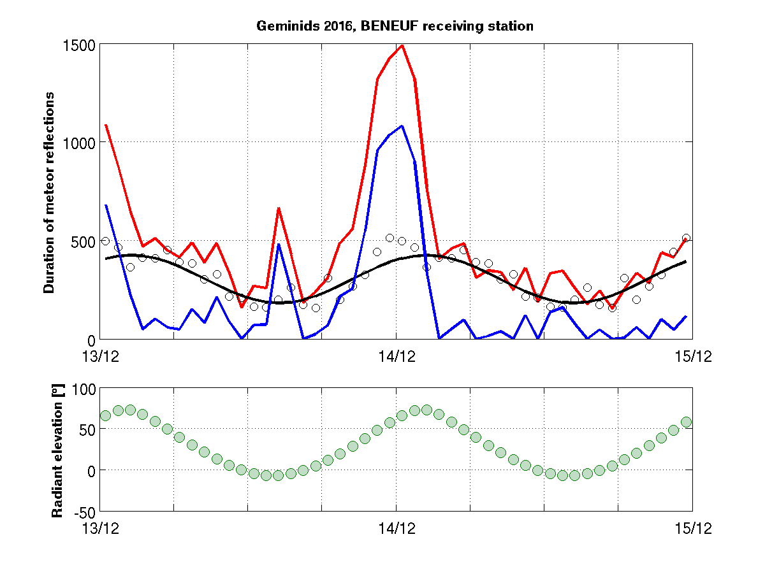
Geminids 2016, Neufchâteau
Number of meteor reflections
Total duration of meteor reflections

Slide 12
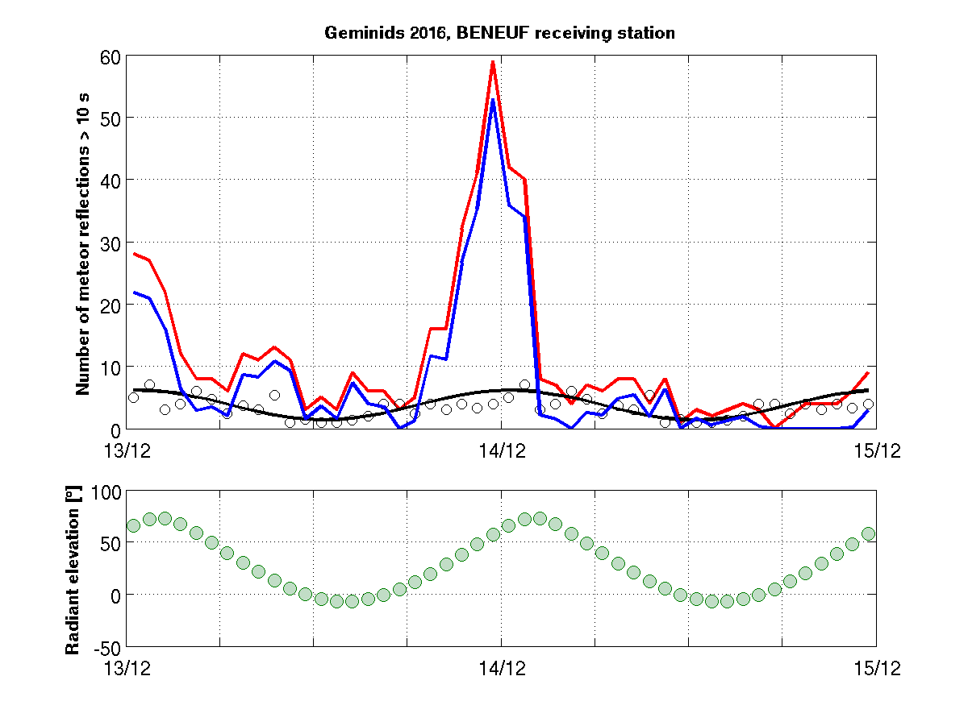
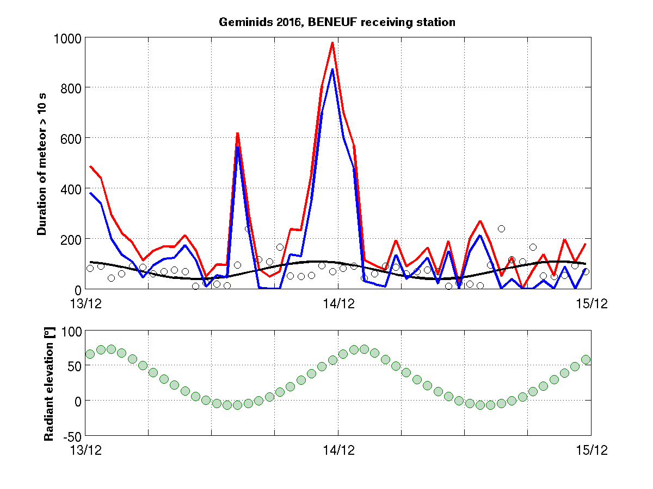
Geminids 2016, Neufchâteau
Number of meteor reflections > 10 s
Total duration of meteor reflections > 10 s

Slide 13
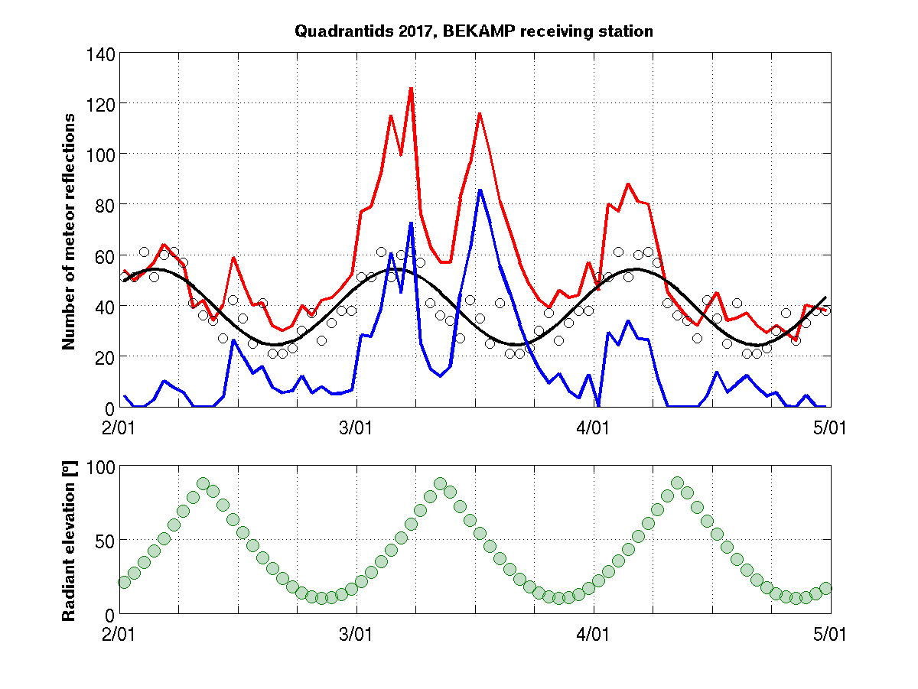
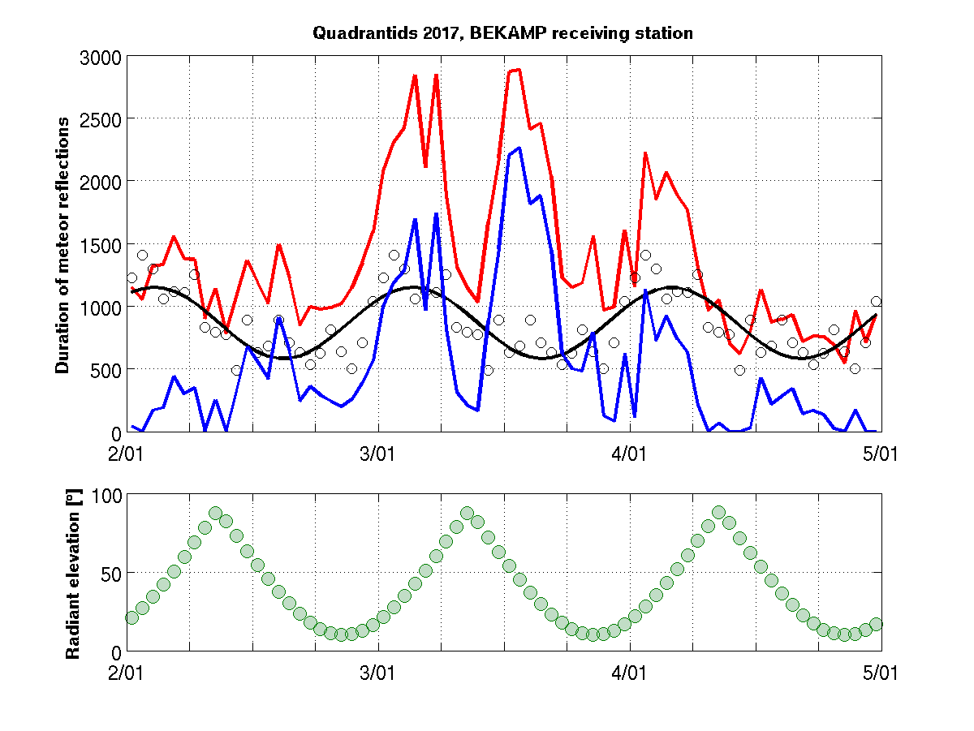
Quadrantids 2017, Kampenhout
Number of meteor reflections
Total duration of meteor reflections
Notes:
QUA well visible in total number, this suggests a high r, but r = 2.1???

Slide 14
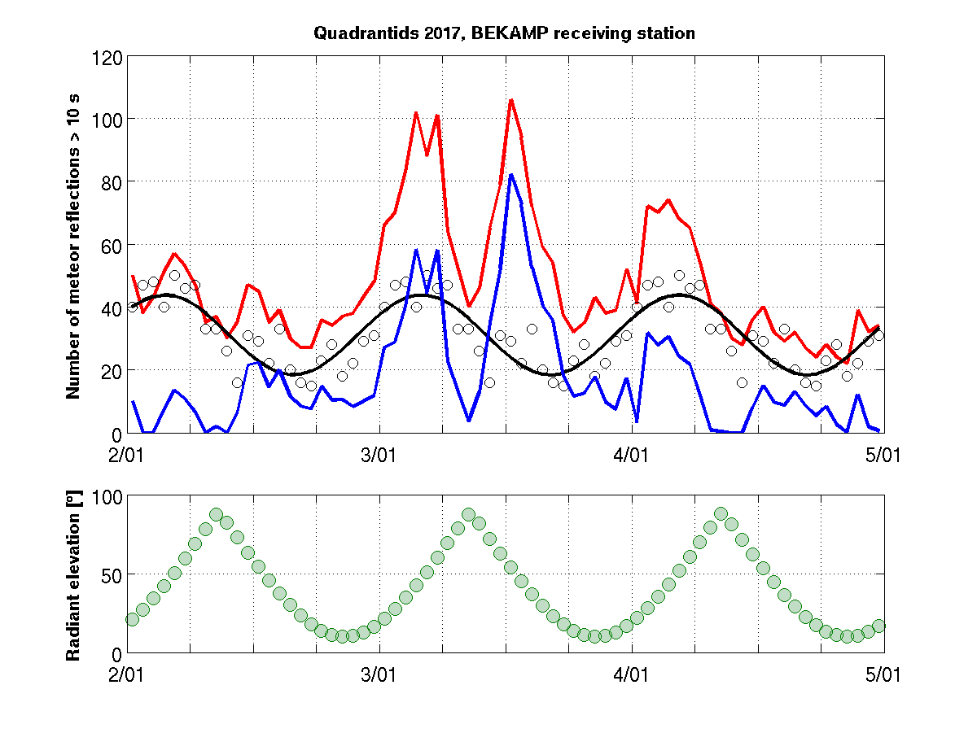
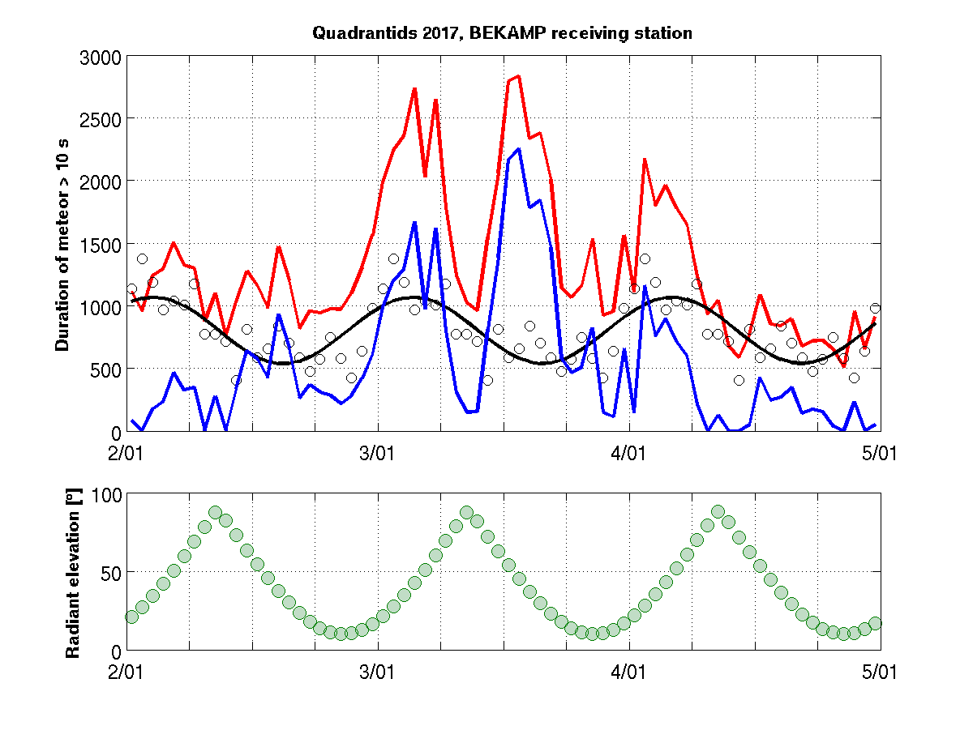
Quadrantids 2017, Kampenhout
Number of meteor reflections > 10 s
Total duration of meteor reflections > 10 s

Slide 15
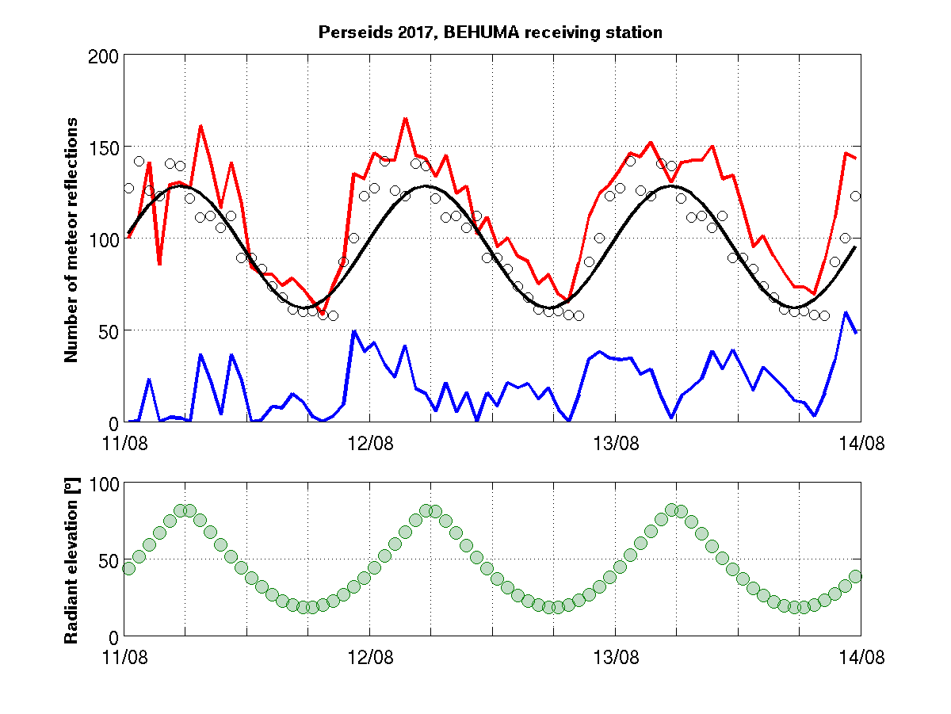
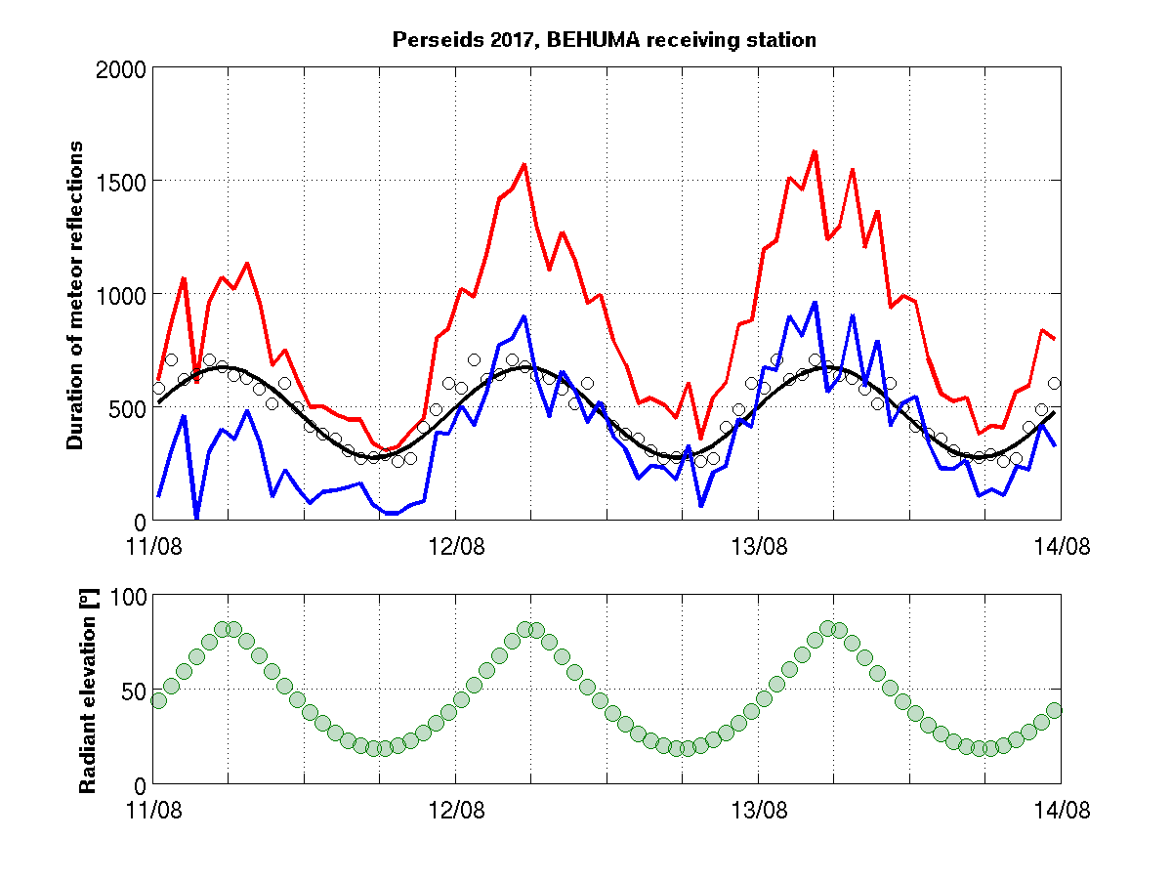
Perseids 2017, Humain
Number of meteor reflections
Total duration of meteor reflections

Slide 16
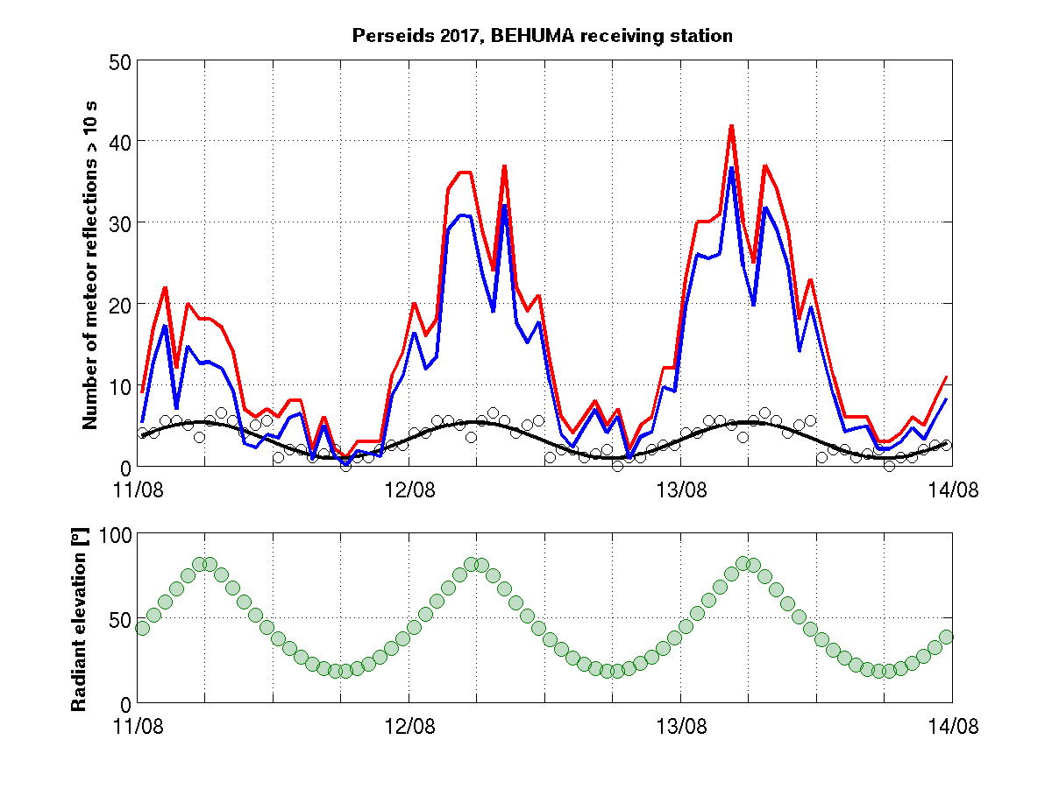
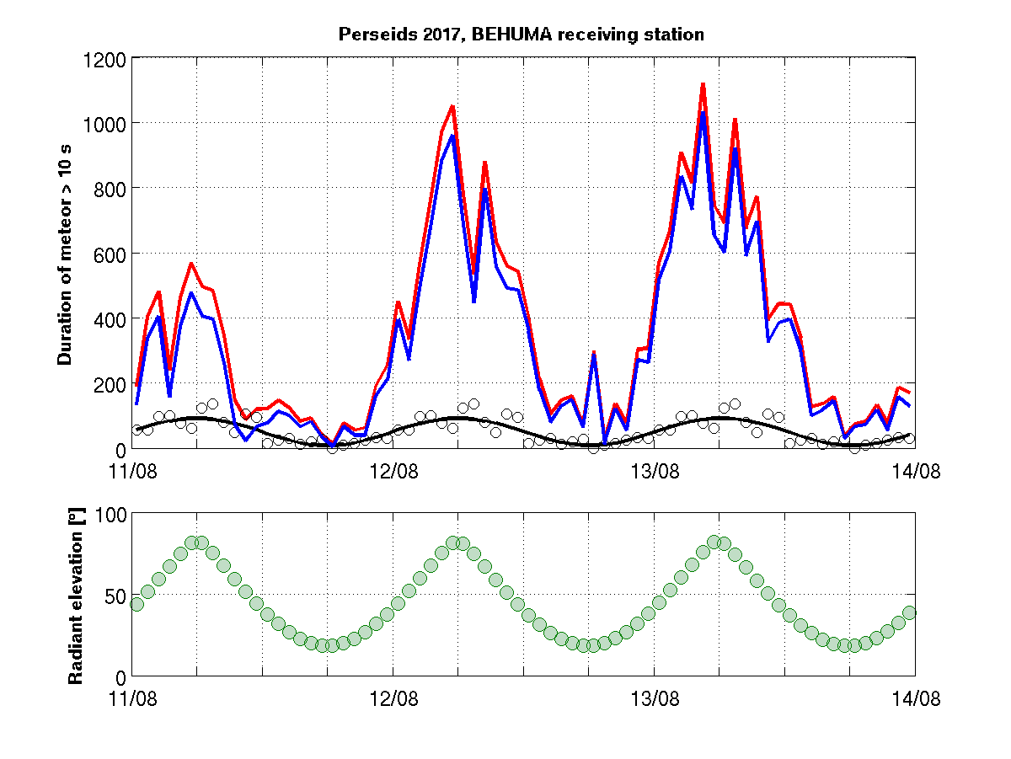
Perseids 2017, Humain
Number of meteor reflections > 10 s
Total duration of meteor reflections > 10 s

Slide 17
Conclusions
The BRAMS team has established a consistent method to estimate the sporadic background and subtract it from the total activity to obtain shower activity.
Most showers are overwhelmed by the many faint sporadic meteors. Showers stand out better when considering only long duration reflections.
The resulting shower rates have to be corrected for the sensitivity of the setup (Observability Function), which is highly dependent on radiant-setup geometry and antenna gains.

Slide 18
Near future
Observability Function code expected to be ready end 2017
What may it bring?

